Slide 1
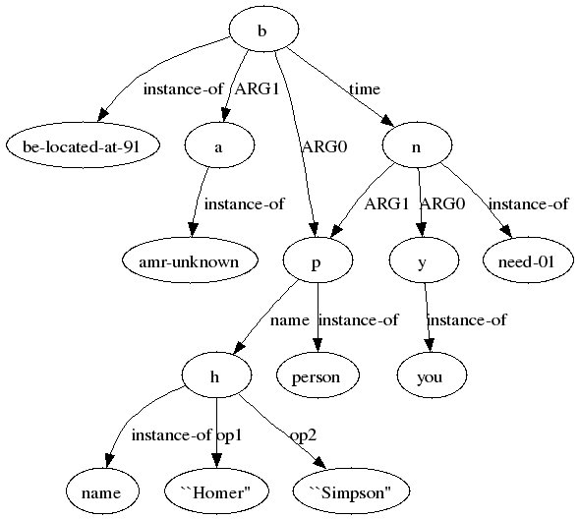
Not an Interlingua, but Close: Comparison of English AMRs to Chinese and Czech
Nianwen Xue*, Ondřej Bojar†, Jan Hajič†, Martha Palmer#, Zdeňka Urešová†, Xiuhong Zhang*
*Computer Science Department, Brandeis University, USA.
†Charles University in Prague, Institute of Formal and Applied Linguistics, Czech Republic
#Department of Linguistics, University of Colorado at Boulder, USA
An Abstract Meaning Representation (AMR) is a rooted, directional and labeled graph that represents the
meaning of a sentence. It focuses on relations between concepts.
(B / be-located-at-91
:ARG0 (p / person
:name (h / name
:op1 “Homer”
:op2 “Simpson”))
:ARG1 (a / amr-unknown)
:time (n / need-01
:ARG0 (y / you)
:ARG1 p))
“Where is Homer Simpson when you need him?”
AMRs abstract away from word category, word order, morphological variation. Some function words are also not represented. Many sources of
cross-lingual differences are removed, creating better alignment for bilingual sentence pairs.
当你需要他时, 霍默辛普森在哪里?
Where is Homer Simpson when you need him?
Divergence at top level
Perfect match
这 是 一 个 大 叫 “ 噢哦 ！ ” 的 时刻 。
This is a major `` D'oh! '' moment .
今年 ， 到 目前 为止 ， 温特弗尔德路 的 交街口 附近 据 报道 已 发生 了 １７ 起 事故 ，
比 ２００４年 全 年 的 １２ 起 还 多 。
17 accidents have been reported near the intersection of Winterfield Road so far this year ,
up from 12 for all of 2004 .
Difference in lexicalization and annotation choice
“Zácpa kolem čeho“
“Localized congestion around what”
“překračovat povolenou rychlost”
“speeding”
“obchvat”
“Circumferential highway”
Difference in annotation choice
MWE vs. single word
“schémata výstavby”,
“Development patterns”
„v dnešním vydání [Times] jsou popsány...“
„[Times] tells the tale today...“
Event object choice and ontology divergence
MWE and structural divergence
Preliminary comparison shows structural compatibility between Chinese and English AMRs, and between Czech and English AMRs.
It also reveals some cross-lingual divergences in lexicalization of concepts, and in how sentences are structured.
Supported by LM2010013, LH12093 of the MEYS Czech Republic, GP13-03351P of GACR Czech Republic, and 0910992 IIS
Of National Science Foundation

