Slide 1
Controlled Language in action for MT
Johann Roturier
May 2009

Slide 2
Outline
Overview of CL
1
2
CL deployment
3
Lessons learnt
4
Impact of CL on MT
5
Future directions

Slide 3
Overview of Controlled Language
Strict use of Controlled Language (CL)
  “Subset of a natural language that uses a restricted grammar and a restricted vocabulary” (technical domain)
  Makes source content clearer and less ambiguous
  Improves comprehensibility and (machine-)translatability of source content
  Example: Caterpillar Technical English in the mid 1990s (142 rules and more than 70000 terms)
Loose use of Controlled Language
  Used since 2006 for large structured documentation sets (authored in XMetal)
  MT requirements in FR, DE, IT, BR, ES, ZH and JA (SYSTRAN)
  Strict enforcement of spelling and grammar checks
  Enforcement of corporate terminology once defined
  Enforcement of specific CL rules
    Minimize impact on authoring productivity

Slide 4
CL deployment
Use authoring application to implement CL rules for English
  Language checker developed by acrolinx
  Customized to deal with Symantec content
  Based on pattern-matching approach (reactive approach)
  Rules can be context-sensitive using XML documents mark-up (DocBook)
  Suggestions or help files are provided to users
acrolinx IQ™ is used to ensure that source content is compliant with
  Grammar rules
  Terminology (5000+ terms)
  Rules based on corporate guidelines (20+)
    Some rules deal specifically with tagging, such as the tagging of SW references
  MT-specific rules (6)
acrolinx IQ™ is used to harvest, store and access source terminology
  In-house panel working to further refine rule set and terminology lists

Slide 5
Lessons learnt during CL deployment
Strict implementation when there is:
  New content
  Little leverage
  Time
Resources must be maintained
  Eliminate false alarms
  Adapt resources to deal with new content
  Language-specific rules are best implemented as:
    Pre-processing step
    MT Normalisation dictionaries
CL + MT is not always sufficient
  Terminology work to update dictionaries (15000+ entries per dictionary)
  PE when specific qualify standard is required

Slide 6
Global content delivery workflow using CL and MT
Controlled Source Authoring (including Terminology Harvesting and Validation)
MT Tuning
Post-Editing
Pre-translation using TM and MT
Evaluation

Slide 7
Importance of CL for (RB)MT
Why is it so difficult to use MT effectively?
  While attempting to install SystemWorks 2005 the error message "Error 1722. An error occurred while performing the task. There is a problem with this Windows Installer package. A program run as part of the setup did not finish as expected. Contact your support personnel or package vendor" appears.
Controlling source content at the segment level
  Reduces complexity and ambiguity during MT step
  Reduces post-editing effort during PE step
Controlling source content at the sub-segment level (terminology)
  New terms harvested and defined during authoring
    Identified variants can be used by search engine (for help system)
    Reduces MT tuning step
  Approved translations are defined during MT tuning step

Slide 8
Impact of source compliance on MT quality
Source words | MT quality | Evaluation type | acrocheck™ project score
1083 | Excellent | Human | 28
3677 | Good | Human | 79
2546 | Medium | Human | 118
2129 | Poor | Human | 150
10972 | Greater than 0.6 GTM scores | Automatic | 64
9926 | Less than 0.6 GTM scores | Automatic | 147

Slide 9
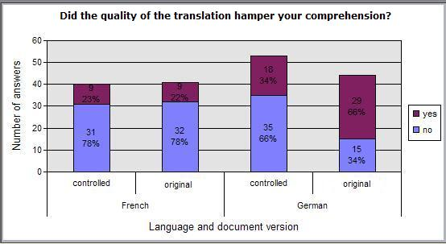
Impact of source compliance on comprehensibility

Slide 10
Future directions
Use automatic tagging and pre-processing
  Tagging: New tags may be used to mark ambiguous terms and used to produce context-sensitive translations (Systran XSL)
  Pre-processing: add, remove or move source words or phrases
Combine a CL approach with a semantic reuse approach
  Increase 100% TM matches by leveraging TMs during authoring (CL through example)
Use CL approach to check MT output
  Can repetitive MT errors be flagged? And possibly fixed automatically?
Use CL knowledge to deal with uncontrolled content
  Short technical notes cannot always go through a full CL cycle, community generated content is increasing (e.g. forums, chat)
  Term variants and deprecated terms can be added to MT normalisation dictionary

