Slide 1
Variability of Languages
in Time and Space
Writing Systems
What is writing?
When did writing develop?
What types of writing systems are there?
Notes:
One of the most important inventions in human history is writing systems. Without the power of recording what has happened in the past we wouldn’t have known about most of what have happened, because … well, we just haven’t been there.
This is something we need in the human experience, as compared to the rest of the animal world, the practice of writing.
Today, more communication takes place in the written than in the oral form (for example in Internet), and writing is not a `minor’ form of communication
Access to knowledge means actually an access to written intelligence.
Throughout history, various societies used writing for various purposes, and there is a lot of readings that talk about this aspect of the study of writing.
But our focus in this lecture will be on the study of writing systems.

Slide 2
Writing
Keep in mind: Writing is not a purer form of language than speech!
Notes:
When talking about writing, first, it’s important to keep several things in mind. Remember that Writing is a recent invention compared to spoken language.
In the form of cave paintings and other pictograms – it has only been around for some 20 thousand to 30 thousand years. And writing more narrowly defined has only been around for about 5 thousand years.
If compared to spoken language that exists for hundreds of thousands of years. Or, depending on how you define language – even millions of years.
So, writing is not a purer form of language than speech! This is actually not language at all. It’s just a form of how you fix it.
It may come as a surprise to you, but Of the 5 thousand to 7 thousand languages in the world, most are unwritten.

Slide 3
Writing
Keep in mind: Writing is not a purer form of language than speech!
Writing is a system of recording language by means of visible / tactile marks
Notes:
Well, what is writing anyway?
Writing is a system of recording language by means of visible / tactile marks.
Writing can be used as the means of communication as through letters or text messages. And as such, a written text must be self-sufficient in term of its meaning. Because the speaker is not there. It can be used as an aid for memory, as a note taking. And it has many and many other functions.
So, writing intrudes into the linguistic behavior of people BUT still it is considered neither an active agent of language, nor an external factor affecting the nature of languages.

Slide 4
Writing
Keep in mind: Writing is not a purer form of language than speech!
Writing is a system of recording language by means of visible / tactile marks
Writing is NOT object of linguistics
Notes:
And Writing is NOT object of linguistics

Slide 5
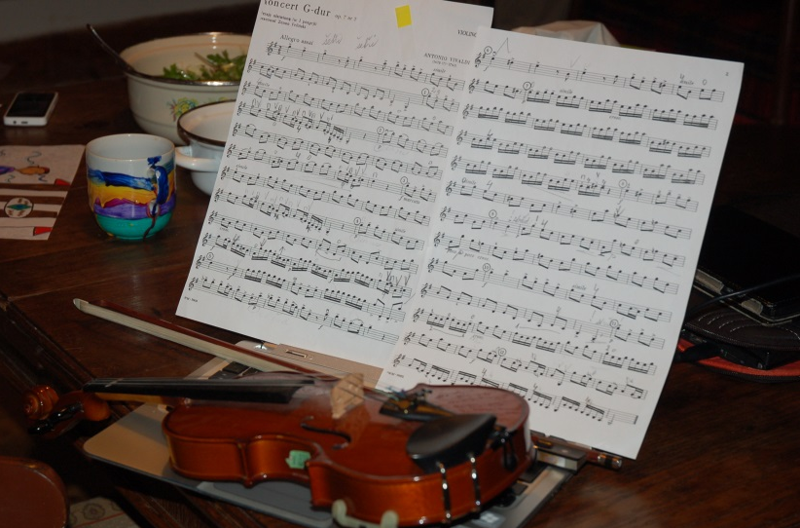
Writing
Keep in mind: Writing is not a purer form of language than speech!
Writing is a system of recording language by means of visible / tactile marks
Writing is NOT object of linguistics
speech – written text
music – written notes
Notes:
The relation between the language and writing can be compared to music and notes, which fix this music on the paper. When we analyse music, we do not actually care, how the notes are written, the only thing that is important is that they reflect the music properly.

Slide 6
Words spoken are symbols of affections or impressions of the soul; written words are symbols of words spoken. (Aristotle: Peri Hermeneias)
Notes:
There are two interesting citations that I consider to be very true about the writing systems.
The first one belongs to Aristotle /ˈær əˌstɒt l/ who says that “Words spoken are symbols of affections or impressions of the soul; written words are symbols of words spoken. ”

Slide 7
Words spoken are symbols of affections or impressions of the soul; written words are symbols of words spoken. (Aristotle: Peri Hermeneias)
Language and writing are two distinct systems of signs; the second exists for the sole purpose of representing the first. The linguistic object is not both the written and the spoken forms of words; the spoken form alone constitutes the object. (F. de Saussure: Course in General Linguistics)
Notes:
The second one belongs to a Swiss linguist Saussure /soʊˈsür/ who says that
“Language and writing are two distinct systems of signs;
the second exists for the SOLE purpose of representing the first.
The linguistic object is not both the written and the spoken forms of words; the spoken form alone constitute the object. ”

Slide 8
Words spoken are symbols of affections or impressions of the soul; written words are symbols of words spoken. (Aristotle: Peri Hermeneias)
Jazyk a písmo jsou dva odlišné znakové systémy, přičemž druhý existuje výlučně proto, aby reprezentoval první. Předmět lingvistiky není vymezen kombinací psaného a mluveného slova, jejím jediným předmětem je slovo mluvené. Avšak psané slovo je tak úzce spjato se slovem mluveným, jehož je obrazem, že si nakonec přisvojuje hlavní úlohu a reprezentaci zvukového znaku se pak přikládá stejná důležitost jako tomuto znaku samotnému, ba větší. J e to, jako bychom věřili, že pro poznání někoho je třeba se spíše dívat na jeho fotografii než na obličej (Saussure, 1989: 59)
Notes:
The second one belongs to a Swiss linguist Saussure /soʊˈsür/ who says that
“Language and writing are two distinct systems of signs;
the second exists for the SOLE purpose of representing the first.
The linguistic object is not both the written and the spoken forms of words; the spoken form alone constitute the object. ”

Slide 9
Speech vs. Writing
continuous
bound to utterance time
contextual
temporal
audible
produced by voice
discrete
timeless
autonomous
permanent
visible
produced by hand
Notes:
Speech is produced by voice and writing is produced by hand

Slide 10
Writing systems of the world
Notes:
There is an enormous diversity of writing systems in the world.
JESTE NEJAKE OBECNE KECY?

Slide 11
Writing systems of the world
semiography
(meaning-based writing)
phonography
(sound-based writing)
Notes:
The writing systems principles of most languages can be defined in terms of the continuum which is illustrated by the horizontal line here.
At one extreme of this continuum we find so-called semiography – or meaning-based writing. And on the other extreme, there is phonography – or sound-based writing .
An ideal semiographic system is an independent graphic language which is not tied to any one spoken language at all. It express directly the meaning, the thought. It is absolutely language-independent.
And – on the other extreme - there is an ideal phonographic system, and is absolutely language-dependent. It uses visible marks of same kind to represent each phonetic element which is pronounced in a specific spoken language. So each sound has its graphical sign in this system.
Now, these two systems are the ideal extremes, and real writing systems of the real languages are located somewhere inbetween on this line.
Well, let’s try to locate some of them here.

Slide 12
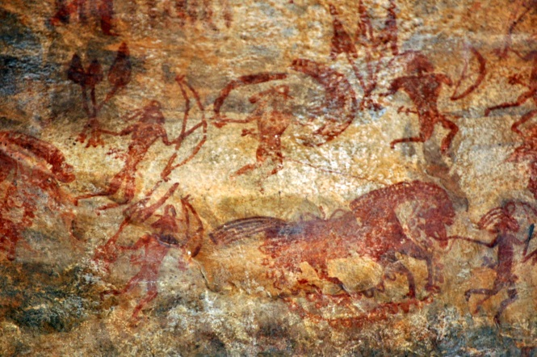
Classification of writing systems
semiography
(meaning-based writing)
phonography
(sound-based writing)
Notes:
Well, writing - broadly defined - emerged some 20 thousand to 30 thousand years ago in the form of cave paintings.
It’s impossible to know for certain, why these painting have been created. It’s possible, that they were created as a means of artistic expression.

Slide 13
Classification of writing systems
semiography
(meaning-based writing)
phonography
(sound-based writing)
pictography
Notes:
These cave paintings can be defined as pictograms, or pichtographs, as they are also known.
Pictographs used picture-based symbols to iconically represent reference.
“Iconically” means that the symbol resembles the thing which it represents in a real world.
It’s important to say here, that it is much easier to iconically represent a concrete object. And – because these pictographs represent concrete objects – they are mostly cross-culturally recognizable

Slide 14
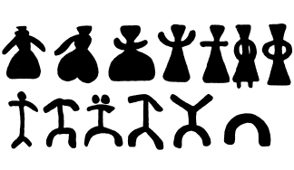
Classification of writing systems
semiography
(meaning-based writing)
phonography
(sound-based writing)
pictography
men and women – Spanish and South French cave paintings
Notes:
Рассказ эскимоса об удачной охоте.
Началом формирования пиктографического письма следует считать период, когда первобытные рисунки начали применяться не для удовлетворения художественных потребностей человека, но и для целей коммуникативных и мемориальных.
При пиктографии высказывание передается целиком путем использования системы взаимосвязанных рисунков. Языковые формы при этом не раскрываются, т. е. мы не знаем, ни как звучали слова, которыми можно передать содержание рисунка, ни какими грамматическими особенностями они обладали.
Пиктографические письменности насчитывают тысячи знаков. Сложность и ограниченность системы (она может описывать только объекты) объясняют движение таких систем в сторону идеографических письменностей. Движение это сопровождается расширением смысла знаков, а также упрощением и канонизацией начертаний каждого знака.
Пиктограммы удобны, поскольку не связаны с конкретным языком и всем понятны. Но именно поэтому они непригодны для записи речи и письмом не являются.

Slide 15
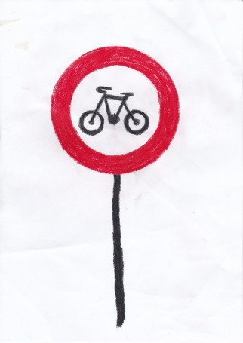
Classification of writing systems
semiography
(meaning-based writing)
phonography
(sound-based writing)
pictography
Notes:
So, regardless of where are you from, you probably recognize this image here as representing a bicycle.

Slide 16
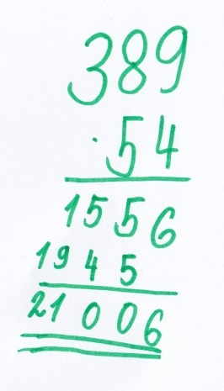
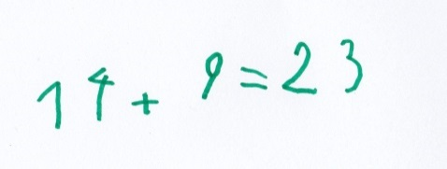
Classification of writing systems
semiography
(meaning-based writing)
phonography
(sound-based writing)
pictography
Notes:
Examples of semiographic - or pictography - writing are also the “language” of mathematics,

Slide 17
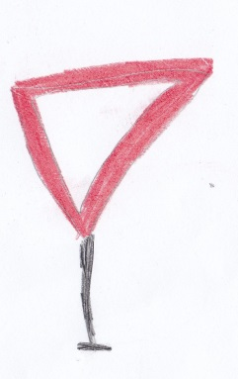
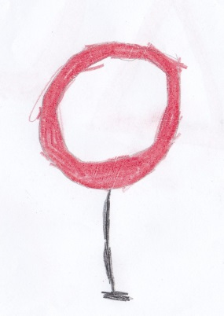
Classification of writing systems
semiography
(meaning-based writing)
phonography
(sound-based writing)
pictography
Notes:
or the international system of road signs in which, [for instance, triangle v. disc means warning v. command

Slide 18
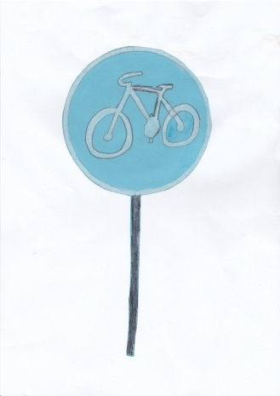
Classification of writing systems
semiography
(meaning-based writing)
phonography
(sound-based writing)
pictography
Notes:
and red vs. solid blue means negative v. positive.

Slide 19
Classification of writing systems
semiography
(meaning-based writing)
phonography
(sound-based writing)
pictography
Notes:
Схематизация изображения мужчины и женщины (пещеры Испании и Южной Франции).

Slide 20
Classification of writing systems
ideography
pictography
Notes:
Now, compare these pictograms to ideograms, which also use picture-based symbols but represent rather ideas, instead of concrete objects.
Because of this, ideograms are less iconic and less cross-culturally recognizable.
However, we are still at the language-independent level.
Well, generally, it’s rather doubtful that there ever was such a writing system. Because it is impossible to design a writing system that operates on the level of concepts regardless of language.
But we can find some ideographic signs in hierogliphic writing systems.

Slide 21
Classification of writing systems
ideography
pictography
Luwian
Notes:
Here is an example from Luwian /ˈluːiən/. Luwian is an ancient language, or group of languages, within the Anatolian branch of the Indo-European language family.
And if we look at this script, we can guess about some signs, what they could mean.

Slide 22
Classification of writing systems
ideography
pictography
Luwian
Notes:
So this is the sign for the pronoun “I”
This is a picture of a person, pointing on herself.
Ideographic signs mostly do not exist by themselves, but as a part of a system of signs.

Slide 23
Classification of writing systems
ideography
pictography
Luwian
Notes:
For example, there is an ideographic system of different phases of moon. The object – the moon – is one and the same, but it is marked differently according to the moon phase.

Slide 24
Classification of writing systems
ideography
pictography
Luwian
Notes:
Or waves – or water – as a symbol for the Aquarius [ə'kweərɪəs], a Zodiac sign

Slide 25
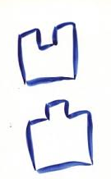
Classification of writing systems
ideography
pictography
‘up’
salient
concave
‘down’
Notes:
Some Chinese hieroglyphs come from ancient ideographich signs
Here you can see up and down, or salient or concave.
However, modern Chinese hieroglyphs are not ideographic signs.
Because what they express, these are not meanings, but words… words in a specific language.
The difference is very subtle, but it means, for example, that synonyms, even very close ones, are expressed by different signs.

Slide 26
Classification of writing systems
ideography
pictography
二千
两个人
‘up’
salient
20
two people
concave
‘down’
Chinese
Notes:
So, in Chinese, we have two different hieroglyphs for the notion of TWO.

Slide 27
Classification of writing systems
ideography
pictography
二千
两个人
‘up’
salient
20
two people
concave
‘down’
Chinese
Notes:
There are “er”

Slide 28
Classification of writing systems
ideography
pictography
二千
两个人
‘up’
salient
20
two people
concave
‘down’
Chinese
Notes:
So, in Chinese, we have two different hieroglyphs for the notion of TWO.

Slide 29
language independent
language dependent
ideography
morphography
pictography
二千
两个人
20
two people
Chinese
Notes:
Actually, it is more accurate to call this system rather morphographic. After all, morphemes could be a word by itself.

Slide 30
Morphographic systems
Relationship between the symbol and its referent is mostly arbitrary
A graphic unit corresponds to a meaningful and grammatically autonomous unit (a word or a morpheme)
Each morpheme gets its own symbol, thousands of symbols needed
There are two major logographic writing systems: Sumerian (Cuneiform) and Chinese
Further in the writing of Japanese, less frequently in Korean, formerly in Vietnamese
Notes:
In a morphographic system
a graphic unit corresponds to a meaningful and grammatically autonomous unit (a word or a morpheme).
It is important that the relation between the symbol and its referent is arbitrary, though there may be a few exceptions. Morphographic writing systems essentially take the morpheme as a unit of analysis.
With morphographic writing system basically, each morpheme gets its own symbol. So this means that thousands and thousands of symbols are required to make this system work, in order to account to all of the morphemes in a language.
There are two major morphographic writing systems: This is the Chinese and the first writing system, for which we have evidence – Sumerian Cuneiform.
Some example of this kind of writing g can be also found in Japanese, less frequently in Korean, formerly in Vietnamese and so on.

Slide 31
Graphical structure of Chinese characters
in Chinese, character map onto morphemes and words, no systematic mapping relation between strokes and segments
lishu (`the six writings’)
first major lexicon compiled, about 120 AD: 9,500 characters, based on six formation principles (simple pictograms, ideographs etc.)
lexicon of current Chinese
tradition of Chinese lexicography: adding characters, never eliminating any
Huang and Huang (1989)
74,000 characters, 25,000 out of which are variants
List of Modern Chinese Characters for Everyday Use by the Committee for the Writing of the National language (1988):
a primary list od 2,500 characters, a secondary list of another 1,000 characters
considered sufficient for other than specialized and technical texts
statistics:
1,000 most common characters account for about 90 % of all characters used in publications directed at a general readership
another 1,400 characters necessary to cover the next 9 %
another 1,400 characters to raise the level to 99.9 %
reflecting the Zipf’s law

Slide 32
Nanjing, Paris, Shanxi, Tian Shan, Paraguay, Tianjin, Beijing, Shanghai, Shandong, Mexico, North Arctic Ocean
Find translations for the place names
Translate

Slide 33
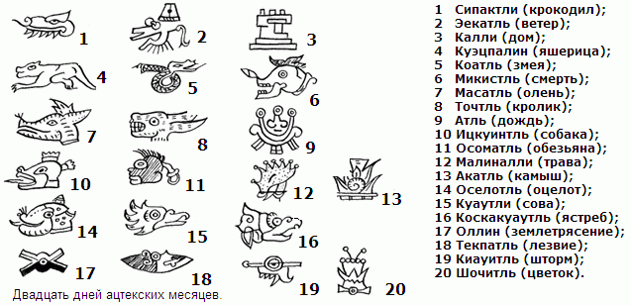
Classification of writing systems
Itzkoatl
language independent
language dependent
Itz ‘arrow’
ko ‘container’
atl ‘water flow’
ideography
morphography
Aztec
pictography
rebus writing
Notes:
Ацтеки – индейцы в центральной Мексике
Ребусным написанием передавались имена собственные уацтеков. Например, чтобы передать слово «Итцкоатль» ацтеки рисовали сначала стрелу (itz) затем сосуд(ko) и поток воды (atl).
Так передавались в основном имена собственные

Slide 34
Classification of writing systems
language independent
language dependent
ideography
morphography
pictography
rebus writing
determinatives, keys
to distinguish homonyms...
en. Polish – polish
g. Leben – leben
Notes:
Ацтеки – индейцы в центральной Мексике
Ребусным написанием передавались имена собственные уацтеков. Например, чтобы передать слово «Итцкоатль» ацтеки рисовали сначала стрелу (itz) затем сосуд(ko) и поток воды (atl).
Так передавались в основном имена собственные

Slide 35
Classification of writing systems
language independent
language dependent
ideography
morphography
syllabic systems
pictography
rebus writing
determinatives, keys
to distinguish homonyms...
en. Polish – polish
g. Leben – leben
Notes:
Ацтеки – индейцы в центральной Мексике
Ребусным написанием передавались имена собственные уацтеков. Например, чтобы передать слово «Итцкоатль» ацтеки рисовали сначала стрелу (itz) затем сосуд(ko) и поток воды (atl).
Так передавались в основном имена собственные

Slide 36
Syllabic Writing System
The basic graphic units are interpreted as speech syllables
a syllable is a unit of speech that can be articulated in isolation and bears a single degree of stress (English) or a single tone (Chinese)
typically, a sound of a consonant followed by a vowel (CV)
different languages allow for different syllables
Notes:
Syllabic writing systems take the syllable as a unit of analysis.
A syllable is a unit of speech that can be articulated in isolation and bear a single degree of stress (as in English) or a single tone (as , for example, in Chinese)
Typically in a syllable, a consonant sound is followed by a vowel
But there are many further varieties of syllable structures.
The point is that different languages allow for different syllables and The specific structure of possible syllables is part of the phonological system of a language

Slide 37
Syllabic Writing System
The basic graphic units are interpreted as speech syllables
a syllable is a unit of speech that can be articulated in isolation and bear a single degree of stress (English) or a single tone (Chinese)
typically, a sound of a consonant followed by a vowel (CV)
different languages allow for different syllables
VC
CVC
V
CvCV
Notes:
There may be reduced vowels in interconsonantal position, as it is - for example - in Hebrew and other Semitic languages

Slide 38
Syllabic Writing System
The basic graphic units are interpreted as speech syllables
a syllable is a unit of speech that can be articulated in isolation and bear a single degree of stress (English) or a single tone (Chinese)
typically, a sound of a consonant followed by a vowel (CV)
different languages allow for different syllables
VC
CVC
CCCVCC
EN: strength
V
CvCV
Notes:
And a very consonantal syllables are used in English, for example in the word “strength”, where we have 3 consonants before and 2 consonants after the vowel in a syllable.

Slide 39
Syllabic Writing System
No writing system could map speech syllables to graphic signs in the ratio 1:1
Notes:
As there is such a large number of possible syllables in a language, no writing system could map all speech syllables to graphic signs in the ratio 1:1

Slide 40
Syllabic Writing System
No writing system could map speech syllables to graphic signs in the ratio 1:1
Languages combine different strategies developed for syllabic writing to decrease the number of signs in comparison to the number of speech syllables
combining simple syllables, disregarding minor distinctions such as aspiration of final consonants
combining syllables with logograms
Notes:
And what languages do? They combine different strategies developed for syllabic writing to decrease the number of signs in comparison to the number of speech syllables
For example, they combine simple syllables and disregard some minor distinctions, such as aspiration of final consonants;
Or they combine syllables with logograms
and so on

Slide 41
Syllabic Writing System
No writing system could map speech syllables to graphic signs in the ratio 1:1
Languages combine different strategies developed for syllabic writing to decrease the number of signs in comparison to the number of speech syllables
combining simple syllables, disregarding minor distinctions such as aspiration of final consonants
combining syllables with logograms
One of the most well-known examples of syllabic systems is the Katakana writing system in Japanese
Notes:
One of the most well-known examples of syllabic systems is the Katakana writing system in Japanese

Slide 42
Sanskrt
(script dévanágarí)
vač ‘speak’
veda ‘knowledge’
čud ‘induce’
mene ‘thought’
dama ‘house’
jad ‘because’
nam ‘respect’
Describe the rules of writing consonants and vowels
Transcribe the following words:
‘think’
‘hold’
‘joy’
‘God’

Slide 43
Classification of writing systems
language independent
language dependent
ideography
morphography
syllabic systems
pictography
alphabetic system
Notes:
Well, Next, we have an alphabetic system.
For many of you this may be the most familiar writing system we discuss.

Slide 44
Alphabetic Writing System
Alphabetic letters encode phonemic segments
Notes:
The Alphabetic Writing System uses letters to encode phonemic segments, it means to write down consonant and vowel sounds.

Slide 45
Alphabetic Writing System
Alphabetic letters encode phonemic segments
Less than 50 symbols is needed to make this system work
Notes:
Because this writing system takes individual sounds, at the phonemic level as the basic unit of analysis, only around 50 or fewer symbols may be needed to make this system work

Slide 46
Alphabetic Writing System
Alphabetic letters encode phonemic segments
Less than 50 symbols is needed to make this system work
Languages: English, German, Greek, Czech, …
Notes:
Languages that use alphabets include English, German, Greek, Slavonic languages and many others.

Slide 47
Armenian
Georgian

Slide 48
surtal ‘study’ tusa ‘benefit’ tariki ‘brain’ öri ‘debt’
usun ‘water’ muskilta ‘crook’ amitan ‘animal’
Transcribe the following words. Try to detect what 2 and 3 mean.
‘crisis’
Mongolian

