Slide 1
Variability of languages in time and space - II
Writing Systems
Anja Nedoluzhko

Slide 2
Writing
writing is a system of recording language by means of visible / tactile marks
writing intrudes into the linguistic behavior of people
BUT writing is considered neither an active agent of language, nor an external factor affecting the nature of languages
writing is not object of linguistics
Words spoken are symbols of affections or impressions of the soul; written words are symbols of words spoken. (Aristotle: Peri Hermeneias)
Language and writing are two distinct systems of signs; the second exists for the sole purpose of representing the first. The linguistic object is not both the written and the spoken forms of words; the spoken form alone constitute the object. (F. de Saussure: Course in General Linguistics)
[paradox: linguistics tends to base the analysis on writing-induced concepts (phoneme, word) but subscribe to the principle of the primacy of speech]

Slide 3
Writing vs. speech
writing and speech are distinct systems, which are related in many ways, have shared and distinct functions and differ in both their production and reception
discrete
timeless
autonomous
permanent
visible
produced by hand
continuous
bound to utterance time
contextual
temporal
audible
produced by voice
today, more communication takes place in the written than in the oral form (Internet)
writing is not a `minor’ form of communication
writing offers ways of reclaiming the past, but is a critical skill for shaping the future
access to knowledge means access to written intelligence

Slide 4
Writing systems of the world
enormous diversity of writing systems
semiography
(meaning-based writing)
phonography
(sound-based writing)

Slide 5
Classification of writing systems
(i) pictography
(ii) ideography
(iii) logographic / word writing systems
(iv) syllabic systems (syllabaries)
(v) alphabetic systems (alphabets)

Slide 6
Classification of writing systems
pictography

Slide 7
(i) Pictography
Eskimo
Interpretations?
Notes:
Eskimo éskimeu

Slide 8
Classification of writing systems
ideography
pictography

Slide 9
(ii) Ideography
ideograms as units expressing ideas
doubtful that there ever was such a writing system: impossible to design a writing system that operates on the level of concepts regardless of language
Luwian
Notes:
Eskimo éskimeu

Slide 10
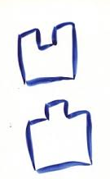
(ii) Ideography
Luwian
2 (two, dva, zwei), 3, 4...
Chinese
salient
concave
Notes:
Eskimo éskimeu

Slide 11
Chinese
二千
两个人
salient
20
two people
concave
红 (hong) < -- > 赤 (chi)
distinguish synonyms → language dependent, i.e. express words (not notions)
Chinese characters (hieroglyph) – for stems an grammatical meanings
Chinese words consist mostly of two or more characters
Notes:
Eskimo éskimeu

Slide 12
Classification of writing systems
language independent
language dependent
ideography
pictography
logography

Slide 13
(iii) Logographic / word writing systems
a graphic unit corresponds to a meaningful and grammatically autonomous unit (a word or a morpheme)
logogram
a unit interpreted as a word or a grammatical meaning
two major logographic writing systems:
Sumerian and Chinese
further in the writing of Japanese, less frequently in Korean, formerly in Vietnamese

Slide 14
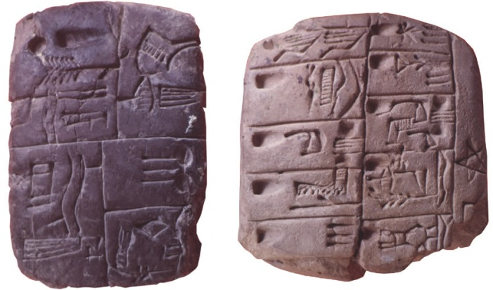
Sumerian writing
one of the earliest writing systems
Sumerians in southern Mesopotamia
clay tablets with pictures of objects (semi-pictographic writing)
animals and their body parts, tools, plants etc. discernible
baked clay tablets are heavy, but indestructible
early tablets
signs conventionalized in form, but considerable variation
the composition of the line drawing not standardized
the primary referent of the signs were physical objects (e.g. a bull)
pictograms developed into
cuneiform signs (klínové písmo)
app. 3500 BC:
http://oi.uchicago.edu/OI/MUS/ED/TRC/MESO/writing.html

Slide 15
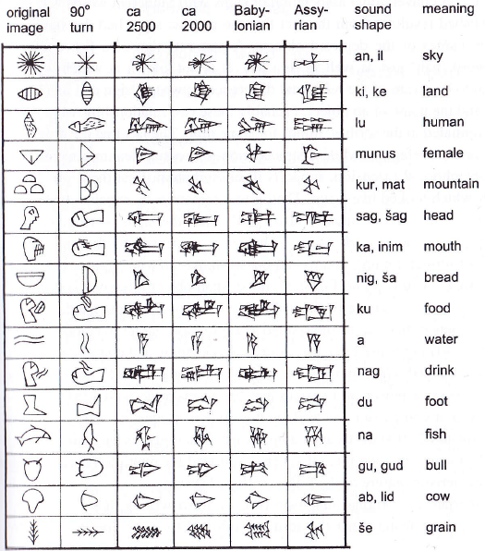
Graphic development of Sumerian cuneiform signs
cuneiform signs used for 3 thousand years
900 to 1,000 attested independently occurring signs in total
a very limited expressive power (cf. an average high-school student uses vocabulary of app. 20,000 words, in comprehensive dictionaries 300,000 words listed)

Slide 16
Sumerian writing
graphic signs had the same referent as the name of the depicted objects
e.g. a pictorial sign of a fish could refer to the word fish as well as to a fish
a conventional association of signs with Sumerian words was gradually established
the oldest signs all had concrete referents, abstract meaning added later by
metaphorical extension: a pictorial sign of a star referred to a star, later to the sky, possibly also to God
rebus extension (ребусный принцип)

Slide 17
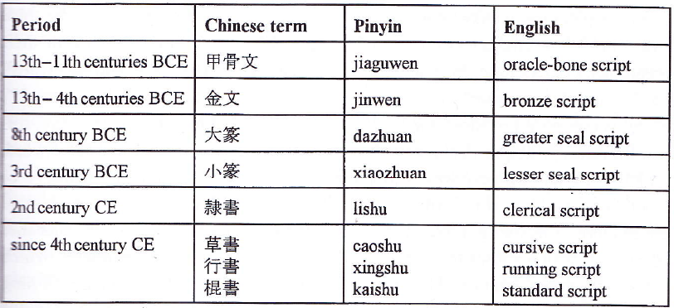
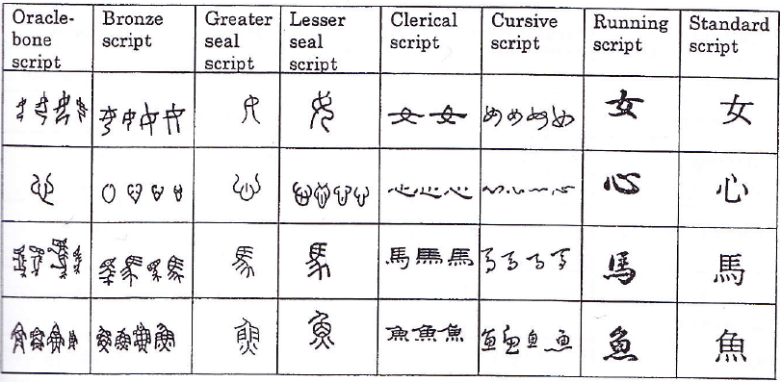
Chinese characters grew out of drawings of natural objects
their origin still unclear, app. 1750–1040 BC
(Coulmas, 2003, 51)

Slide 18
Graphical structure of Chinese characters
in Chinese, character map onto morphemes and words, no systematic mapping relation between strokes and segments
lishu (`the six writings’)
first major lexicon compiled, about 120 AD: 9,500 characters, based on six formation principles (simple pictograms, ideographs etc.)
lexicon of current Chinese
tradition of Chinese lexicography: adding characters, never eliminating any
Huang and Huang (1989)
74,000 characters, 25,000 out of which are variants
List of Modern Chinese Characters for Everyday Use by the Committee for the Writing of the National language (1988):
a primary list od 2,500 characters, a secondary list of another 1,000 characters
considered sufficient for other than specialized and technical texts
statistics:
1,000 most common characters account for about 90 % of all characters used in publications directed at a general readership
another 1,400 characters necessary to cover the next 9 %
another 1,400 characters to raise the level to 99.9 %
reflecting the Zipf’s law

Slide 19
Nanjing, Paris, Shanxi, Tian Shan, Paraguay, Tianjin, Beijing, Shanghai, Shandong, Mexico, North Arctic Ocean
Find translations for the place names
Translate

Slide 20
Classification of writing systems
language independent
language dependent
ideography
pictography
logography

Slide 21
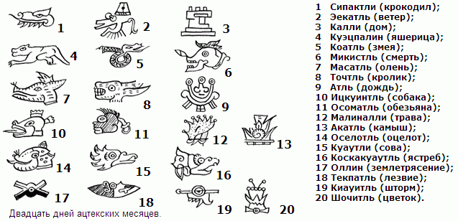
I (1sg)
ideography
you (2sg/pl)
pictography
logography
Aztec
to express words that are not easy to paint...
rebus writing

Slide 22
[sti:l]
ideography
pictography
logography
to express words that are not easy to paint...
to distinguish homonyms...
rebus writing
determinatives, keys
Sumerian (initial)
Egypt (final position)
Chinese (together with hieroglyph)
en. Polish – polish
g. Leben – leben

Slide 23
ideography
pictography
logography
syllabic systems
rebus writing
determinatives, keys

Slide 24
ideography
pictography
logography
syllabic systems
rebus writing
determinatives, keys

Slide 25
(iv) Syllabic systems
the basic graphic units are interpreted as speech syllables
a syllable is a unit of speech that can be articulated in isolation and bear a single degree of stress (English) or a single tone (Chinese)
typically, a sound of a consonant followed by a vowel (CV)
further: VC, V, CVC, CCV, CvCV (reduced vowels in interconsonantal position in Hebrew and other Semitic languages), ... CCCVCC (cf. English strength)
however: Everybody is able to recognize a syllable, even if some difficulty is experienced in defining what a syllable is. (A. Burgess: A Mouthful of Air)
Japanese kana as one of the purest examples
further Akkadian cuneiform script, Aegean script Linear B, Cherokee scripts of North America etc.

Slide 26
Syllables of various languages
different languages allow for different syllables
the specific structure of possible syllables is part of the phonological system of a language
the complexity of possible syllables of a language interacts with their number
for instance
more than 11,000 different syllables in Korean
more than 14,000 different syllables in Vietnamese
app. 23,000 different syllables in Thai
even more in German and English
no writing system could map speech syllables to graphic signs in the ratio 1:1
different strategies developed for syllabic writing to decrease the number of signs in comparison to the number of speech syllables
e.g. combining simple syllables, disregarding minor distinctions such as aspiration of final consonants; combining syllables with logograms

Slide 27
vač ‘speak’
veda ‘knowledge’
čud ‘induce’
mene ‘thought’
dama ‘house’
jad ‘because’
nam ‘respect’
Describe the rules of writing consonants and vowels
Transcribe the following words:
‘think’
‘hold’
‘joy’
‘God’

Slide 28
Give the Latin transliteration of

Slide 29
ideography
alphabets
pictography
logography
syllabic systems
rebus writing
determinatives, keys

Slide 30
(v) Alphabetic systems
alphabetic letters encode phonemic segments
the segments cannot be extracted from the speech
“it is impossible to disarticulate phonological representation into a string of non-overlapping units” (Prince 1992:368)
phoneme
an abstract unit: phonetic segment (phone) which fulfills a meaning-differen-tiating function in a given language
statistics based on 317 languages
languages have 22.8 consonant phonemes and 8.7 vowel phonemes on average
in individual languages, between 6 and 95 consonants and 3 and 46 vowels

Slide 32
surtal ‘study’ tusa ‘benefit’ tariki ‘brain’ öri ‘debt’
usun ‘water’ muskilta ‘crook’ amitan ‘animal’
Transcribe the following words. Try to detect what 2 and 3 mean.
‘crisis’

