Slide 1
CLARINO Dspace repository
(repo.clarino.uib.no)
A status from the University of Bergen Library, section for digital systems and services
09.11.2016
Hemed Al Ruwehy

Slide 2
History
Inspired by the DSpace repository at LINDAT/CLARIN.
University of Bergen had already DSpace installation. (BORA), handled by IT department.
Jozef Misutka from Charles University visited Bergen in August 2013 (CLARIN Mobility) and helped to set up a DSpace repository.
The installation process was run once again by the University of Bergen IT-department (IT) and the University of Bergen Library (UBL) early 2014.

Slide 3
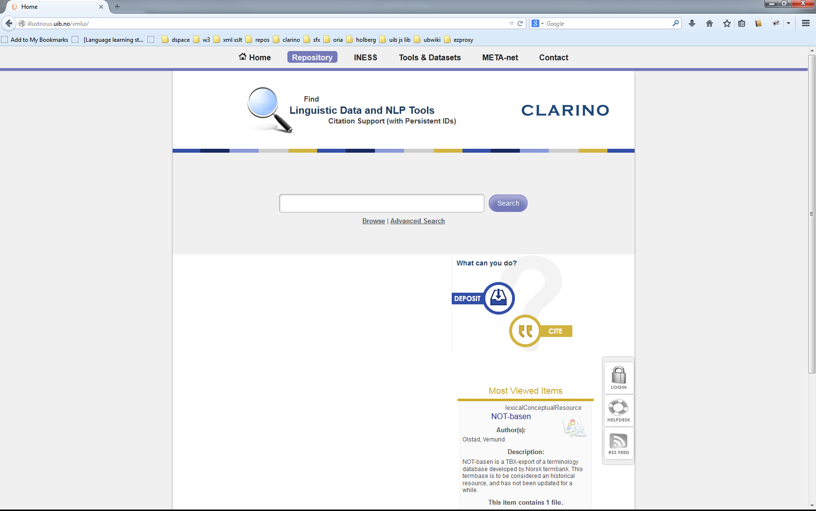

Slide 4
CLARINO DSpace
Implementation by the UBL for the CLARINO Bergen Centre.
  Issue tracking and work coordination are done in Redmine (rts.uib.no).
  Curation tasks (metadata, licenses) and design is done by CLARINO staff at the Department of Linguistic, Literary and Aesthetic Studies.
  Curation tasks, Front-end changes, upgrading, and local DSpace configuration done by UBL.
  Configuration of authentication, system services are handled by IT. (Feide, Shibboleth, Postgres).
Some tasks are shared.

Slide 6
Status and what we have done:
User interface and static pages customization
Setting up local handle server
Authentication via Feide, CLARIN IdP, Federated login
We have several items from UiB, UiT, UiO
Almost, all the things from the CLARIN B Centre checklist. E.g A configuration for MdSelftLink to redirect to metadata file instead of landing page.

Slide 7
What we would like to have:-
Statistics:
- How many downloads in the past year?
- How many times does item “X” has been referenced?
Implementation of Norwegian profiles (metadata model) within the repository.
Integration with COMEDI in the depositing workflow(?)

Slide 8
Goals & challenges
Having a common place where user can search for everything within the centre:
How can this best be done?
- Harvesting from INESS, Corpuscle to the repository?
- VLO instance at the centre’s landing page?
- How others are doing?
Engage more into CLARIN DSpace community (CLARINO-PLUS).

Slide 9
CLARINO-PLUS
It’s goal is to update and consolidate the CLARINO infrastructure, which represents Norway's participation in the CLARIN ERIC.
It will result into more contents into CLARINO e.g Menota, Wittgenstein Archives.
New positions:
Technical development - 50% developer position for 5 years.
User involvement manager – increase outreach.

Slide 10
Thank you!

