Slide 1
Jak čeští mluvčí 'uptalkují'?
Martin
James
University Leeds
Martin Havlík
Czech Language Institute, Czech Academy of Sciences
havlik@ujc.cas.cz

Slide 2
Structure of presentation
Conversation Analysis
Interactional Linguistic
On-line syntax
Uptalk
Uptalk in Czech
Examples

Slide 3
Conversation Analysis
Ethnomethodology (Harold Garfinkel)
“Its concerns are with the ‘observability’ of ordinal social life, and its principle method of investigation is that of observation. Its focus is upon the methods by which observable social activities are produced. It seeks to investigate how social activities are accomplished by members of society.” (Hester&Francis, 2004)
Conversation Analysis (Harvey Sacks, Emanuel Schegloff)

Slide 4
Conversation Analysis
“The CA approach is distinctive (i) in assuming that language use, and social interaction more generally, is orderly at a minute level of detail. Additionally, this orderliness is conceived of as the product of shared methods of reasoning and action to which all competent social interactants attend. CA is also distinctive (ii) in that the goals of the analyses are structural — i.e. to describe the intertwined construction of practices, actions, activities, and the overall structure of interactions. With these goals and assumptions in mind, the data required for analyses are also distinctive (iii) in that they must be records of spontaneous, naturally occurring social interaction rather than, for instance, contrived interactions or those that might occur in a laboratory.” (Sidnell&Stivers, 2013)

Slide 5
Conversation Analysis
turn-constructional unit
“There are various unit-types with which a speaker may set out to construct a turn. Unit-types for English include sentential, clausal, phrasal, and lexical constructions. Instances of the unit-types so usable allow a projection under way, and what, roughly, it will take for an instance of that unit-type to be completed. Unit-types lacking the feature of projectability may not be usable in the same way.” (Sacks, et al., 1974)
transition-relevance place

Slide 6
Interactional Linguistics
“The term Interactional Linguistics was introduced early in this century as a cover term for research endeavors such as phonology of conversation, grammar and interaction, contextualization of language, and prosody in talk-in-interaction – all attempts to to explore the working of language as systematically deployed in social interaction.”
(Couper-Kuhlen&Selting, 2018)

Slide 7
On-line syntax
“It is almost trivial to point out that a structuralist definition of the sentence is not carried with the on-line of syntax processing. The structuralist segmentation of a text into sentences is carried out not from a real-time emergence perspective, but rather from the bird’s eye view of the text editor, i.e. finished product.” (Auer, 2009)

Slide 8
On-line syntax
Transitoriness (“rapid fading”)
Irreversibility
Synchronisation
Projection

Slide 9
Projection
“Projection is forward-oriented; it enables speakers and recipients to predict – on the basis of what has been said so far – structural slots in the emergent syntactic gestalt more or less accurately. Projection hence enables speakers and hearers to answer the question ‘what next?’ in the online processing of an emergent gestalt. (…) One of the main functions of what we call ‘syntax’ for oral language is therefore to make projection possible.”(Auer, 2015)

Slide 10
Functions of intonation
Indexical – properties of intonation about the speaker, such as their regional or social background their sex or their age.
Linguistic – indicates whether an utterance is statement or a question; phrasing and so on.
Discourse – management of an interaction, such as holding or ceding the floor, or signalling inclusion of the listener in the conversation.
(House, 2006; Warren, 2016)

Slide 11
Uptalk
“a way of speaking in which the voice rises at the end of a statement, making it sound like a question” (OALD)
“a marked rising intonation pattern found at the ends of intonation units realised on declarative utterances, and which serves primarily to check comprehension or to seek feedback.”
(Warren, 2016)
High-rising terminal
Urban Northern British

Slide 12
Uptalk
Melodém ukončují stoupavý
Melodém neukončující
“(…) existuje jeden znak, který charakterizuje všechny polokadence a jež chybí všem antikadencím (…): je to klesnutí slabiky předcházející bezprostředně před slabikou s intonačním centrem (t.j. před přízvučnou slabikou, na němž se kadence realisuje).”
(Daneš, 1957)

Slide 13
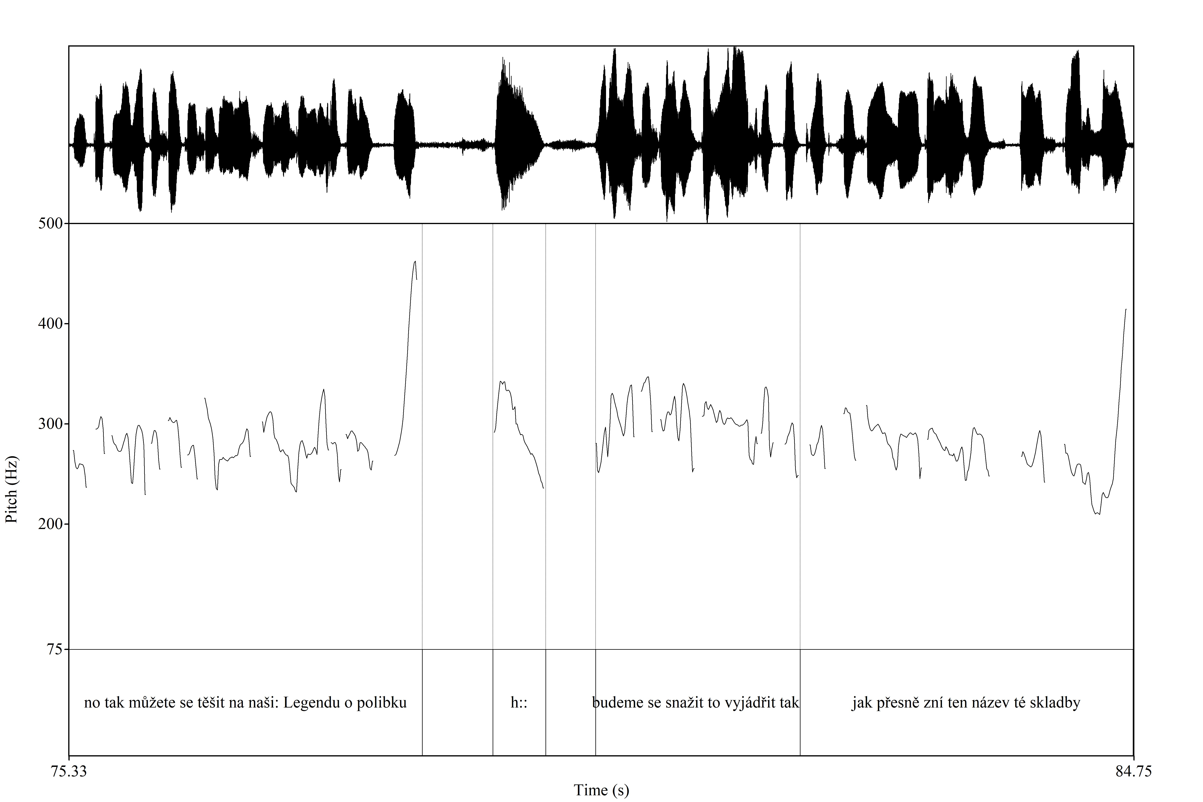

Slide 14
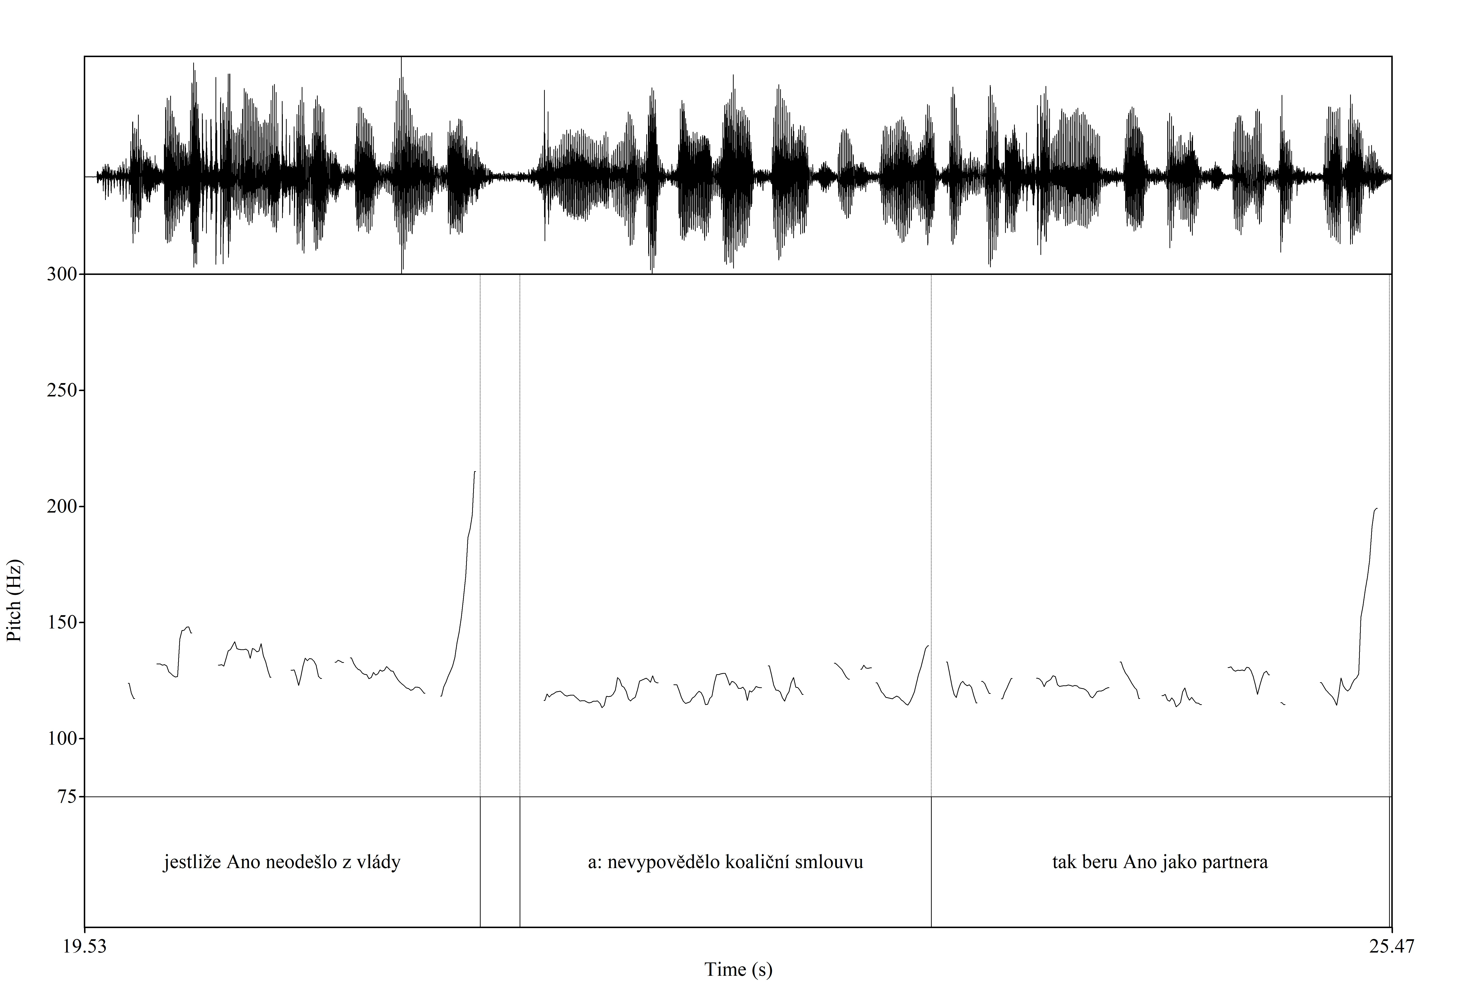

Slide 15
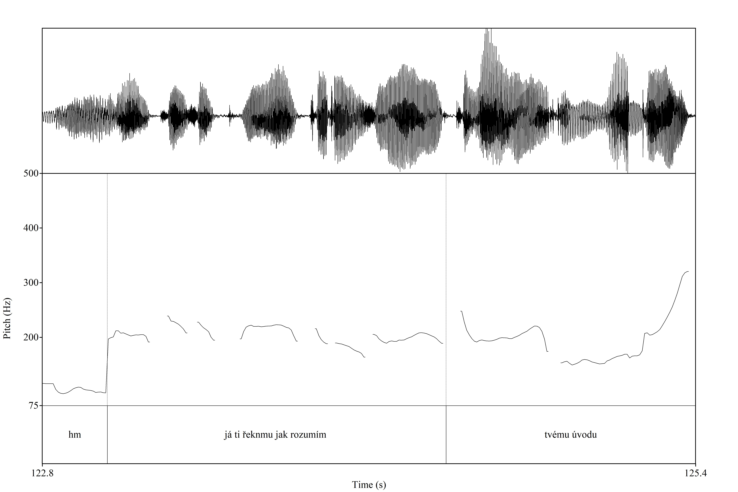

Slide 16
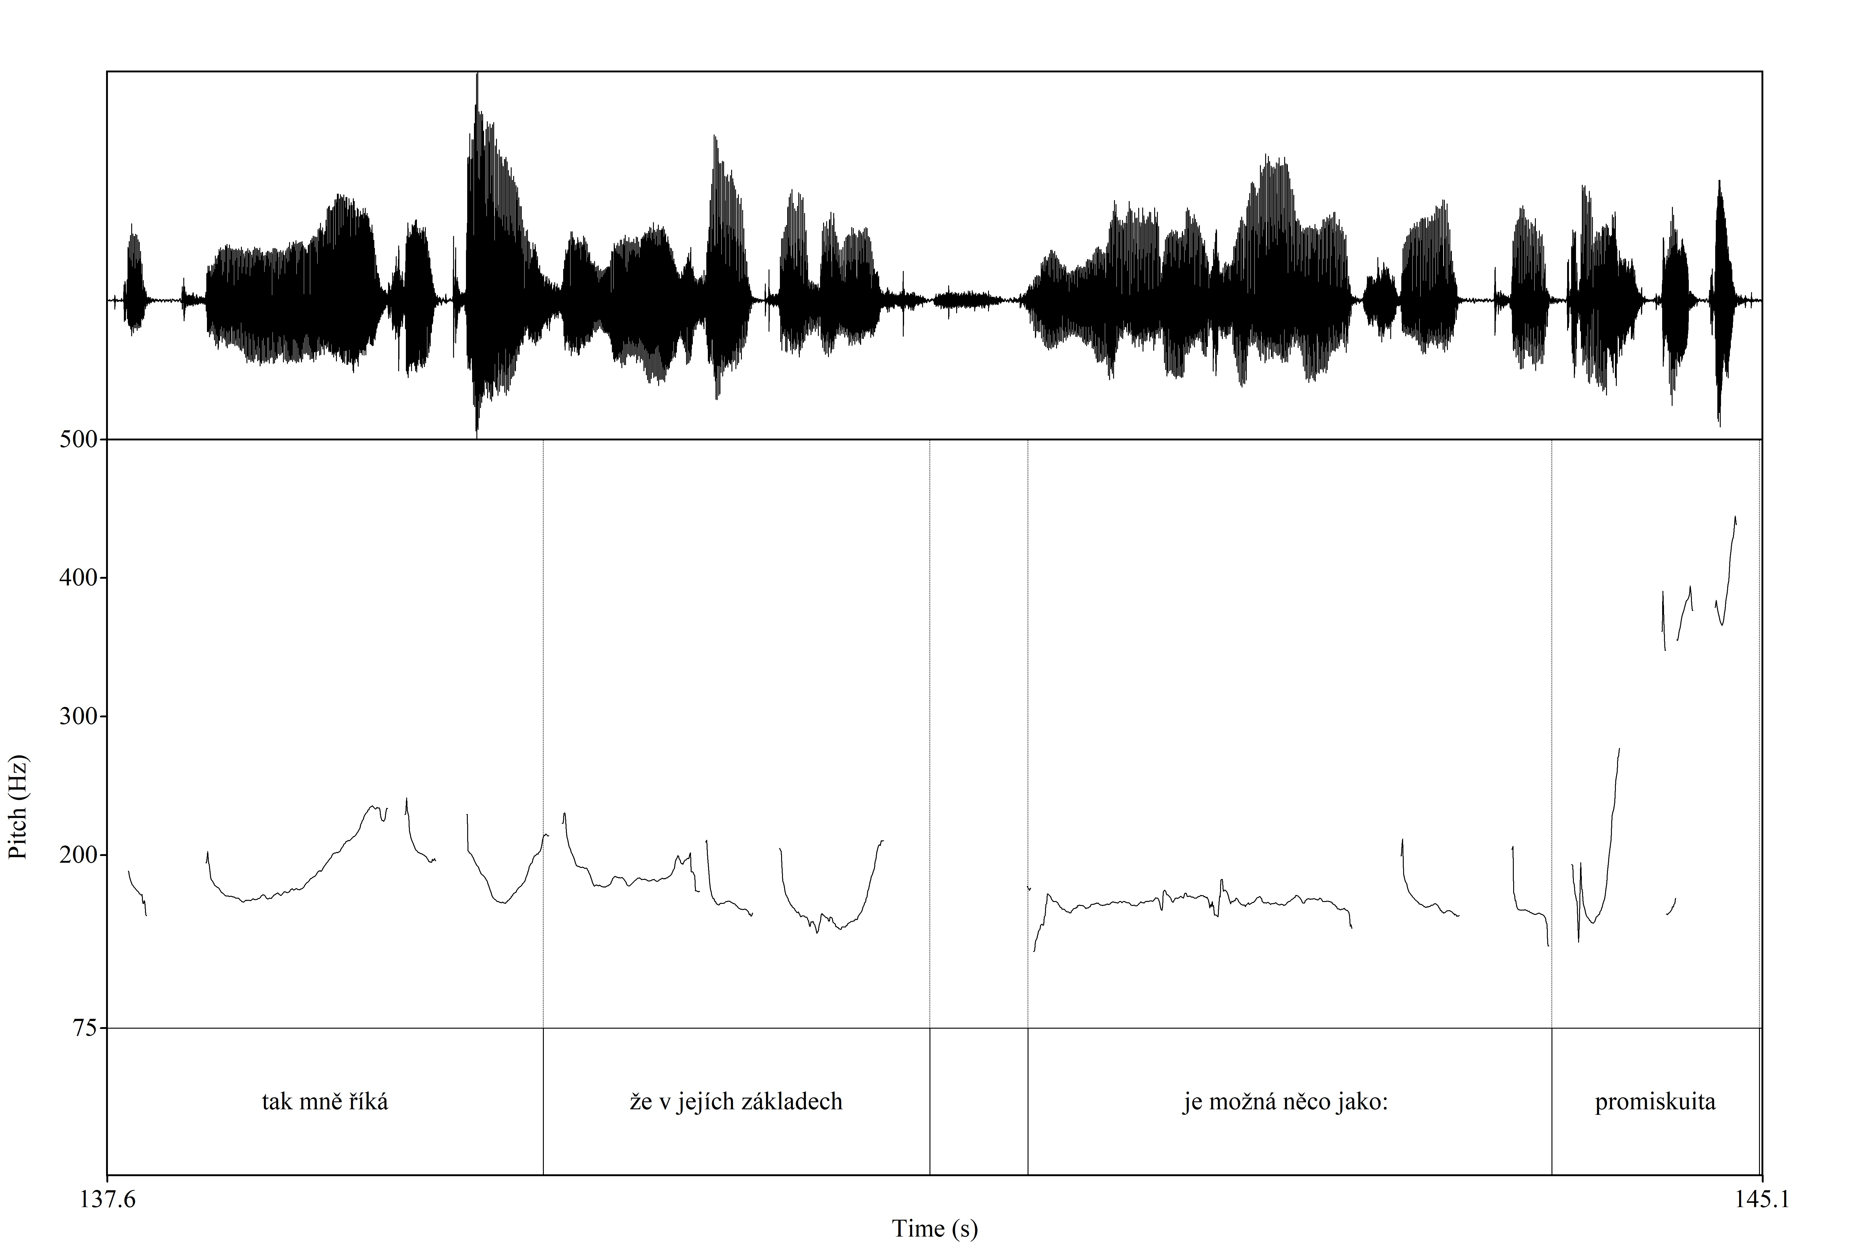

Slide 17
Uptalk vs. questions
“(…) the assumption that uptalk is ‘question-like intonation on a declarative utterance’ is problematic on many counts. The notion of ‘question’ is ambiguous between function and form; the belief that there is any single type of ‘question intonation’ is misplaced, as is the assumption that questions necessarily have rising intonation; and even if accept that ‘question-like intonation’ is shorthand for the type of rising intonation often found on YNQs, then there is lack of agreement concerning whether that type of rising intonation is identical or even similar to uptalk.
(…)
That is, true questions usually include some anaphoric reference to a previous utterance, and will usually be at the end of a turn. By contrast, uptalk tends to provide new information, and the speaker of uptalk typically continues to hold the floor.”
(Warren, 2016)

Slide 18
Uptalk vs. question
A: do Barcelony
(0.8)
B: a tam se mluví jenom katalánsky
A: no i španělsky [ale i katalánsky]
B: [((smích)) ]
B: tak to stačíš ty
A: jo (0.6) myslíš (0.6) (no asi)
B: osvěžíš španělštinu
(0.6)
B: já se naučím základy ”

Slide 19
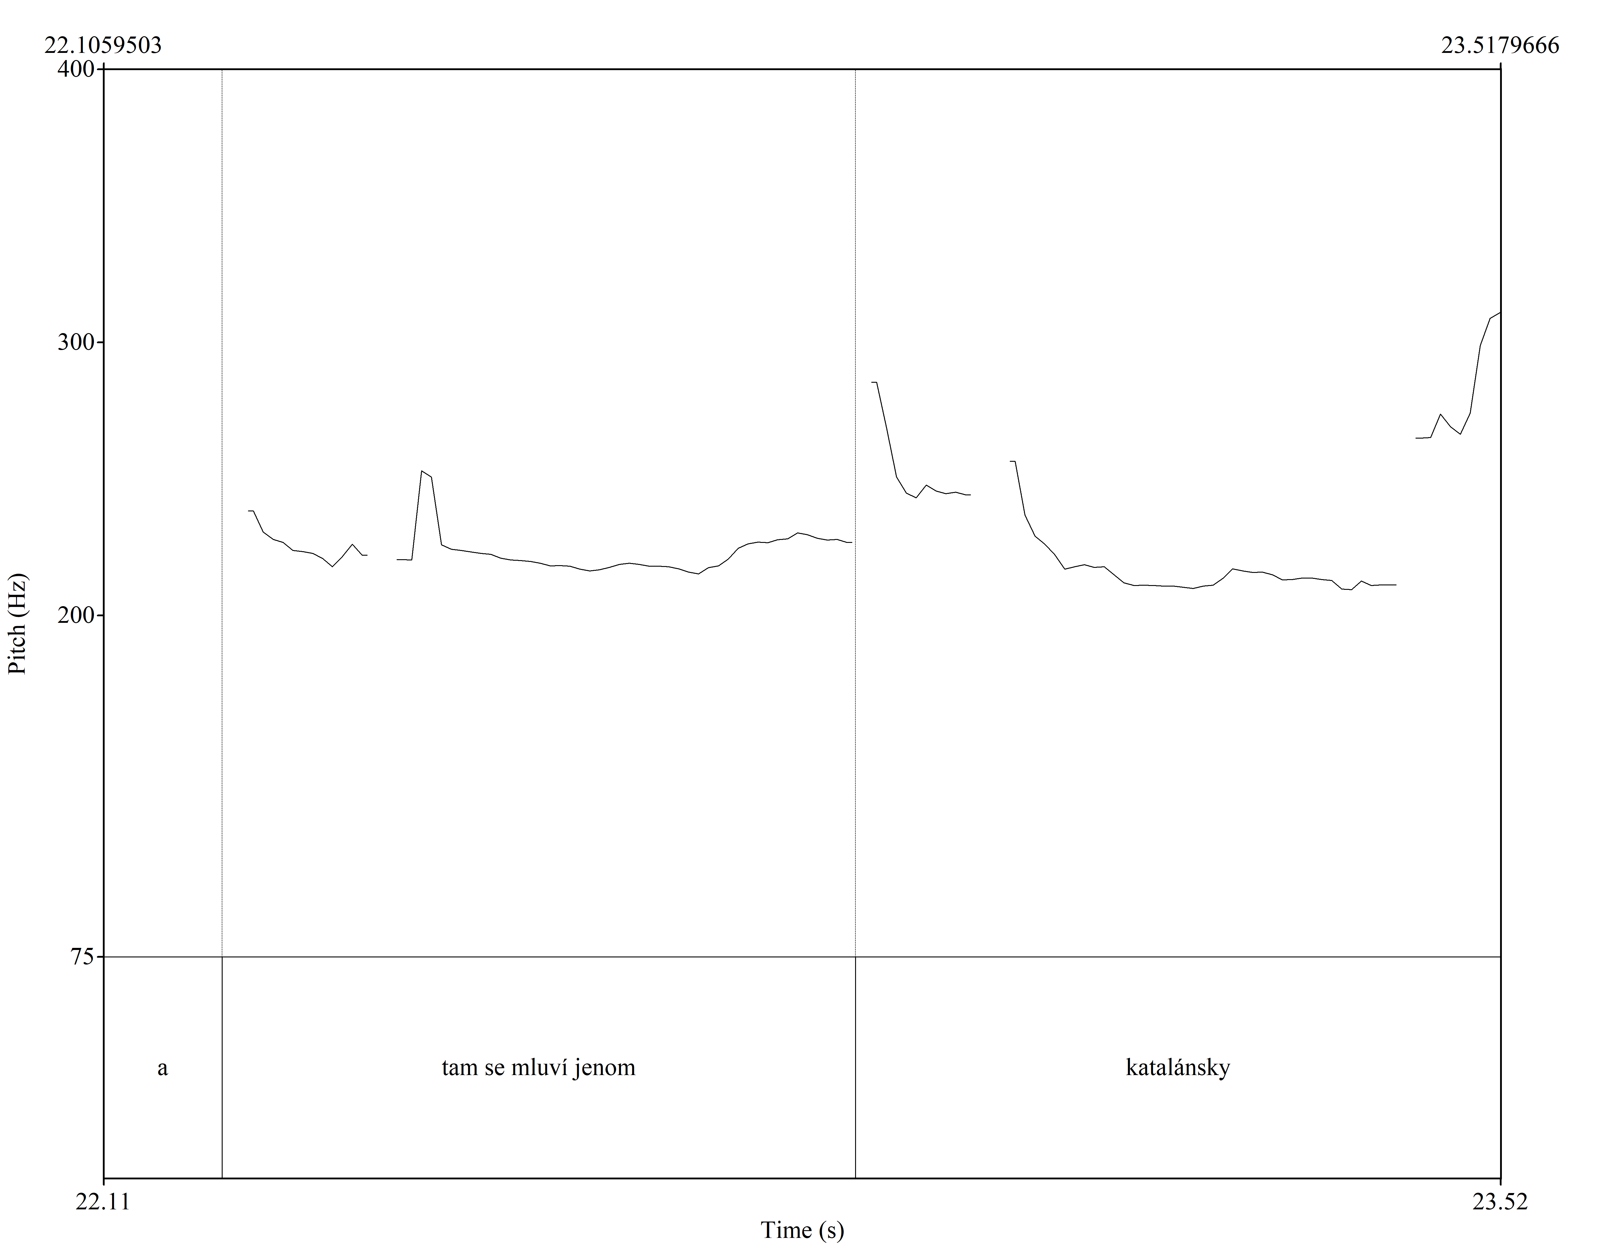

Slide 20
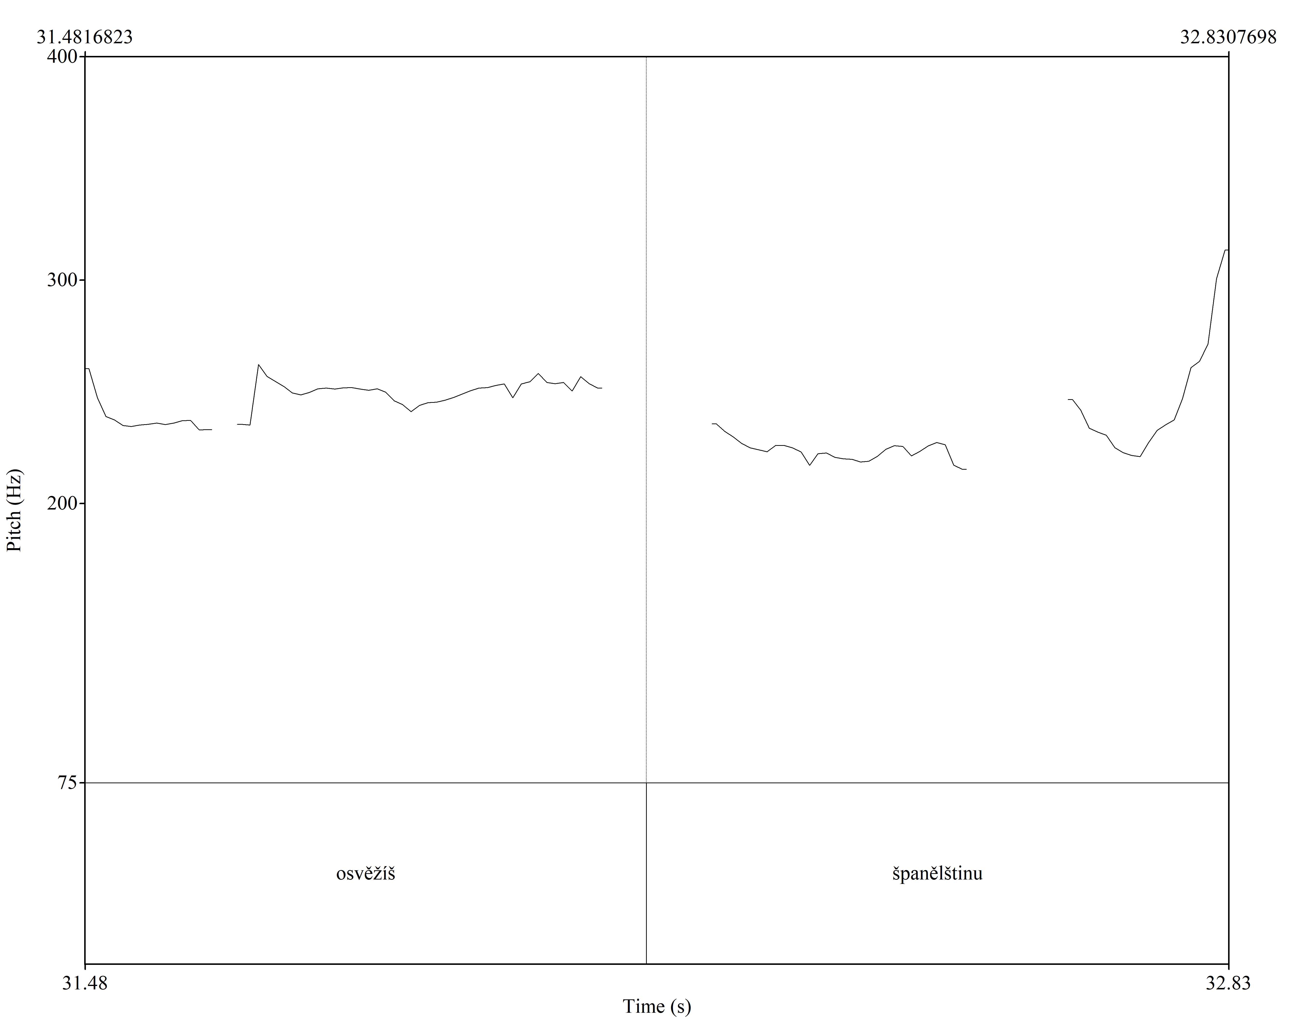

Slide 21
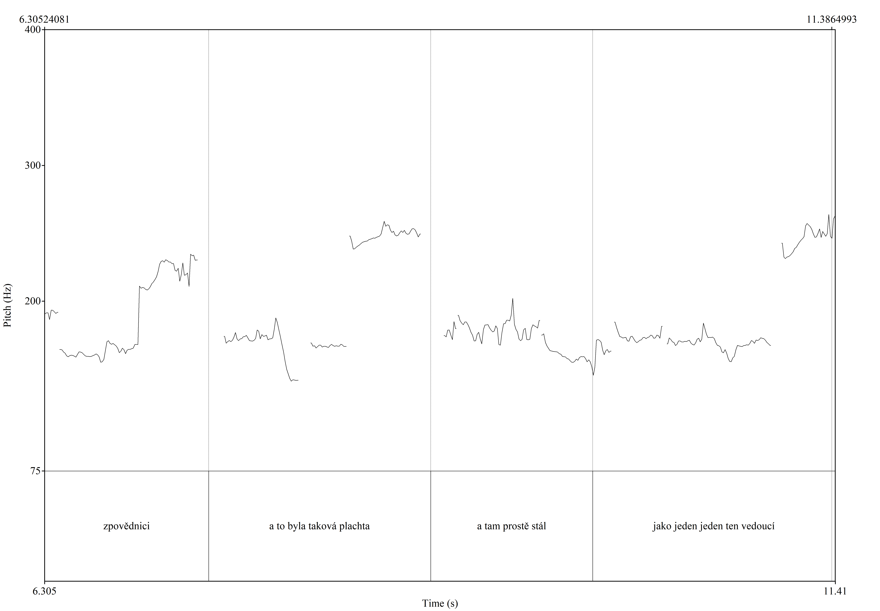

Slide 22
Uptalk se obvykle realizuje na konci výpovědí (TCU), nikoli uprostřed (ani např. na spojkách); projektuje pokračování repliky, většinou v delších, vícevýpovědních, replikách; často monologického rázu typu přednáška, vyprávění, delší odpověď v interviewu; není obecně rozšířen (tj. užívají jej někteří mluvčí, většinou mladší generace). Dvě podoby: a) prudké stoupnutí na poslední slabice; b) stoupnutí na začátku posledního taktu, pak tovná intonace (plateau).

Slide 23
References:
Auer, P. (2005): Projection in interaction and projection in grammar. Text, 25: 7-36.
Auer, P. (2009): On-line syntax: Thoughts on the temporality of spoken language. Language Sciences, 31: 1-13.
Couper-Kuhlen & Selting, M. (2018): Interactional Linguistics. Studying Language in Social Interaction. Cambridge: Cambridge University Press.
Daneš, F. (1957): Intonace a věta ve spisovném češtině. Praha: Nakladatelství Československé akademie věd.
Hester, S. & Francis, D (2004): An Invitation to Ethnomethodology. Language, Society and Interaction. London, Thousand Oaks, New Delhi: SAGE.
House, J. (2006): Constructing a context with intonation. Journal of Pragmatics, 38 (10): 1542-1558.
Sacks, H, Schegloff, E. & Jefferson, G. (1974): A simplest systematics for the organization of turn-taking for conversation. Language, 50: 696-735
Sidnell, J. & Stivers, T. (2013) (eds.): The Handbook of Conversation Analysis. Malden, Oxford, Chichester: Wiley-Blackwell.
Warren, P. (2016): Uptalk. The phenomenon of rising intonation. Cambridge: Cambridge University Press.

