Slide 1
Is Neural Machine Translation the New State of the Art?
Sheila Castilho
sheila.castilho@adaptcentre.ie
Joss Moorkens Federico Gaspari
Iacer Calixto John Tinsley
Andy Way
The ADAPT Centre is funded under the SFI Research Centres Programme (Grant 13/RC/2106) and is co-funded under the European Regional Development Fund.

Slide 2
Outline
MT and the hype
Use cases
  NMT for E-Commerce
  NMT for Patents
  NMT for MOOC
Conclusion

Slide 3
Great excitement and anticipation each new wave of MT
  NMT:
    “bridging the gap between human and MT”

Slide 4
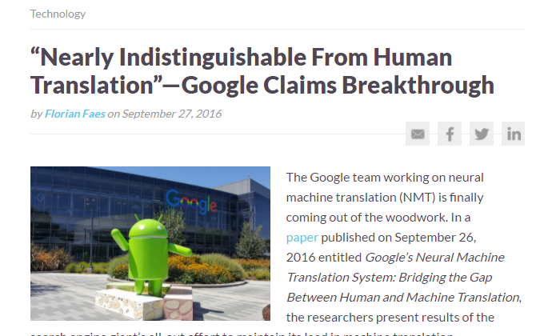
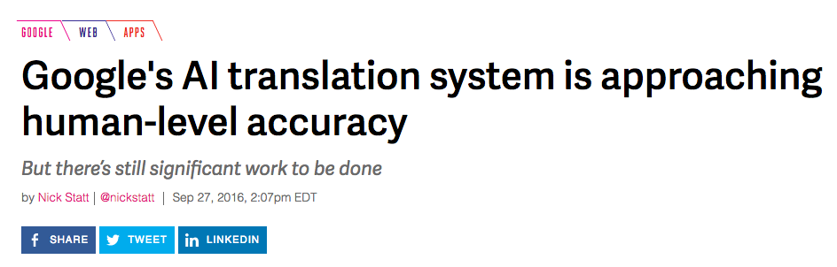
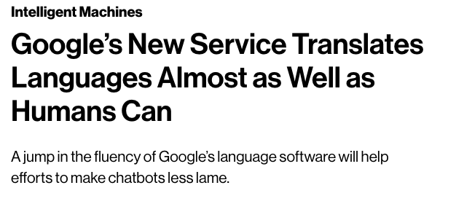
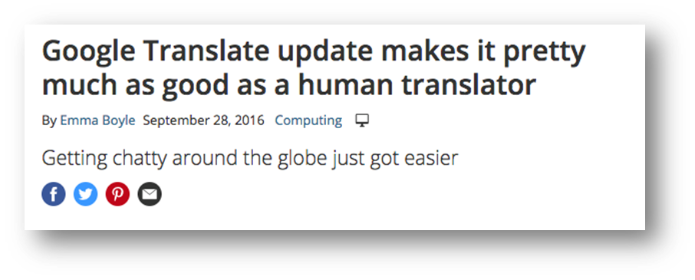
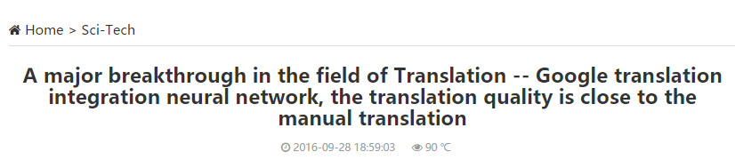
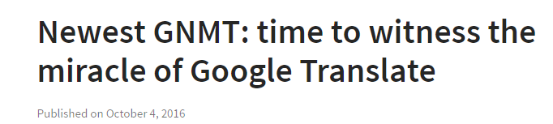
The hype

Slide 5
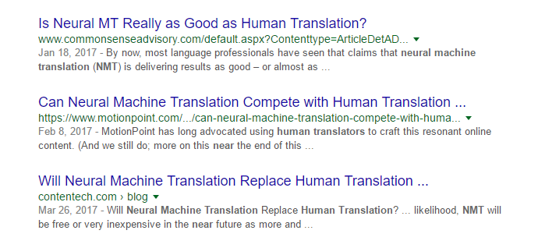

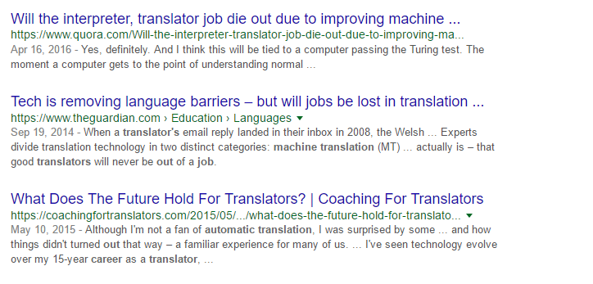

And translators go…

Slide 6
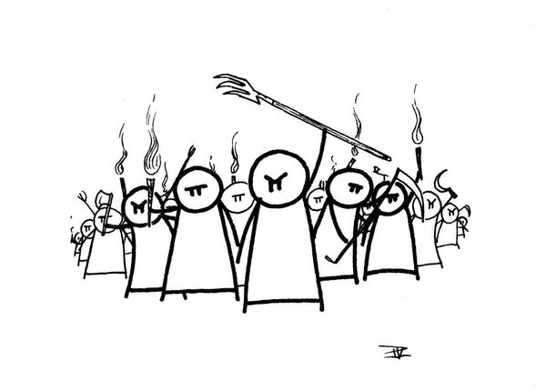
The reaction
    “MT will steal translators' jobs”
    “translators will be merely post-editors of MT”
    “MT is a threat”
Us vs them
Notes:
-Same as SMT came along
Translators refusing to use MT vs translators being forced to use MT
Problems for translations industry, clients, vendors and translators
In Argentina, and in other parts of the world, some “futurologists” are stating that in about 5-10 years there will no longer be a need for translators and that parents should not send their children to university to study translation.

Slide 7
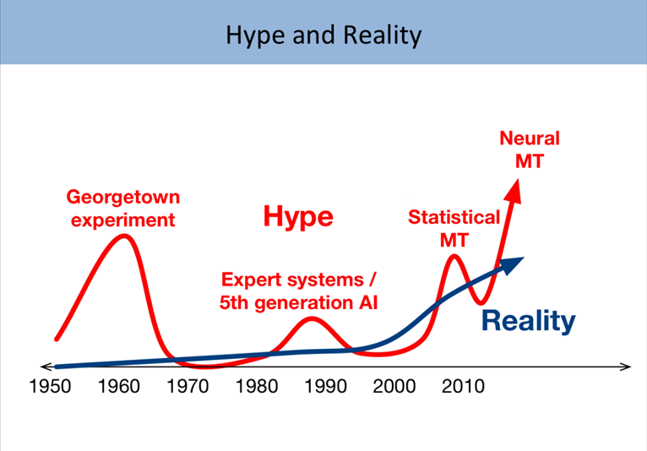
(Philipp Koehn, Omniscien Webinar 2017)
Notes:
great discrepancy between the high expectation of what MT should accomplish and what it is actually able to deliver

Slide 8
But is NMT really that good?
Use cases
different domains
different set of language pairs

Slide 9

NMT for E-Commerce
Systems (Calixto et al. 2017):
  (1) a PBSMT baseline model built with the Moses SMT Toolkit
  (2) a text-only NMTt model
  (3) a multi-modal NMT model (NMTm)
English into German
Data set: 24k parallel product titles + images
Validation/test data: 480/444 tuples
18 German native speakers
Ranking
  Translations from the 3 systems + product image
Adequacy (Likert scale 1- All of it to 4- None of it)
  Source + translation + product image
Notes:
Test whether training an NMT system with access to the product images improved the output quality against two text-only
the translation of user-generated product listings poses particular challenges:
often ungrammatical
can be difficult to interpret even by a native speaker of the language
scattered keywords and/or phrases glued together
typos

Slide 10
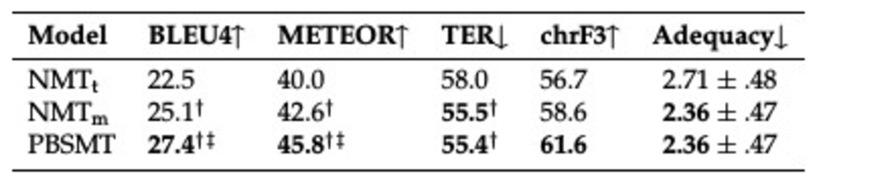
NMT for E-Commerce
AEM:
  PBSMT outperforms both NMT models (BLEU, METEOR and chrF3)
  NMTm performs as well as PBSMT (TER)
Adequacy
  NMTm performs as well as PBSMT
Ranking
  PBSMT: 56.3% preferred system
  NMTm: 24.8%
  NMTt: 18.8%
Notes:
Likert scale – less is better
1- All of it
2-
3-
4- None of it

Slide 11
NMT for Patents
Compare the performance between the mature patent MT engines used in production with novel NMT
Systems
  PBSMT (a combination of elements of phrase-based, syntactic, and rule-driven MT, along with automatic post-editing)
  NMT (baseline)
English into Chinese
Data set: ~1M sentence pairs chemical abstracts, ~350K chemical titles, ~12M general patent, and ~2K glossaries.
2 reviewers
Ranking
Error analysis
  Punctuation, part of speech, omission, addition, wrong terminology,
  literal translation, and word form.
Notes:
Titles are on average ~8 tokens
Abstracts ~40

Slide 12
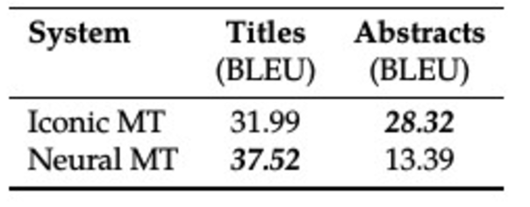
NMT for Patents
AEM:
  SMT outperforms NMT for abstracts, NMT outperforms SMT for titles
Ranking
  General: PBSMT 54% - NMT 39%
  Long sentences: PBSMT 58% - NMT 33%
  Short sentences: PBSMT 84% - NMT 8%
  Medium-length sentences: PBSMT 36% - NMT 57%
Notes:
Short: (<10 words)
Medium: (11 and 39 words)
Long: (>40 words)

Slide 13
NMT for Patents
Error analysis
  SMT: sentence structure 35% (10% NMT)
  NMT: 37% omission (8% SMT)
  % segments with “no errors”
    SMT 25%
    NMT 2%
Notes:
Short: (<10 words)
Medium: (11 and 39 words)
Long: (>40 words)

Slide 14
NMT for MOOCs
Decide which system would provide better quality translations for the project domain
Systems
  PBMST (Moses)
  NMT (baseline)
English into German, Greek, Portuguese and Russian
Data set:
  OFD : ~24M (DE), ~31M (EL), ~32 (PT), ~22(RU)
  In-domain : ~270K(DE), ~140K(EL), ~58K(PT), ~2M(RU)
Ranking
Post-editing
Fluency and Adequacy (1-4 Likert scale)
Error analysis: inflectional morphology, word order, omission, addition, and mistranslation

Slide 15
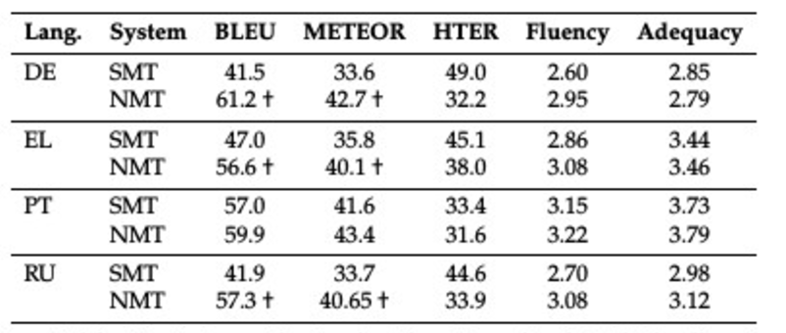
NMT for MOOCs
AEM:
  NMT outperforms SMT in terms of BLEU and METEOR
  More PE for SMT
Fluency and Adequacy
  NMT is preferred across all languages for Fluency
  Adequacy results a bit less consistent

Slide 16
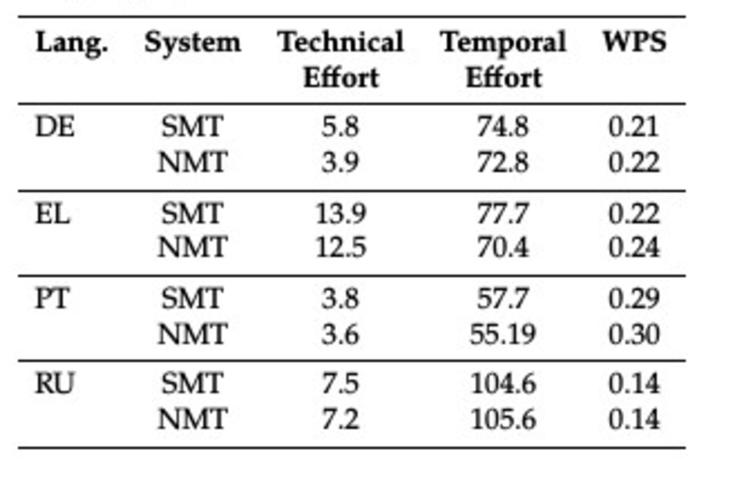
NMT for MOOCs
Post-editing
  Technical effort improved for DE, but marginally for other languages
  Temporal effort marginally improved
Ranking
  NMT is preferred across all languages (DE 80%, EL 56%, PT 61% and RU 63%)

Slide 17
So… NMT is good, right?
NMT results are really promising!
But…
human evaluations show that results are not yet so clear-cut
Notes:
NMT can sometimes be better but it is not “much better” all the time!

Slide 18
Conclusion
Translation industry is eager for improved MT quality in order to minimise costs
The hype around NMT must be treated cautiously
Overselling a technology that is still in need of more research may cause negativity about MT
    “us vs them”
    “MT is a threat to human translators”
Notes:
5 years to convice translators to use MT again!

Slide 19



Slide 20
Thank you!
Questions?
Sheila Castilho
sheila.castilho@adaptcentre.ie

