Slide 1
Statisical Spoken Dialogue
Talk 3 – Action selection
CLARA Workshop
Presented by Blaise Thomson
Cambridge University Engineering Department
brmt2@eng.cam.ac.uk
http://mi.eng.cam.ac.uk/~brmt2

Slide 2
Action Selection – Outline
Introduction
Model-based reinforcement learning
Online reinforcement learning
Function approximation
Application to dialogue systems

Slide 3

Introduction – Reinforcement learning

Slide 4
Introduction – The idea
We’re in a state – called the belief state, b
We take actions – a
We get rewards – r (b,a)
This process repeats over time
We want to maximise the sum of the rewards (or at least its expected value).
The expected future reward is called the value function, V

Slide 5
Introduction – The idea
Trial and error
Let’s take actions randomly, see what happens
The expected future reward for taking a particular action is called the Q function
Just compute the sample average of the rewards we got
That’s basically the idea but we need to take into account the effect of future actions

Slide 6
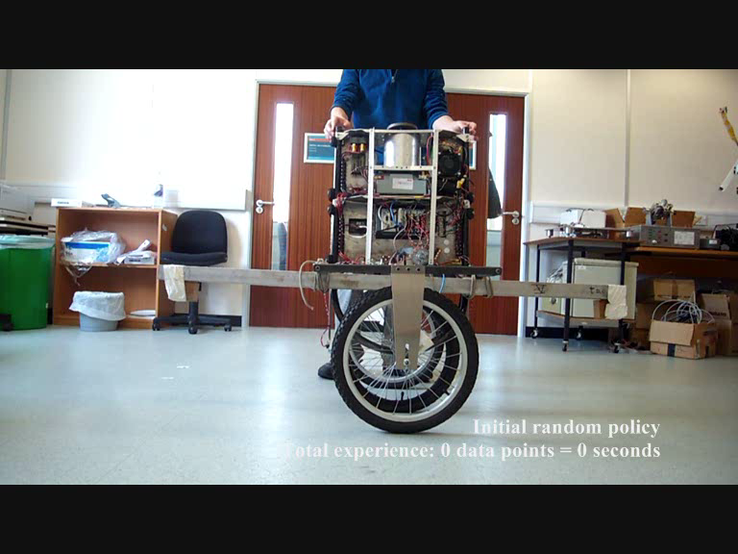
Introduction – an example

Slide 7
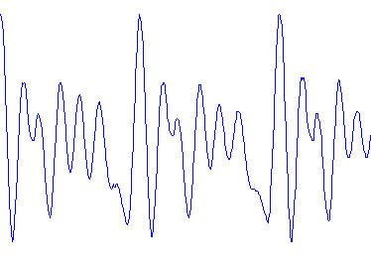
Introduction– States & Transitions
save
delete
State
(Belief State)
New State
(Belief State)
save
delete
Observation
(b,o)
Τ
b’
7

Slide 8
Introduction – Actions & Policies
State
(Belief State)
Actions
/ Probability distribution
over actions
Policy
ask
doSave
doDelete
save
delete
b
π
a

Slide 9
Introduction – Rewards
System is rewarded every turn based on:
Environment state
Action taken
save
delete
-1 | -1
+5 | -10
-20 | +5
ask
doSave
doDelete

Slide 10
Introduction – What is the objective?
Care about Expected Future Reward:
Future Reward
V^{π}(b) = r(b,π(b)) + P(b’|b,π(b))V^{π}(b’)
Expected Future
Reward (Value function)
Immediate Expected
Reward
Transition Function
Choose π to maximise V^{π}(b₀):
Start State

Slide 11
Introduction – The MDP special case
Define a finite set of options for beliefs
Define transitions by hand
Rewards a function of belief state
Simplifies policy learning – we will start with Markov Decision Processes (MDPs)
Definitely Delete
Probably Delete
Don’t know
Probably Save
Definitely Save
save
delete

Slide 12
Model-based learning – An MDP example
Transitions
States
Definitely Delete
Probably Delete
Don’t know
Probably Save
Definitely Save
T(ask) | DSave | PSave | ? | PDel | DDel
DSave | 0.8 | 0.1 | 0.1 | 0 | 0
PSave | 0.5 | 0.2 | 0.1 | 0.1 | 0.1
? | 0.2 | 0.2 | 0.2 | 0.2 | 0.2
PDel | 0.1 | 0.1 | 0.1 | 0.2 | 0.5
DDel | 0 | 0 | 0.1 | 0,1 | 0.8
Actions
Rewards
DSave | PSave | ? | PDel | DDel
-1 | -1 | -1 | -1 | -1 | ask
4 | -2 | -8 | -16 | -20 | doSave
-20 | -16 | -8 | -2 | 4 | doDelete
ask
doSave
doDelete

Slide 13
Model-based learning – An MDP example
Transitions
T(ask) | DSave | PSave | ? | PDel | DDel
DSave | 0.8 | 0.1 | 0.1 | 0 | 0
PSave | 0.5 | 0.2 | 0.1 | 0.1 | 0.1
? | 0.2 | 0.2 | 0.2 | 0.2 | 0.2
PDel | 0.1 | 0.1 | 0.1 | 0.2 | 0.5
DDel | 0 | 0 | 0.1 | 0,1 | 0.8
A transition matrix
for each action: T_{a}
Rewards
A reward vector
for each action: r_{a}
DSave | PSave | ? | PDel | DDel
-1 | -1 | -1 | -1 | -1 | ask
4 | -2 | -8 | -16 | -20 | doSave
-20 | -16 | -8 | -2 | 4 | doDelete

Slide 14
Model-based learning – Getting V given π
Aim to maximise Expected Future Reward:
Replace with matrix notation (finite states):
Solve using matrix inverse
V^{π}(b) = r(b,π(b)) + P(b’|b,π(b))V^{π}(b’)
V^{π} = r^{π} + T^{π}V^{π}
r^{π}(b) = r(b,π(b))
T^{π}(b,b’) = P(b’|b,π(b))

Slide 15
Model-based learning – Optimising π
Starting with any policy π
Calculate Value function
DSave | ask | doSave | doDelete
PSave | ask | doSave | doDelete
? | ask | doSave | doDelete
PDel | ask | doSave | doDelete
DDel | ask | doSave | doDelete
V^{π} = r^{π} + T^{π}V^{π}

Slide 16
Model-based learning – Optimising π
3a. See what happens for each state if:
  We start with ANY action
  THEN follow the policy
  3b. Define Q(b,a) as the expected reward
THEN
DSave | ask | doSave | doDelete
PSave | ask | doSave | doDelete
? | ask | doSave | doDelete
PDel | ask | doSave | doDelete
DDel | ask | doSave | doDelete
FIRST TURN
PSave | ask | doSave | doDelete
Q^{π}(b,a) = r(b,a) + P(b’|b,a)V^{π}(b’)

Slide 17
Model-based learning – Optimising π
If Q^{π}(b,a) > V^{π}(b) then:
    a is a better action than π(b)
    Make a new policy π’ taking the best action:
    π’(b) = Q^{π}(b,a)
    This will always improve things:
    V^{π’}(b) V^{π}(b)

Slide 18
Model-based learning – Optimising π
Repeat the process until there is no change
    Calculate Value function
    See what happens for other actions (calc Q)
    Choose new policy based on this
This is always an optimal policy!

Slide 19
Model-based learning – Summary
  Two important stages:
    Estimating Value function
    Improving policy
  Two problems with the algorithm:
    Need to know transition probabilities (model-based)
      Want to do learning online
    Need small (finite) number of belief states
      Want to use function approximation

Slide 20
Online learning – The idea
We had:
In terms of expectation and values at time t:
Q^{π}(b, a) = r(b,a) + P(b’|b,a)V^{π}(b’)
Q^{π}(b_{t}, a_{t}) = E_{π} (r_{t} + Q^{π}(b_{t+1}, a_{t+1}))

Slide 21
Online learning – The idea
We don’t have this!
We had:
In terms of expectation and values at time t:
But we do have lots of samples:
Q^{π}(b, a) = r(b,a) + P(b’|b,a)V^{π}(b’).
We can’t calculate this!
Q^{π}(b_{t}, a_{t}) = E_{π} (r_{t} + Q^{π}(b_{t+1}, a_{t+1})).
b₁, a₁, r₁, b₂
b₂, a₂, r₂, b₃
b₃, a₃, r₃, b₄
…

Slide 22
Online learning – The idea
We want:
in terms of samples:
Optimise for Q^{π}(b_{i}, a_{j}) using standard techniques!
Q^{π}(b_{t}, a_{t}) = E_{π} (r_{t} + Q^{π}(b_{t+1}, a_{t+1})),
Q^{π}(b₁, a₁) r₁ + Q^{π}(b₂, a₂)
Q^{π}(b₂, a₂) r₂ + Q^{π}(b₃, a₃)
…
Q^{π}(b_{t}, a_{t}) r_{t} + Q^{π}(b_{t+1}, a_{t+1}).

Slide 23
Online learning – Solving for Q
METHOD 1 – Least Squares:
Q^{π}(b_{t}, a_{t}) are variables to be estimated
METHOD 2 – Iterative:
Q^{π}(b_{t}, a_{t}) ← Q^{π}(b_{t}, a_{t}) +
α [r_{t} + Q^{π}(b_{t+1}, a_{t+1}) - Q^{π}(b_{t}, a_{t}) ]
Q^{π}(b₁, a₁) r₁ + Q^{π}(b₂, a₂)
Q^{π}(b₂, a₂) r₂ + Q^{π}(b₃, a₃)
…

Slide 24
Online learning – The algorithm
Follow currently optimal policy
    Take a random action with probability ε (Exploration)
Estimate Q using samples
    Iterative version: SARSA(0)
    Least squares: LS-SARSA(0)
    SARSA = State, Action, Reward, State, Action
Update policy using best action given by Q
Repeat, gradually decreasing ε.

Slide 25
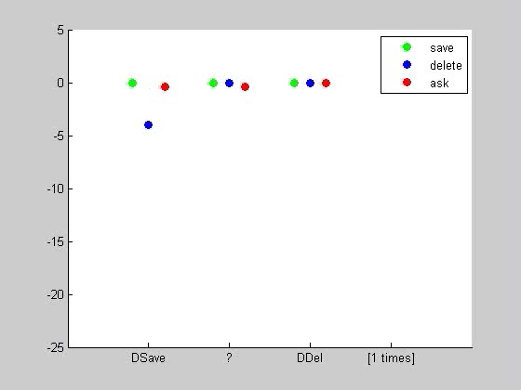
Online learning – An example

Slide 26

Fuction approximation – POMDP Problem
2 states
3 states
4 states
POMDP is just an MDP with a continuous state space
We need a way to handle continuous spaces!

Slide 27
Function approximation – The POMDP problem
Q : MDP do-save
Q : MDP ask
DSave | PSave | ? | PDel | DDel
DSave | PSave | ? | PDel | DDel
R. Sutton and A. Barto. (1998). “Reinforcement Learning: An Introduction”. MIT Press

Slide 28
Function approximation – The POMDP problem
Q : MDP do-save
Q : MDP ask
DSave | PSave | ? | PDel | DDel
DSave | PSave | ? | PDel | DDel
Q : POMDP do-save
Q : POMDP ask

Slide 29
Function approximation – Formalities
General linear form is:
Summarising function
(result is a vector)
Q^{π}(b, a) = φ_{a}(b) . θ
Parameter vector

Slide 30
Function approximation – Formalities
Discrete approximation uses:
Q^{π}(b, a) = φ_{a}(b) . θ
= θ_{i}
Where each (region, action) is given an index i
0’s everywhere else
Q : ask
φ_{a}(b)
1 at index i
0’s everywhere else

Slide 31
Function approximation – Formalities
Can use other approximations (e.g. quadratic):
Q^{π}(b, a) = φ_{a}(b) . θ
= θ_{a,1} + b . θ_{a,2} + b² . θ_{a,2}
Q : ask
φ_{a}(b)
0’s for other
actions

Slide 32
Function approximation – The details
In the SARSA algorithms we had:
Replacing with function approximations gives:
Q^{π}(b₁, a₁) r₁ + Q^{π}(b₂, a₂)
Q^{π}(b₂, a₂) r₂ + Q^{π}(b₃, a₃)
…
φ_{a1}(b₁) . θ r₁ + φ_{a2} (b₂) . θ
φ_{a2}(b₂) . θ r₂ + φ_{a3} (b₃) . θ
…

Slide 33
Function approximation – Solving for θ
φ_{a1}(b₁) . θ r₁ + φ_{a2} (b₂) . θ
φ_{a2}(b₂) . θ r₂ + φ_{a3} (b₃) . θ
…
METHOD 1 – Least Squares:
θ are variables to be estimated
METHOD 2 – Iterative:
θ ← θ +
α [r_{t} + φ_{at+1} (b_{t+1}) . θ - φ_{at}(b_{t}) . θ ] φ_{at}(b_{t})

Slide 34
Function approximation – The algorithm
Follow currently optimal policy
    Take a random action with probability ε (Exploration)
Estimate θ using samples
    Iterative version: SARSA(0)
    Least squares: LS-SARSA(0)
Update policy using best action given by Q
Repeat, gradually decreasing ε.

Slide 35
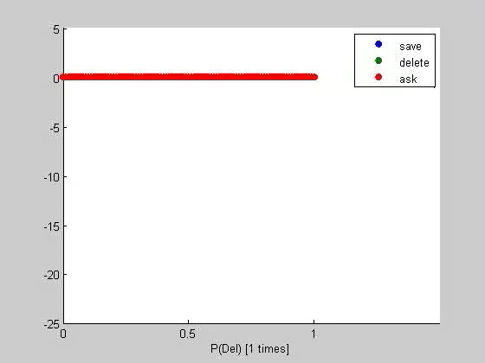
Function approximation – An example
Voicemail – Save message, Delete message or Ask user?

Slide 36
Other learning techniques – Policy Gradients
V^{π}(b) = r(b,π(b)) + P(b’|b,π(b))V^{π}(b’)
V^{π}(b)
θ ← θ + α V^{π}(b)
36
Aim is to get probabilistic π to maximise:
Parameterise π according to θ. Directly estimate:
Update using gradient descent:

Slide 37

Application – Summary actions
Some things are obvious!
User wants to save
STUPID!!!
Lets delete!
Jason D. Williams and Steve Young. (2005). Scaling Up POMDPs for Dialog Management: The "Summary POMDP" Method. Proc IEEE Workshop on Automatic Speech Recognition and Understanding (ASRU), San Juan, Puerto Rico, USA.

Slide 38
Application – Summary actions
Some things are obvious!
Replace “do-save” and “do-delete” with one action:
  Do whatever is the most likely
Formally still an MDP – actions simply different
User wants to delete
STUPID!!!
Lets save!

Slide 39

Application – “Best of both worlds”
Businesses need to be sure the policy:
  Doesn’t do something stupid
  Follows business rules
Policy learning should learn this from rewards
  But sometimes it doesn’t
  And we can’t have the system “exploring”
VERY BAD!
Hi! My name’s Bill Gates. Could you transfer all my money to A/C ….
Sure! It’s done!

Slide 40
Application – “Best of both worlds”
Augment belief state with position in a flow chart
Restrict actions to those allowed by a system designer
Constrains policy search – allows more complexity
Dialogue designers can incorporate good design
Get name and password
Ask user what they want
OR Transfer money
OR Give bank statement
Yes
c > δ
No
Can use POMDP info
Jason D. Williams. (2008). The best of both worlds: Unifying conventional dialog systems and POMDPs. Proc Interspeech, Brisbane, Australia.

Slide 41
Application – Summary features
For factorised approaches:
    Need to use probabilities / entropies of each slot
    Too many values to discretise joint space
    Consider effect of each slot independently
index corresponding
to slot “to”, region with
(0.5, 0.3) and action a
Feat | Val
P_{to,1} | 0.5
P_{to,2} | 0.3
P_{from,1} | 0.1
p_{from,2} | 0.05
φ_{a}(b)
index corresponding
to slot “from”, region with
(0.1, 0.05) and action a
0’s everywhere else
B. Thomson and S. Young (2009). "Bayesian update of dialogue state: A POMDP framework for spoken dialogue systems." Computer Speech and Language.

Slide 42
Application– Summary POMDPs¹
Policy: States → Actions
Original
Belief Space
Actions
Policy
Summary
Function
Master
Function
Summary
Space
Summary
Actions
Summary Policy
¹ J. Williams and S. Young (2005). "Scaling up POMDPs for
Dialogue Management: The Summary POMDP Method."
Notes:
In order to handle the problem of having so many values to estimate we need to use some extra approximation. Fortunately, in dialogue systems a lot the decision making is reasonably obvious. For example, some of the possible actions are obviously useless in certain situations: if you believe the user is more likely to want a “restaurant” than a “hotel” then it would be very silly to talk about hotels! Also, we can bring a lot of intuition in to what information is needed when decisions are made. Maybe we don’t need the full distribution, but only the entropy / most likely probability. These ideas motivate the idea of using some sort of summary when doing learning.
So usually a policy would be a mapping from each possible distribution over goals into actions to take. But we can split this policy up by first summarising the belief somehow and choosing summary actions. The summary could for example contain the probability of the most likely user goal, while the summary actions might be things like confirm the most likely goal. Our algorithm then becomes essentially the same as standard Q-learning except that we learn the Q-functions by discretising of a summarised space instead the original one.
A similar idea has been used previously with PBVI, and what is new in our model is that we use Q-learning in the summary space instead. The most important point here is that PBVI has only really been applied to toy problems, whereas here we were trying to get something that could work in a real-world size application. There are also other difference in that it allows us to have a continuous observations (so we can have all possible confidences), and we can also use summaries that are not probabilities.
Need extra approx:
SDS obvious
Motivates summary space idea
Example
Q-learning
Other techniques

Slide 43
Application – Summary space learning
Simplifies belief & action space by enforcing symmetry
p (Cheap)
Cheap
Cheap
Moderate Expensive
Moderate Expensive
Notes:
To give some intuition into how this helps, I’ve tried to show here how this summary function translates into an approximation.
Lets say we have three possible user goals: Cheap, Moderate and Expensive. Then the set of all possible states can be represented by a triangle. Each point in the triangle is one possible probability distribution over the three different goals. For example, the point in the bottom right would represent the state of being 100% sure that the person wants something expensive. Now for each point in this triangle we need to model the Q-value. If we discretise the original space, then we will be breaking up this triangle into tiles and assigning one Q-value to each section.
Now suppose we’re going to use the summary idea to model Q function for confirming that the pricerange is cheap. Maybe we believe that the probability that the user wants something cheap is the only thing we need to take into account. Then we might map the full distribution down to simply one number – the probability that its cheap. This can be represented as a line so when we discretise the summary space then we are breaking this line into little sections and assigning Q-values to each of them. Since the policy is actually being performed in the original space you can think of this as approximating the Q-function in the original space. But the mapping back depends only on the probability of the user wanting cheap, the Q value is equal wherever the probability of the cheap goal is the same. This means that doing Q-learning in the summary space is very similar to Q-learning in the original space except that we’ve enforced some constraints on how we approximate the Q-functon.
As long as the way we do this mapping is reasonable, the resulting Q-function should give us a reasonable policy, even with very complicated state spaces.

Slide 44
Application – Summary of steps
Assume a reward is obtained at the end of each dialogue
Extract feature
vector at each turn
Beer Bar Bye
Store an estimate
of the expected future
reward for each action
from each state
(Q function)
Choose actions
according to their
future reward. Update
estimates with the
reward obtained
Q
inform(bar)
P(bar)

Slide 45

Application – Simulations
Getting people to talk to a system is difficult
We can do a lot by just simulating
Simulate the error channel too

Slide 46
Action Selection – Note
Many algorithms for POMDPs:
    SARSA / LS-SARSA / MCMC (Zhou et al., Young et al)
    CSPBVI (Williams and Young)
    HSVI (Kim et al)
    Policy gradient / Natural Actor Critic (Thomson et al.)
    Dynamic Decision Network (Bui et al.)
    Least Squares Policy Iteration (Li, et al.)
    Q-MDP (Henderson & Lemon)

Slide 47
Action Selection – Summary
Generally, learning algorithms alternate between:
    Estimating Value Function
    Updating Policy
Algorithms are typically
    Model based
    Online
Applications to dialogue use:
    Function approximation
    Summary features
    Summary actions
Business rules can be included by restricting actions and keeping extra states

Slide 48
The End – Thanks!
Dialogue Group homepage:
http://mi.eng.cam.ac.uk/research/dialogue/
My homepage:
http://mi.eng.cam.ac.uk/~brmt2/

Slide 49
Other learning techniques – POMDP approaches
Assumption of finite observations & finite look-ahead →
POMDP value function is piecewise linear
Build policy from this - Point Based Value Iteration (PBVI)
Implementations for dialogue:
Composite Summary Point Based Value Iteration (CSPBVI)
Heuristic Search Value Iteration (HSVI)
Reward
P(del)=1

