Slide 1
PDT-Vallex: Valency Lexicon Linked to Czech Corpora
Zdeňka Urešová
Alevtina Bémová, Eva Fučíková, Jan Hajič, Veronika Kolářová, Marie Mikulová, Petr Pajas, Jarmila Panevová, Jan Štěpánek
ÚFAL, Computer Science School
Faculty of Mathematics and Physics
Charles University, Prague, Czech Republic
Acknowledgements:
LINDAT/CLARIAH-CZ Research Infrastructure, GAUK 52408/2008, MSMT CR MSM0021620838, Grant Agency of the Czech Republic: No. GA17-07313S, and the Ministry of Education, Youth and Sports of the Czech Republic (MEYS): No. LM2015071 and LM2018101,

Slide 2
Outline
Background
Concept of Valency
Valency Lexicon and Annotation
Valency Frame and Morphosyntactic Form
References

Slide 3
Background 1 PDT-C
Prague Depedency Treebank – consolidated (PDT-C)
A project for manual annotation of Czech
Written, spoken texts at different grammatical levels
Morfology
Surface (dependency) syntax
Deep syntax/semnatics (“tectogrammatics”) + Valency
Charles University in Prague, ÚFAL
Effort: ~ 60 people, 10 years
LDC release (first in 2006)

Slide 4
Background 2 FGDVT
Functional Generative Description Valency Theory (FGDVT)
dependency-based formal framework
multilayered approach (morphology, syntax)
two syntactic layers (surface and underlying/”deep”)
Deep layer:
“Tectogrammatical” + valency
modified + extended for PDT data

Slide 5
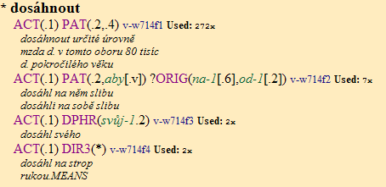
PDT-Vallex Example
PDT-VALLEX Entry
verb: dosáhnout
meaning 1: to reach sth
meaning 2: to get sb to do sth
meaning 3: …
meaning 4: …

Slide 6
Valency entry content I
Principle: one frame corresponds to one meaning
Meaning: basic, abstract (phraseological), „empty“ (light verb constructions)
Verb nést (carry)
knihy - books (PAT)
jméno - name (PAT)
kůži na trh - lit: skin-to-market(DPHR)
odpovědnost - responsibility (CPHR)
Frames grouped by t-lemma
t-lemma = basic verb form
6
6

Slide 7
Valency entry content II
1 2 3 4
ACT(1) EFF(4;↓že;↓aby;.s;↓c) ?PAT(o+6) ?ADDR(3)
(napsat, zaznamenat) naťukal jim o tom pár řádků
(write, record) tapped them a few lines about it
naťukat (write, record)
Number of slots
One slot~ one functor
Label of slots
Functors for actants or obl. adjuntcs
Characteristics (obligatoriness)
Obligatory vs. facultative (actants only)
Surface realizations
Canonical form (active voice)
Examples
With a specific lexical filling of the frame, an aid mainly for annotation
Notes
Synonyms, antonyms, aspect
ACT(1) EFF(4;↓že;↓aby;.s;↓c) ?PAT(o+6) ?ADDR(3)
(napsat, zaznamenat) naťukal jim o tom pár řádků
(write, record) tapped them a few lines about it
ACT(1) EFF(4;↓že;↓aby;.s;↓c) ?PAT(o+6) ?ADDR(3)
(napsat, zaznamenat) naťukal jim o tom pár řádků
(write, record) tapped them a few lines about it
ACT(1) EFF(4;↓že;↓aby;.s;↓c) ?PAT(o+6) ?ADDR(3)
(napsat, zaznamenat) naťukal jim o tom pár řádků
(write, record) tapped them a few lines about it
ACT(1) EFF(4;↓že;↓aby;.s;↓c) ?PAT(o+6) ?ADDR(3)
(napsat, zaznamenat) naťukal jim o tom pár řádků
(write, record) tapped them a few lines about it
ACT(1) EFF(4;↓že;↓aby;.s;↓c) ?PAT(o+6) ?ADDR(3) (napsat, zaznamenat) naťukal jim o tom pár řádků
(write, record) tapped them a few lines about it
7
7

Slide 8
Surface Form Realization
Prepositional case
hněvat se ACT(1) PAT(na-1[4])
be angry at sb
Subordinate clause
kontrolovat ACT(1) PAT(4;zda[v];jestli[v];c)
check sth/sb; whether; where, what, etc.
Special lexical, POS, and/or morphol. Properties
stůj co stůj DPHR(co-5,stát-3.S$2<i>$8<2>$11<A>)
no matter what
Surface dependency relation
bere dílo jako umění EFF(.4[{jako,jakožto}:/AuxY])
takes work as art
8
8

Slide 9
Valency & Form
functor (argument) + obligatoriness + surface form
Surface form of a functor (examples):
ACT in nominative (she buys)
PAT in accusative (she buys a book)
ADDR in dative (she bought him a book)
or preposition pro + accusative (she bought a book for him)
… etc.
... but it is not always so simple (as we have already seen)!
PDT-VALLEX Entry:
kupovat (to buy) ACT(.1) PAT(.4) ?ADDR(.3;pro+4) ?ORIG(od+2)

Slide 10
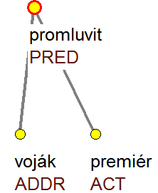
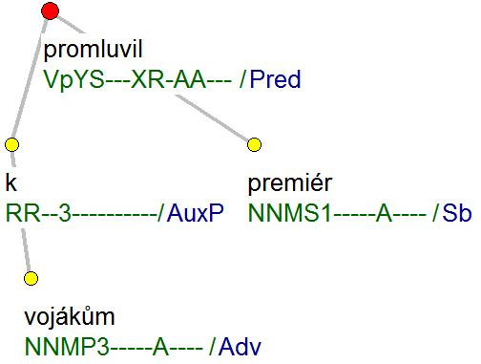
Example Annotation
to-Prep.Dat the-soldiers.Dat talked the-prime-minister.Nom

Slide 11
References
How to cite
Urešová, Zdeňka; Bémová, Alevtina; Fučíková, Eva; Hajič, Jan; Kolářová, Veronika; Mikulová, Marie; Pajas, Petr; Panevová, Jarmila and Štěpánek, Jan (2021). PDT-Vallex: Czech Valency lexicon linked to treebanks 4.0. LINDAT/CLARIAH-CZ digital library at Institute of Formal and Applied Linguistics, Charles University in Prague, http://hdl.handle.net/11234/1-3499
Publications
To be found on the project website https://ufal.mff.cuni.cz/pdt-vallex-valency-lexicon-linked-czech-corpora
Available
separately as PDT-Vallex 4.0,
or as part of PDT-C 1.0

Slide 12
Thank you!

