Slide 1
SynSemClass - an Event-type Ontology in Multiple Languages
Zdeňka Urešová
Institute of Formal and Applied Linguistics
Computer Science School
Faculty of Mathematics and Physics
Charles University, Prague, Czech Republic
Charles University:
J. Hajič (PI 2022-2024), Z. Urešová (PI 2017-2019, project coordinator - Czech, English, German, Spanish, Korean, Chinese), E. Fučíková (IT), J. Straková (Language Models), K. Rysová (German), P. Kašpárek (Korean preparation), V. Tumanian (Chinese)
DFKI and Univ. of Potsdam:
K. Zaczynska, P. Bourgonje, G. Rehm
University of Granada:
C. F. Alcaina, A. E. R. Gómez, C. L. Clares
Supported by LUSyD (GAČR, GX20-16819X), using resources of LINDAT/CLARIAH-CZ RI (MŠMT ČR, LM2018101).

Slide 2
Outline
Background
FGD Valency + Contextual Synonymy
SynSemClass
Goal + Content + Structure
Resources
Links
Annotation workflow
Editor
Live web version for browsing (and searching in the future)

Slide 3
Background
Valency
FGD – dependency oriented, multilayered approach –> deep syntax
valency frame: dát [give] ACT(1) PAT(4) ADDR(3)
She.ACT gave him.ADDR a book.PAT
Synonymy
loose: similar or overlapping meaning
contextually-based
synonym class cross-lingual group of synonymous verbs (verb senses) with arguments mapped to a common set of semantic roles

Slide 4
SynSemClass
Goal
tool for the annotation of the Knowledge Representation
“bottom-up” approach, starting with evidence in corpus
Content
~800 Classes Cz-Eng
~9000 Class Members synonymous verb senses with similar meaning
Languages Czech, English, German, Spanish, Korean, Chinesse, Polish
Based on parallel (translated) corpus
Freely available http://hdl.handle.net/11234/1-4746

Slide 5
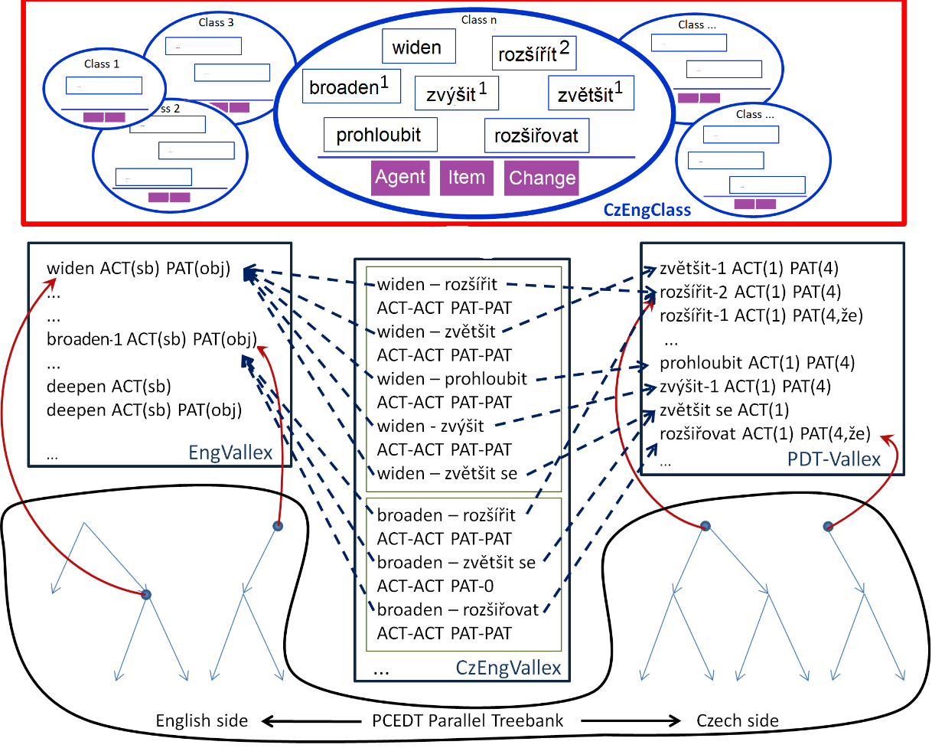
Structure
Common
Synonym Classes
RoleSet of Semantic Roles
Lang-dependent
Class Members
Role-Argument Mapping
Links
Examples

Slide 6
Resources
Eng:
The Prague Ces-Eng Dependency Treebank, EngVallex, CzEngVallex
Ces
The Prague Ces-Eng Dependency Treebank, PDT-Vallex, CzEngVallex
Deu
ParaCrawl corpus, (E-Valbu, GUP)
Spa:
X-SRL corpus, AnCora

Slide 7
Links
Eng
FrameNet, OntoNotes,VerbNet, PropBank, WordNet
Deu
FrameNet des Deutschen, E-Valbu lexicon, GUP, Deu Woxicon
Spa
SenSem, ADESSE, Spa WordNet, Spa FrameNet, Spa Woxicon
Part of “human” understanding of the associated concept
Allows for comparison, mapping, re-annotation etc.
Aiming at: Linguistic Linked Open Data (LLOD)

Slide 8
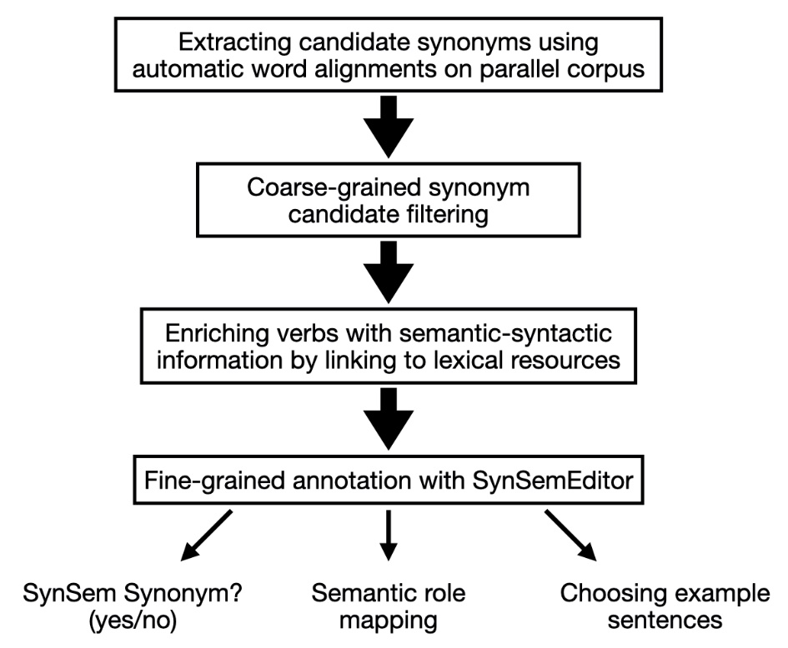
Annotation workflow
Manual annotation steps
Filtering (CM status)
Roles
Mapping
Links
Examples

Slide 9
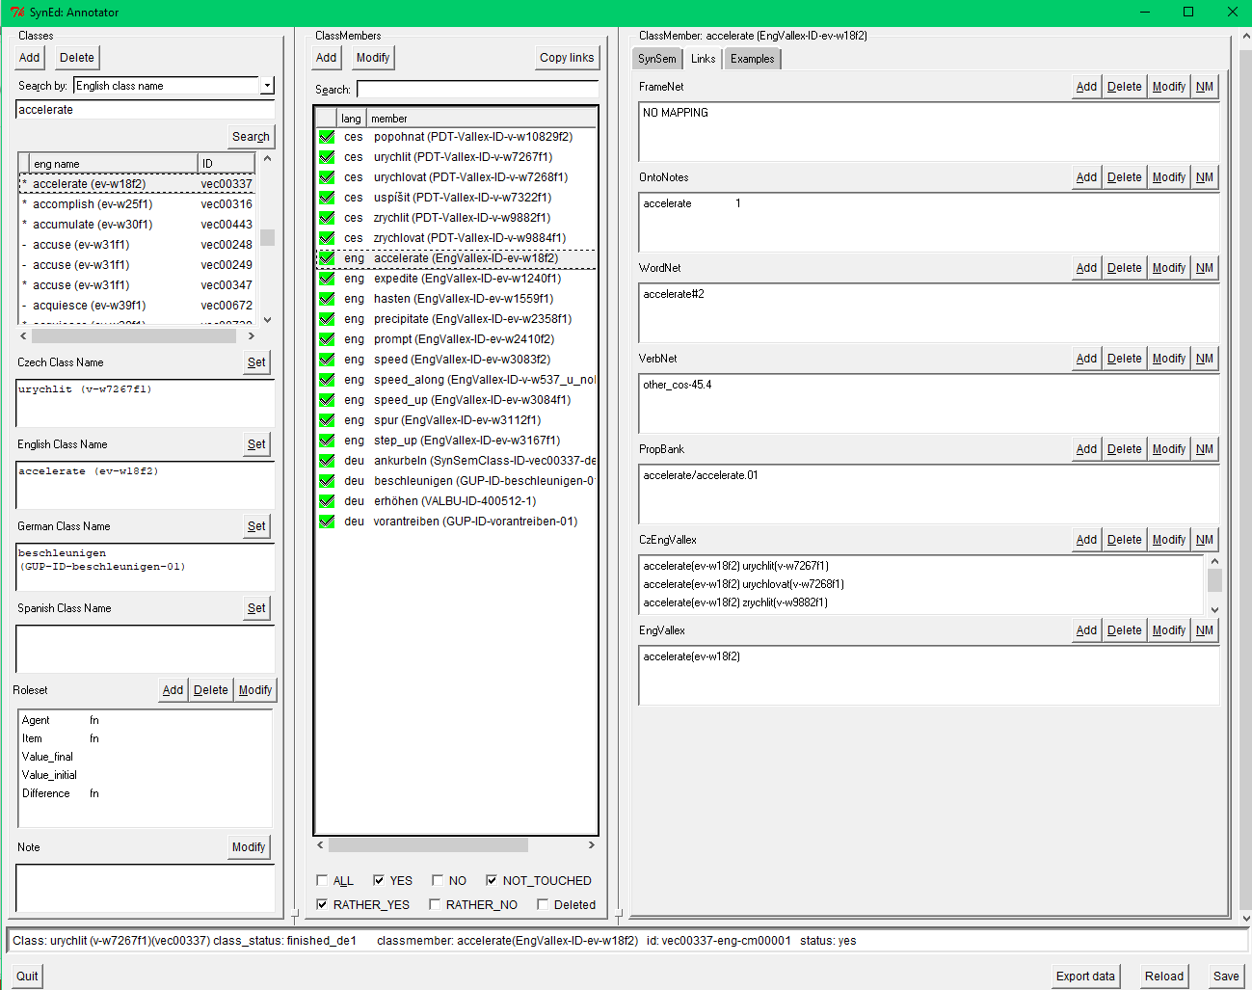
Editor
Synonym Classes
Editable Info for the Selected Class (Concept) “accelerate”
Ces
Class name
Info about the CM selected
for editing
Examples
Eng
Class name
Deu
Class name
Links
Spa
Class name
RoleSet

Slide 10
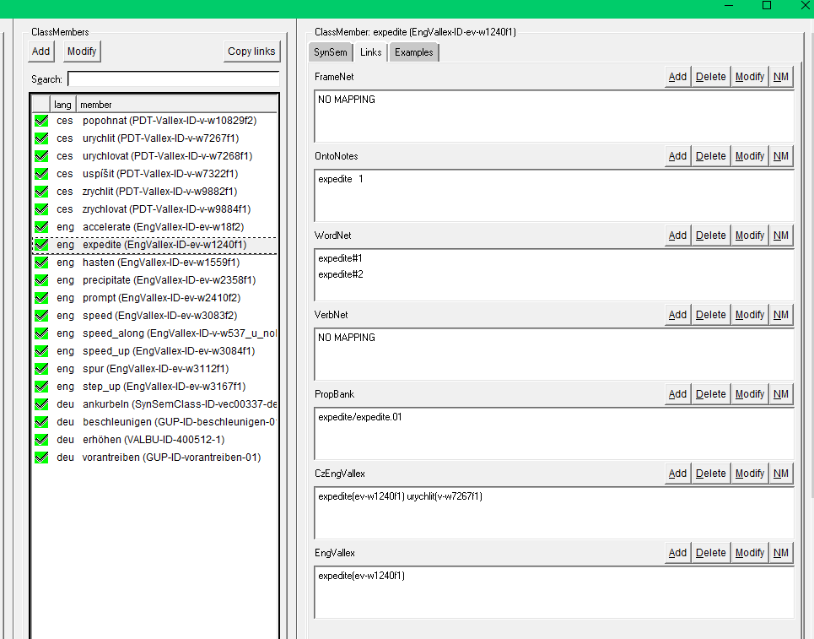
Editor - Links
Links for the CM selected

Slide 11
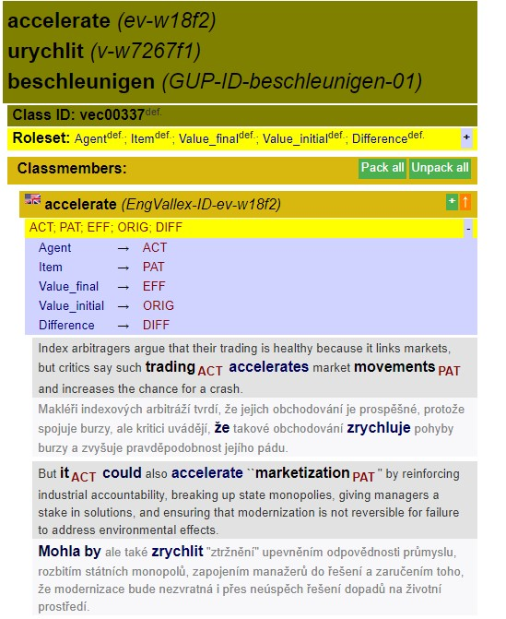
Class multilingual concept
Class definitions
Class’ common roleset
Roles’ definitions
Role_Argument Mapping
Examples

Slide 12
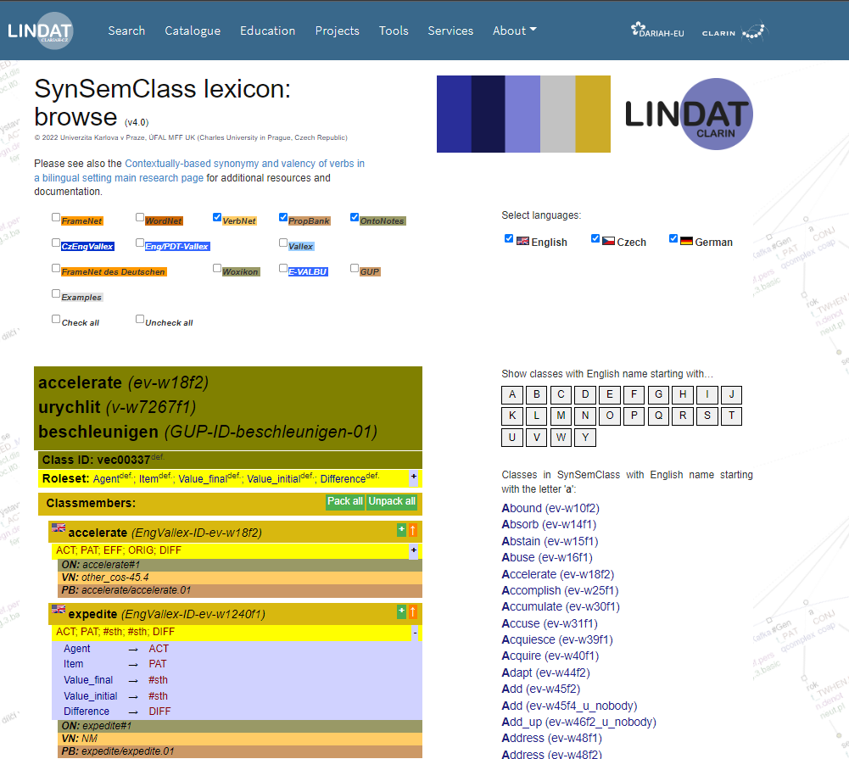
Web Browser LINKS
Selected Links
Links for
the CM “expedite”

Slide 13
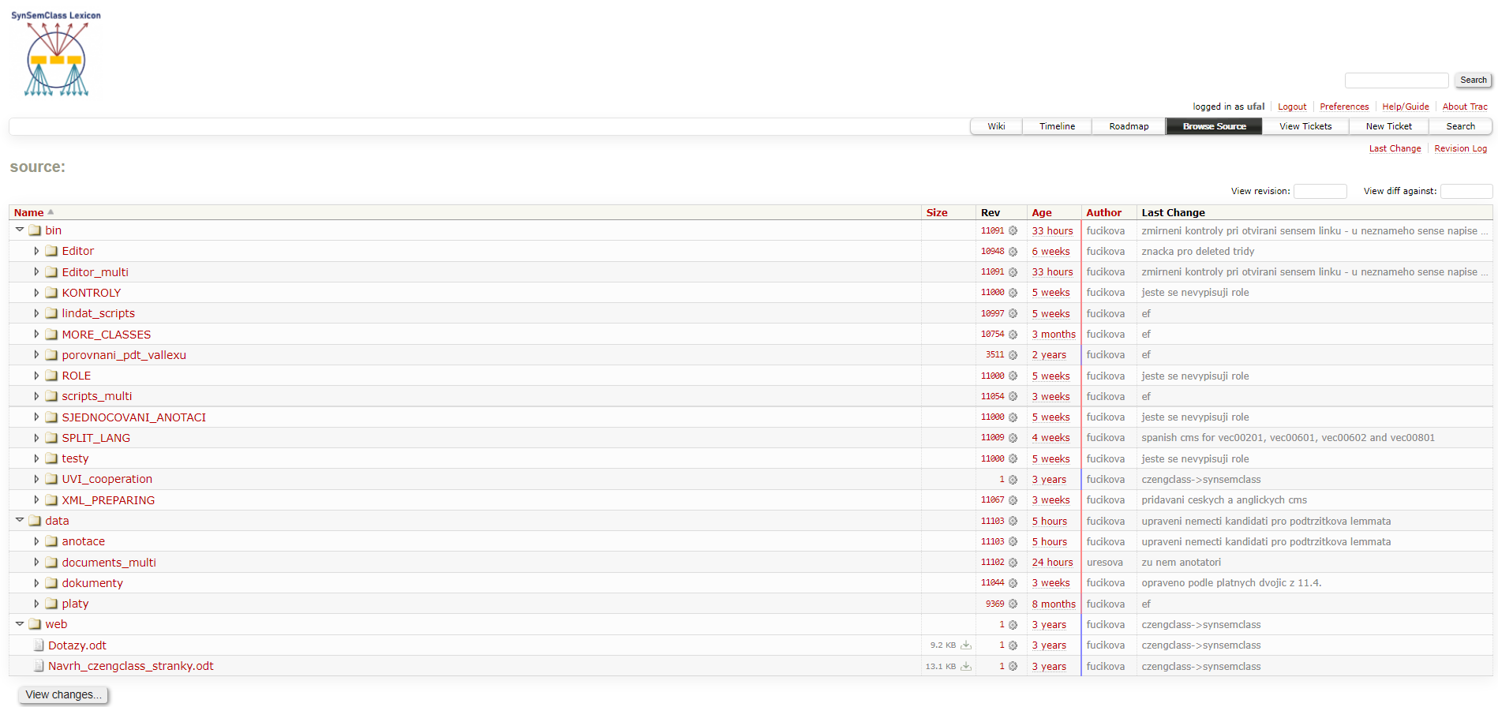
SVN
GITHUB

Slide 14
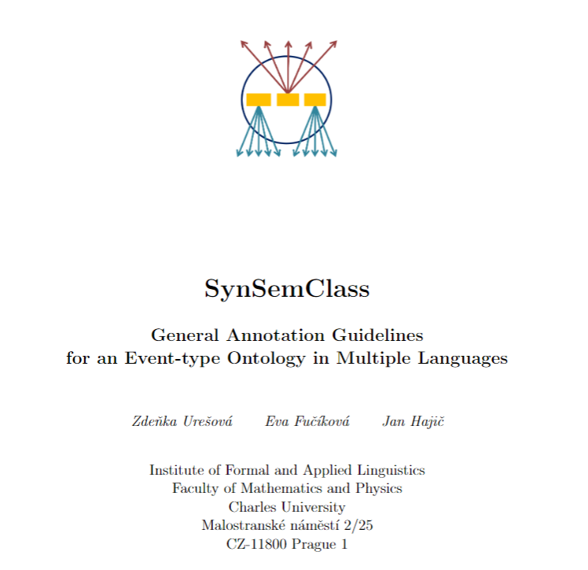
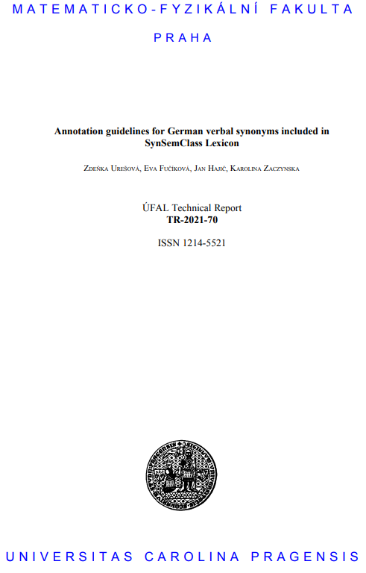
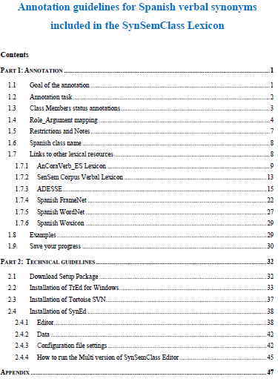
Guidelines
General for all Languages
Languag-specific
German
Languag-specific
Spanish

Slide 15
References
Quoting SSC
Urešová, Zdeňka; et al., 2022, SynSemClass 4.0, LINDAT/CLARIAH-CZ digital library at the Institute of Formal and Applied Linguistics (ÚFAL), Faculty of Mathematics and Physics, Charles University, http://hdl.handle.net/11234/1-4746.
Publications relating to SSC
To be found on the project website https://ufal.mff.cuni.cz/synsemclas.
Web browsing (+ free for download)
https://lindat.cz/services/SynSemClass40

Slide 16
thankyou
Thank you, for your attention and
to
all my annotators
Czech and English
Petr Kujal, Markéta Malcová, Tomáš, Razím, Anna Staňková, Darya Klambotskaya, Katie Conger
German
Charlotte Friedrich, Danny Srp, Kateřina Rysová (Anna Fišerová, Ilyas Zivana)
Spanish
Alba E. Ruz Gómez, Cristina Lara Clares

