Slide 1
End-to-end Neural Dialogue Systems
Ondřej Dušek
VOCALLS AI Afternoon 19.10.2022

Slide 2
Dialogue systems
Standard architecture (text-based):
Natural language understanding
user utterance → user dialogue act (DA)
Dialogue state tracking
update user preferences based on DA
Dialogue policy
choose next action based on state
system DA
consult DB if needed
Natural language generation
express system DA as a sentence
inform(food=Chinese)
NLU
food: Chinese
price: cheap
area: ?
I’m looking for a cheap Chinese place
tracking
🗣
policy
DB
many results
What area would you prefer?
NLG
request(area)

Slide 3
End-to-end neural systems
Standard approach: Pipeline
each module built separately
NLU typically trained (or combined with rules)
Tracking could be either
Policy, DB, NLG: rules, templates
problem: error accumulation
End-to-end models: remove the pipeline
NLU/Tracking/Policy/NLG is one neural network
generate response word-by-word
DB must be external → 2-step operation
trained on (many) example dialogues

Slide 4
Neural language models
Transformer neural architecture
(sub)word representation: embedding = vector of numbers
blocks: attention (combining context) + fully-connected (abstracting)
predicting next (sub)word = classification: choosing 1 out of ca. 50k (probabilistic)
trained from data: initialize randomly & iteratively improve
Pretrained models
Transformers trained on vast amounts of data
Self-supervised training: just naturally occurring text & simple tasks
predicting next word
predicting masked word
fixing corrupt sentences …
Lot of them released online, plug-and-play
https://github.com/huggingface/transformers

Slide 5
Transformer neural language model
predicting next word
Transformer block: attention & fully connected
embeddings
0.4 -0.3 2.1 -0.2
-1.1 0.8 -0.9 4.3
numbered
(sub)words
0.0 2.7 -0.6 -3.0
…
multiple layers
encoding position
generation: predicted word fed back in

Slide 6
Multi-domain dialogue (MultiWOZ, DSTC9)
MultiWOZ: benchmark for task-oriented dialogue in multiple domains
hotels, restaurants, attractions, trains, taxi, police, hospital
domains are connected (e.g. taxi from hotel to attraction)
10k dialogues, extensive annotation (but noisy!)
1.
user: I am looking for a train from Cambridge to London Kinks Cross.
state: {train {departure = cambridge, destination = london kings cross}}
DB: {train (70) {…}}
[count] [departure] [destination]
system: There are 70 trains departing from Cambridge to London Kings Cross. What day would you like to travel?
user: I would like to leave on Saturday after 18:45.
state: {train {day = saturday, departure = cambridge, destination = london kings cross, leave at = 18:45}}
DB: {train (3) {arrive by = 19:51,21:51,23:51; id = TR0427,TR0925,TR4898; leave at = 19:00,21:00,23:00; … }}
[id] [leave_at] [arrive_by]
system: TR0427 leaves at 19:00 and arrives by 19:51 . Would you like to book this train?
user: Yes, I would like to book it for eight people.
[reference]
system: I have booked it for you. Your reference number is 00000057. Is there anything else I can help you with?
user: I am also looking for an expensive restaurant in the centre.
belief: {restaurant {area = centre, price range = expensive} train {...}}
DB: {restaurant (33) {area = centre (33); name=Curry Garden, ...; ...}, ...}
[count] [price_range] [area]
system: There are 33 expensive restaurants in the centre. Is there a particular type of food you would like?
2.
3.
4.
Notes:
mention slot filling, delexicalization, DSTC9

Slide 7
End-to-end Neural Dialogue with GPT-2
GPT-2: one of most popular pretrained language models
Transformer
pretrained on next-word prediction
8M docs, 40GB data from the web
Dialogue: GPT-2 finetuned (=further trained) on dialogue data (MultiWOZ)
Single neural network, fits Transformer operation
Multi-step, all word-by-word:
feed in dialogue context (← ignore generation outputs for this bit)
generate dialogue state (as text)
query DB
feed in DB results as text (← ignore outputs)
generate response
https://huggingface.co/gpt2
https://github.com/ufal/augpt

Slide 8
End-to-end Neural Dialogue with GPT-2
DB queried here
output tokens
generate state
generate system output
train
{
destination
Cambridge
}
There
are
over
1,000
[destination]
departing
trains
Where
you
from
<eos>
to
.
will
be
?
(output ignored)
<db>
(out. ign.)
Transformer layers
embeddings
to
.
will
be
?
<usr>
destination
trains
Where
you
from
I’m
[destination]
departing
looking
for
a
train
to
Cambridge
<ds>
train
{
Cambridge
}
<db>
train
1113
matches
<sys>
There
are
over
1,000
user input
prev. state toks.
DB output
previous output tokens
input tokens

Slide 9
Problems & solutions
Needs a lot of data & annotation (1000s of dialogues)
costly, may be noisy
→ transfer learning, data augmentation
Hallucinates sometimes
may generate factually incorrect outputs, hard to control
→ data cleaning, consistency training (corrupt data & train to detect this)
Repetitive/dull outputs
settles for the most frequent output
→ sampling (randomness)
Still a long way to go
~70% correct/successful dialogues
still needs a lot of data

Slide 10
Thanks
Contact me: odusek@ufal.mff.cuni.cz http://ufal.cz/ondrej-dusek
Credits:
Our work: https://github.com/ufal/augpt
These slides: https://bit.ly/e2e-ds-vocalls
Vojtěch Hudeček
Jonáš Kulhánek
Tomáš Nekvinda

Slide 11
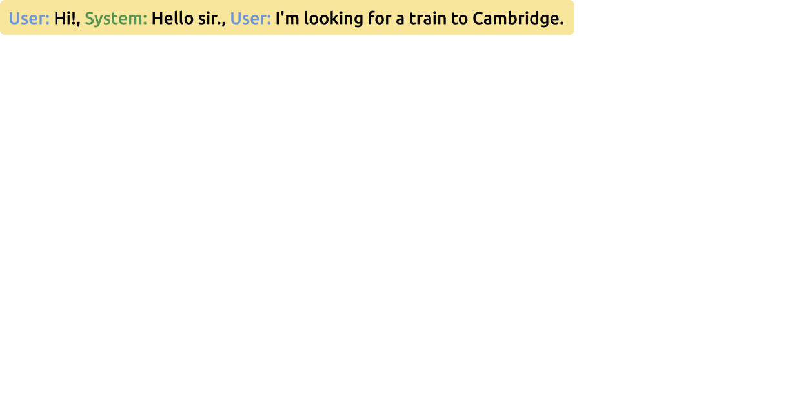
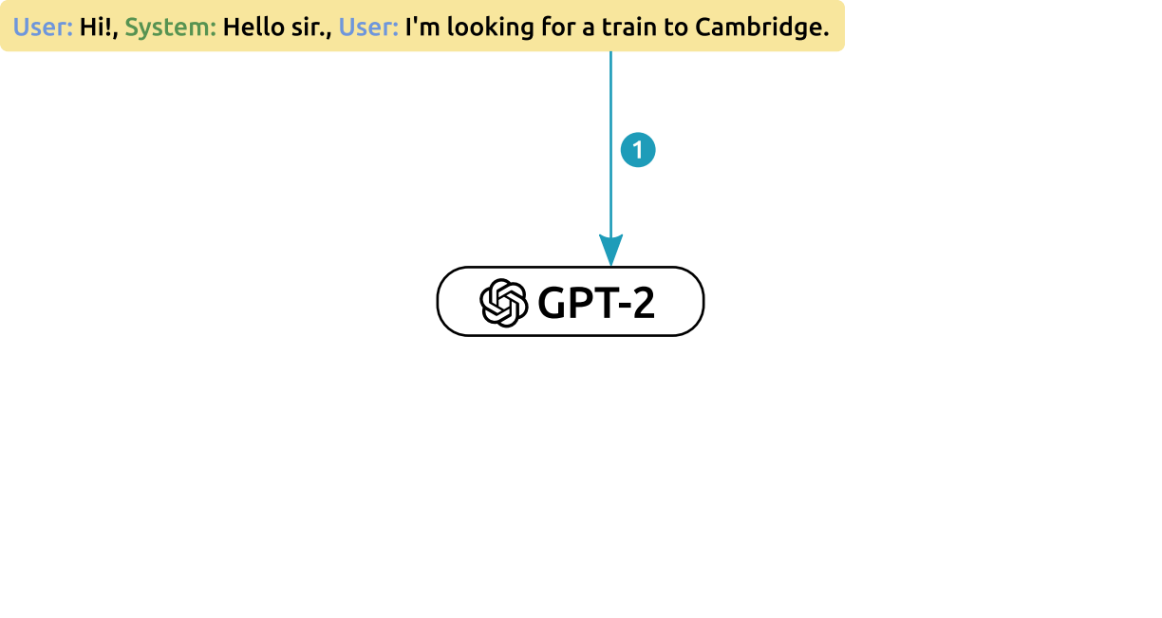
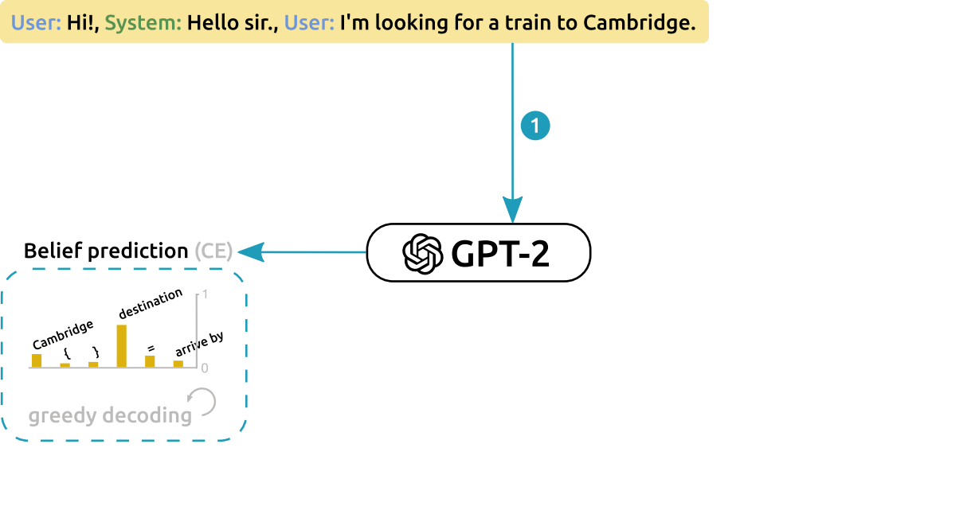
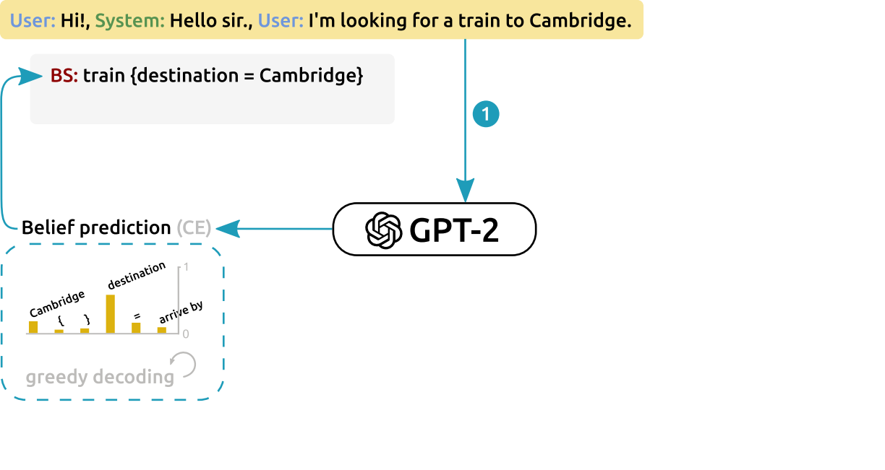
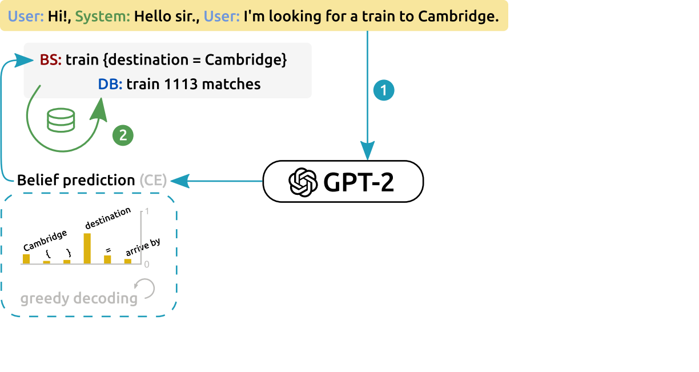
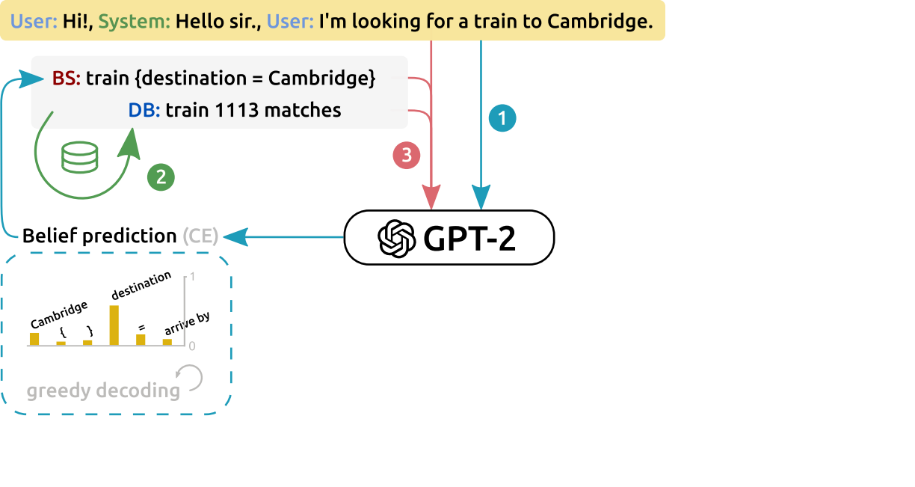
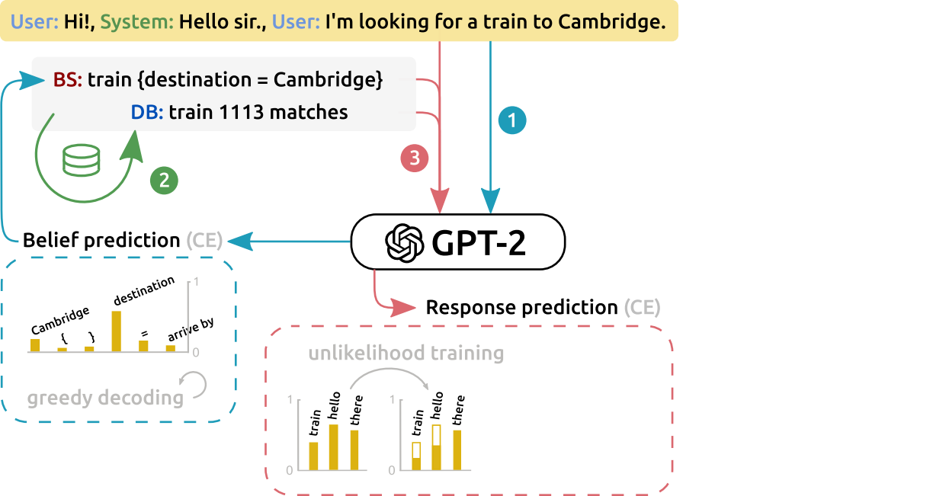
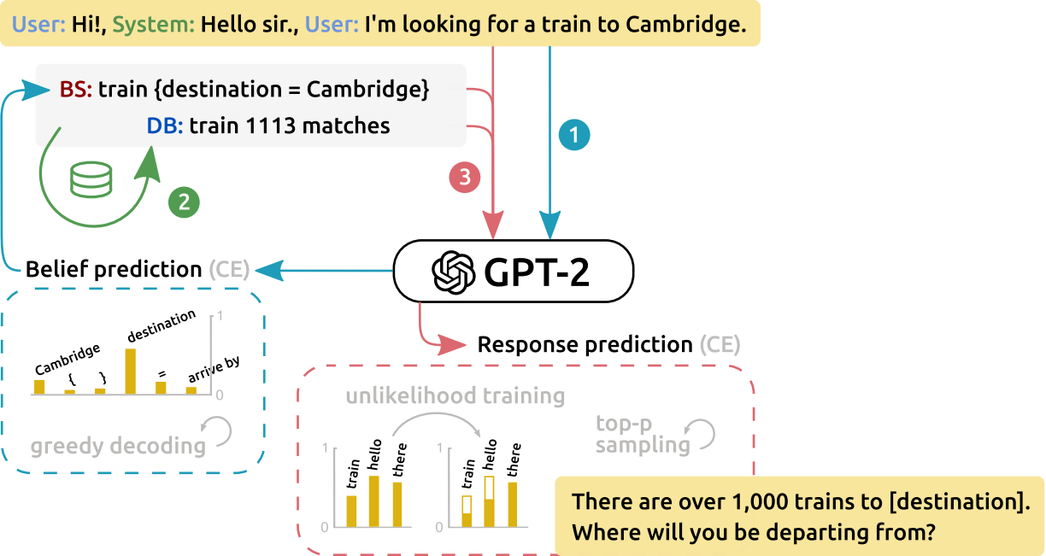
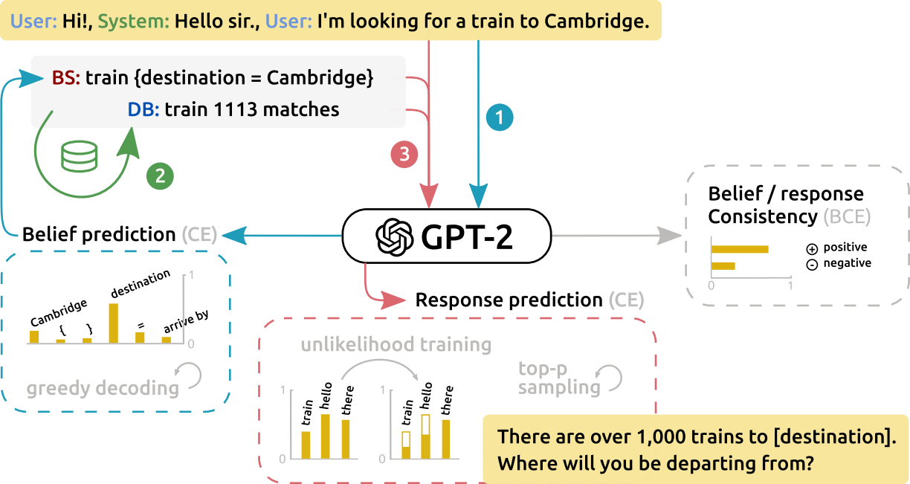
AuGPT architecture
Same principle, multiple improvements
based on SOLOIST
Operation:
context → belief state
greedy decoding
text-like belief state
belief state → DB
text-like DB results
DB → response
top-p sampling (diversity)
delexicalized (slot placeholders)
Training:
belief/response prediction + consistency (Y/N)

Slide 12
Consistency task
Additional training task – generating & classifying at the same time
additional classification layer on top of last decoder step logits
incurs additional loss, added to generation loss
Aim: robustness – detecting problems
½ data artificially corrupted – state or target response don’t fit context
SOLOIST: corrupted state sampled randomly
AuGPT: corrupted state sampled from the same domain – harder!
context
state
response
consistent?
i want a cheap italian restaurant { price range = cheap , food = Italian } ok which area ?
✅
i want a cheap Italian restaurant { price range = cheap , food = Italian } thanks, goodbye !
❎
bad response
i want a cheap italian restaurant { destination = Cambridge , leave at = 19:00 } ok which area ?
❎
SOLOIST
bad state
i want a cheap italian restaurant { area = north , food = Chinese } ok which area ?
❎
bad state (same domain)
new in AuGPT

Slide 13
Results
 | succ | inf | BLEU
SOLOIST | 85.5 | 72.9 | 16.5
DAMD | 76.3 | 60.4 | 16.6
LAVA | 91.8 | 81.8 | 12.0
AuGPT | 83.1 | 70.1 | 17.2
Corpus-based MultiWOZ 2.0
Corpus-based evaluation: competitive
1-turn – uses gold contexts
Simulator: much better
runs whole dialogue
good 1-turn $≠$ good over whole dialogue!
DSTC9 competition – humans
beats the baseline (4 out of 10)
3rd overall, 1st if DB consistency ignored
shortest dialogues needed
Ablation
simulator + corpus
confirms our new features (unlikelihood & data cleaning – sim only)
 | cpl | succ | inf F1 | book
DAMD | 39.5 | 34.3 | 56.3 | 51.4
AuGPT | 89.4 | 60.1 | 70.1 | 85.7
ConvLab 2 simulator
 | succ+DB | succ-DB | # turns
baseline | 56.8 | 82.4 | 18.5
winner | 70.2 | 79.4 | 18.5
AuGPT | 62.0 | 82.6 | 17.1
DSTC9
Notes:
complete rate = system

Slide 14
Error analysis
We talked to the system & recorded errors
130 dialogues, goals from test set
50 erroneous dialogues, 17 unsuccessful
success rate ~87%
most errors recoverable
correct behavior in many non-trivial cases
Errors categorized
hallucinated values (21) – non-grounded slots
wrong lexicalization (6) – repeated values
missing information (5) – over-eager booking
ignored input (5) – asks for the same thing repeatedly
…

