Slide 1
Interplay of Coreference and Discourse
Research and Annotations
Anna Nedoluzhko
Charles University, Prague

Slide 2
Outline
Corpora Annotated with Coreference and Discourse Relations
Coreference to Discourse Transitions
structural
diachronic
Examples of Coreference $↔$Discourse Interplay (not only) from Prague Dependency Treebank
Other Dimensions (TFA, Salience)
What Does It Mean? (= Conclusions)

Slide 3
Coreference + Discourse
Maybe together again?
(many dreams, incl. Poesio et al. 2016)
coreference
Cohesion
Coherence
(Halliday&Hasan 1976 …)
discourse
Notes:
direction is rather from coreference to discourse as from smth easier to smth more complex. Coreference is used in the discourse parsing.
As for from discourse to coreference direction, Webber, Grishina: find smth anaphoric in discourse connectives.

Slide 4
Coreference annotation
Discourse annotation
MUC corpora (Hirschman, 1998)
ACE corpora (Doddington et al. 2000)
Ontonotes (Pradhan et al.)
AnCora (Recasens et al.)
MATE, (Poesio et al.)
GNOME (Poesio et al.)
ARRAU (Poesio et al.)
Postdam Commentary Corpus (coref. Stede, Grishina et al.)
Prague Dependency Treebank (coref. Nedoluzhko et al.)
Polish Coreference corpus (Ogrodniczuk et al.)
GECCo (Kunz et al.)
Penn Discourse Treebank (Prasad et al.)
RST Discourse Treebank (Carlson et al. 2003)
CatDiG (Badia et al.)
RST signalling corpus (Dag&Taboada)
Postdam Commentary Corpus (Neumann, Stede)
DISCOR and ANNODIS (Afantenos et al.)
PragueDT (discourse: Zikánová, Poláková et al.)
DiscAn (Sanders et al.)
GECCo (Kunz et al.) …
+EntRels

Slide 5
Coreference annotation
Discourse annotation
MUC corpora (Hirschman, 1998)
ACE corpora (Doddington et al. 2000)
Ontonotes (Pradhan et al.)
AnCora (Recasens et al.)
MATE, (Poesio et al.)
GNOME (Poesio et al.)
ARRAU (Poesio et al.)
Postdam Commentary Corpus (coref. Stede, Grishina et al.)
Prague Dependency Treebank (coref. Nedoluzhko et al.)
Polish Coreference corpus (Ogrodniczuk et al.)
GECCo (Kunz et al.)
Penn Discourse Treebank (Prasad et al.)
RST Discourse Treebank (Carlson et al. 2003)
CatDiG (Badia et al.)
RST signalling corpus (Dag&Taboada)
Postdam Commentary Corpus (Neumann, Stede)
DISCOR and ANNODIS (Afantenos et al.)
PragueDT (discourse: Zikánová, Poláková et al.)
DiscAn (Sanders et al.)
GECCo (Kunz et al.) …
+EntRels

Slide 6
SDRT
Penn Discourse Treebank (PDTB)
DISCOR
DisFrEn
LUNA corpus
CatDiG
ANNODIS (French)
French Discourse Treebank
PDTB-like
Hobbs
Discourse
Graphbank
Prague Dependency Treebank (PDT)
STAC
Turkish Discourse Bank
RST discourse treebank
RST signalling corpus
Disco-SPICE
Postdam Commentary Corpus
RST-like
CCR
RST Spanish Corpus
DiscAn Corpora
Basque-Spanish-English parallel corpus
Halliday and Hasan
HMC (Hungarian)
Basque RST Treebank
GECCo

Slide 7
SDRT
Penn Discourse Treebank (PDTB)
DISCOR
DisFrEn
LUNA corpus
CatDiG
ANNODIS (French)
French Discourse Treebank
PDTB-like
Hobbs
Discourse
Graphbank
Prague Dependency Treebank (PDT)
STAC
Turkish Discourse Bank
RST discourse treebank
RST signalling corpus
Disco-SPICE
Postdam Commentary Corpus
RST-like
CCR
RST Spanish Corpus
DiscAn Corpora
Basque-Spanish-English parallel corpus
Halliday and Hasan
HMC (Hungarian)
Basque RST Treebank
GECCo

Slide 8
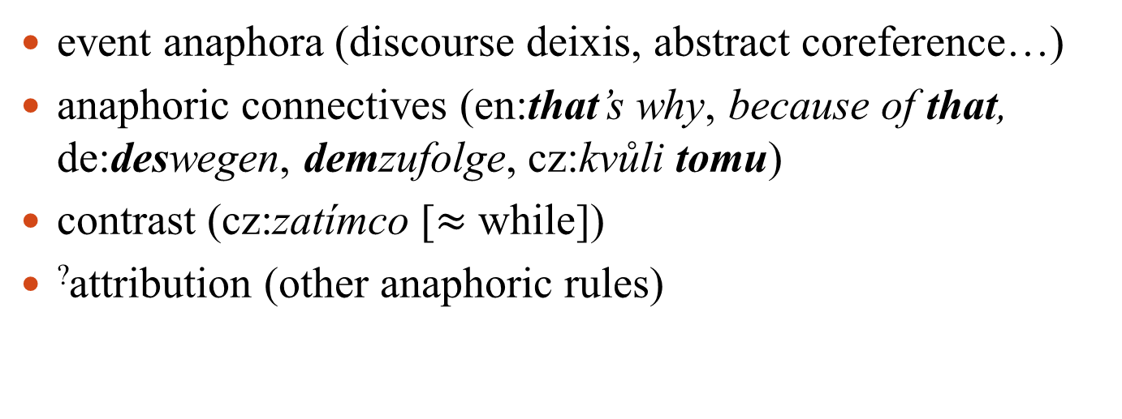
Coreference + Discourse Relations
Coref
Disc
entity-based of discourse-based coherence
coreference $↔$ logico-semantic relations
bridging relations $↔$ logico-semantic relations
(co-existing)
Coref
Disc
(overlapping)
event anaphora (discourse deixis, abstract coreference…)
anaphoric connectives (en:that’s why, because of that, de:deswegen, demzufolge, cz:kvůli tomu)
contrast (cz:zatímco [$≈$ while])
?attribution (other anaphoric rules)

Slide 9
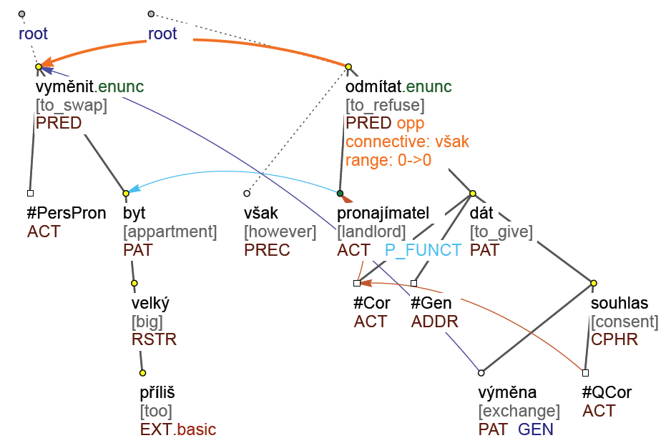
Bridging, Coreference and Discourse
opposition
from PDT
Coref
Disc
bridging
(co-existing)
event
anaphora
Chtěl bych vyměnit příliš velký byt. Pronajímatel však odmítá dát k výměně souhlas.
$≈$ lit. en. I’d like to swap an apartment that is too big. However, the landlord refused to give consent to the exchange.

Slide 10
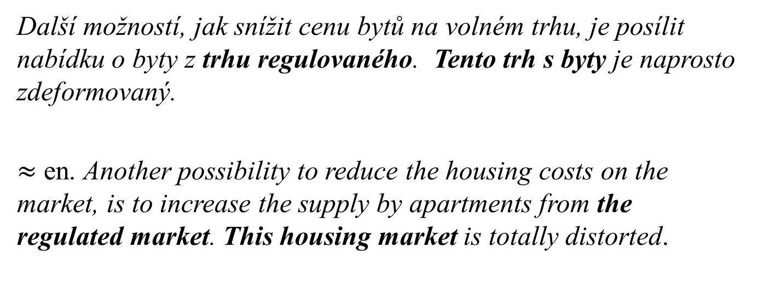
Coreference and Discourse: co-existing
from PDT
Další možností, jak snížit cenu bytů na volném trhu, je posílit nabídku o byty z trhu regulovaného. Tento trh s byty je naprosto zdeformovaný.
$≈$ en. Another possibility to reduce the housing costs on the market, is to increase the supply by apartments from the regulated market. This housing market is totally distorted.
Sent. 1
Sent. 2
(implicit) opposition
coreference

Slide 11
Coreference → Discourse: Event anaphora
Coref
Disc
Ted arrived late. He wanted to irritate Mary.
…..
…..
Ted arrived late. This irritated Mary.
Ted arrived late. His late arrival irritated Mary.
Ted arrived late. Mary was really irritated that he was late.
Ted arrived late. It was impossible for him to come on time.
elaboration
explanation
specification
explication
equivalence
reformulation
examplification
generalization

Slide 12
Event anaphora + discourse
from PDT
(1) Loňské léto bylo v Uherském Hradišti dost bouřlivé […].
(2) Juran musel budovat tým za pochodu v rozeběhnuté soutěži...
(3) Já to považuji za výhodu.
(4) Když přijde trenér do hotového mužstva, musí vycházet z hráčů, které má, a tomu přizpůsobit hru.
(1) Last summer in Uherske Hradiste was quite stormy.
(2) Juran had to build a team during the competition.
(3) I consider this to be an advantage.
(4) When a new trainer comes to an already completed team, he must base the strategy on the players he has, and to adapt the game to them.
Sent. 1
Sent. 2
explication
coreference

Slide 13
Anaphoric Connectives
coreference
Ted was a great cook. Mary loved him for this.
Ted was a great cook. This is why Mary loved him.
that’s why
Ted was a great cook. Therefore she loved him.
Ted was a great cook. So she loved him.
thus
discourse
German trotz dem → trotzdem, Czech kvůli tomu, přestože

Slide 14
Conclusion
coreference-discourse interplay is richer in discourse
discourse perspective is ‘deeper’
different weight of coreference relations for textual coherence
‘important’ coreference is not accidental (thematic progressions, information structure, ...)
there are standard transfers from coreference to discourse (for this – therefore, event anaphora – coreference between events)
other topics (saliences, information structure, ellipses, attribution)

Slide 15
References
S.Botley, et al. (eds.) 1999. Corpus-based and Computational Approaches to Discourse Anaphora
Laurence Danlos, Bertrand Gaiffe. Event coreference and discourse relations. L. Kulda. Language, Music and Cognition, Kluwer Academic Publishers, 2004.
M.A.K. Halliday & Ruqaiya Hasan. Cohesion in English. 1976
E. Hovy, M. Marcus, M. Palmer, L. Ramshaw, and R. Weischedel. 2006. Ontonotes: the 90% solution. In NAACL-HLT.
Lapshinova-Koltunski, E. and Kunz, K. (2014). Annotating cohesion for multillingual analysis. LREC.
Louis Annie, Aravind Joshi, Rashmi Prasad, Ani Nenkova. (2010) Using entity features to classify implicit discourse relations.
M. Poesio et al. Anaphora Resolution. Algorithms, Resources, and Applications. 2016.
Brian Reese, Julie Hunter, Nicholas Asher, Pascal Denis and Jason Baldridge. Reference Manual for the Analysis and Annotation of Rhetorical Structure. 2007 (DISCOR)
B. Webber, A. Joshi, M. Stone, A. Knott. Anaphora and Discourse structure. ACL, 1994
... and many others

Slide 16
Acknowledgements
We acknowledge the support from the Grant Agency of the Czech Republic (grant 16-05394S). This work has been using language resources developed and stored and distributed by the LINDAT/CLARIN project of the Ministry of Education, Youth and Sports of the Czech Republic (project_LM2015071).

Slide 17
Thank you!
coreference
discourse

