Slide 1
Overview
Annotation of textual phenomena in the Prague Dependency Treebank (April 27)
Coreferential expressions in English and Czech (April 28)
Coreference in Czech and cross-lingually – ideas and perspectives (April 30)
“made in ÚFAL” Institute of Formal and Applied Linguistics, Charles University in Prague, Faculty of Mathematics and Physics)
Notes:
В последней лекции расскажу про проблемы,
А еще про то, что можно делать с нашими данными, например, вместе

Slide 2
Coreferential expressions in English and Czech
Michal Novák, Anna Nedoluzhko
Warsaw, 28.4.2015

Slide 3
Example
EN: It switched to a caffeine-free formula ∅ using its new Coke in 1985. CS: V roce 1985 ∅.ACT přešla na bezkofeinovou recepturu, kterou používá pro svoji novou kolu.
different languages use different means of expressing coreference (or they prefer some more than the others)
parallel English – Czech annotated corpus
comparison in terms of syntax and deep syntax

Slide 4
Motivation
NLP tasks
anaphor detection – categories helping to improve mention detection
bilingual coreference resolution (= treebanking)
co-training [Blum and Mitchell, 1998] with language-dependent feature sets – use semi-supervised technique of ML: co-training using two set of features (2 languages), resulting in systems working on monolingual texts
MT via deep syntax: TectoMT [Popel and Zabokrtsky, 2010]
Theoretical
linguistic typology
grammatical structure of individual languages
preference for different types of constructions – translatology, etc.

Slide 5
Workflow
Parallel treebank

Slide 6
Workflow
Parallel treebank
Classes of nodes

Slide 7
Workflow
Parallel treebank
Classes of nodes
Alignment

Slide 8
Workflow
Parallel treebank
Classes of nodes
Alignment
Statistics of counterparts
statistics, examples, analysis

Slide 9
Related Work
Theoretical linguistics and typology
Referent activation theories (theory of topicality in [Givon, 1983]; hierarchy of referential devices in [Ariel, 2015]; neural networks model for pronominal choice in [Kibrik, 1997], [Kibrik, 2011]; saliences in [Hajicova et al., 2006])
Analysis of one language vs. linguistic typology
Corpora: Postolache et al., 2006 [Rom-En], Guillou et al., 2014 [DE-EN ParCor], Bojar et al., 2012 [CzEng]
Corpus-based studies: (Kunz and Lapshinova-Koltunski, 2015; Zinsmeister et al., 2012)
NLP applications: coreference projection: de Souza and Orasan, 2011, Postolache et al., 2006, Rahman and Ng, 2012; Ogrodniczuk, 2013
Czech-English comparison: [Onderkova, 2009], [Veselovska et al., 2012], [Novak et al., 2013], [Novak and Zabokrtsky, 2014])
Notes:
доделать по статье, которую мы посылаем

Slide 10
PCEDT
Prague Czech-English Dependency Treebank [Hajic et al., 2012]
English Wall Street journal texts translated to Czech sentence by sentence
1.2 million words in almost 50,000 sentences for each language
annotated on morphological (m-layer), analytical (shallow syntactic, a-layer) and tectogrammatical (deep syntactic, t-layer),
sentence-aligned, word-aligned
t-layer includes
semantic labeling of content words and coordinating conjunctions
argument structure description based on a valency lexicon
coreference annotation
ellipsis reconstruction
Notes:
поискать в презентациях про ПСЕДТ красивые картинки про синтаксические уровни

Slide 11
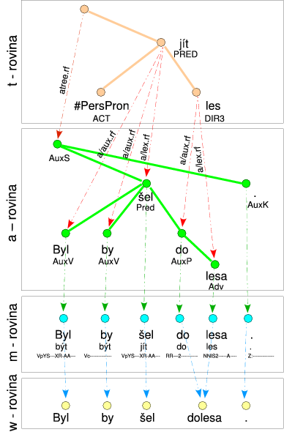
Byl by šel dolesa.
(He) would go to the forest.

Slide 12
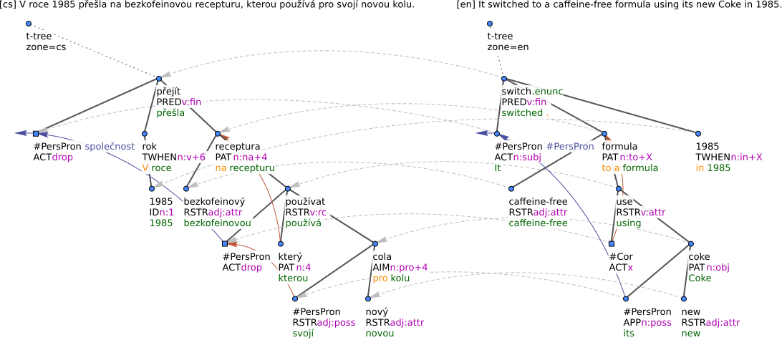
PCEDT – sample tree and alignment
Notes:
derevja

Slide 13
PCEDT - Coreference
Grammatical coreference
Coreference with reflexive pronouns,
My daughter likes to dress herself without my help;
Coreference with relative elements (pronouns and pronominal adverbs),
Alex is the boy who kissed Mary;
Control (with control verbs, e.g. begin, let, want, etc.)
Peter wants to Ø.ACT sleep;
Coreference with verbal modifications that have dual dependency,
John saw Mary Ø.ACT run around the lake;
Coreference in constructions with reciprocity. John and Mary kissed Ø.PAT
Textual coreference
Helen asked her mother to wait for her but mother did not agree.

Slide 14
Data subset under analysis
a first half of the PCEDT section 19, particularly the 50 documents from wsj 1900 to wsj 1949
manual annotation of word alignment

Slide 15
Classes of inspected expressions
Central pronouns
Relative pronouns
Anaphoric zeros

Slide 16
Central pronouns
Personal pronouns in the third person (he, she, him, her, etc.)
Possessive pronouns (his, her, mine, etc.)
Reflexive pronouns (myself, themselves, etc.)
Reflexive possessive pronoun (svůj)
English central pronouns that do not have their own representation on the t-layer (the pleonastic usage of the pronoun it, such as in It is possible that. . . )
!!! Central pronouns must be expressed on the surface!

Slide 17
Relative pronouns
Relative pronouns (which/který, etc.)
Relative that with heuristics excluding suborsinate conjunctions
Relative adverbs that act like relative or interrogative pronouns (in English, e.g., how, where, why etc.), in Czech kde (where) and kdy (when)
Relative pronouns which are not represented by its own node on the t-layer
Numeral kolik (how much/many)

Slide 18
Anaphoric zeros
$Ø$ Zanechal mu zprávu, ve které $Ø$viní Darmana ze zaprodanosti.
[=En He left a message $Ø$accusing Mr. Darman of selling out.]
John bumped into Mary $Ø$riding a bike.

Slide 19
Classes of inspected expressions
We covered 99% and 95% of coreferential nodes in English and Czech, respectively.

Slide 20
Original alignment
original alignmnet of t-nodes in PCEDT
unsupervised: GIZA++ [Och and Ney, 2000] run on a surface text in both directions and then projected onto the t-layer
+ rule-based alignment of nodes with already aligned parents sharing the same semantic role
this covered most unexpressed sujects
still many generated nodes remained uncovered

Slide 21
The rule-based improvements
quality of unsupervised alignment for function words and pronouns lower than for content words
rule-based heuristics exploiting:
links between content words
gold annotation of t-trees: both structure and attributes
set of rules designed for:
English central pronouns
Czech relative pronouns

Slide 22
Manual alignment
two annotators
annotated according these rules:
Align with a direct translation of the source expression (direct alignment)
Align with the translation of the source expression’s antecedent, if there is no direct translation of the expression and the antecedent appears close enough to the expression (indirect alignment)
Do not align, otherwise.
sum of all CS and EN instances: 2991; only 2036 pairs necessary to annotate

Slide 23
Indirect alignment
usually occurs when the relative clause introduced by the Czech relative pronoun is expressed
by a simple modifier depending on a noun
by a predicative complement or other construction depending on a verb in English

Slide 24
Alignment quality evaluation
Notes:
Celkove se zlepsil o 7 percentualnich bodu

Slide 25
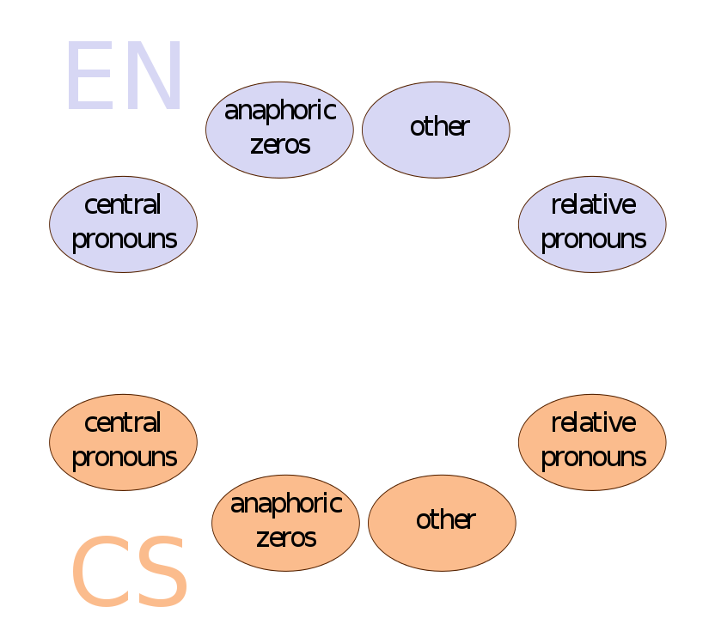
Counterparts

Slide 26
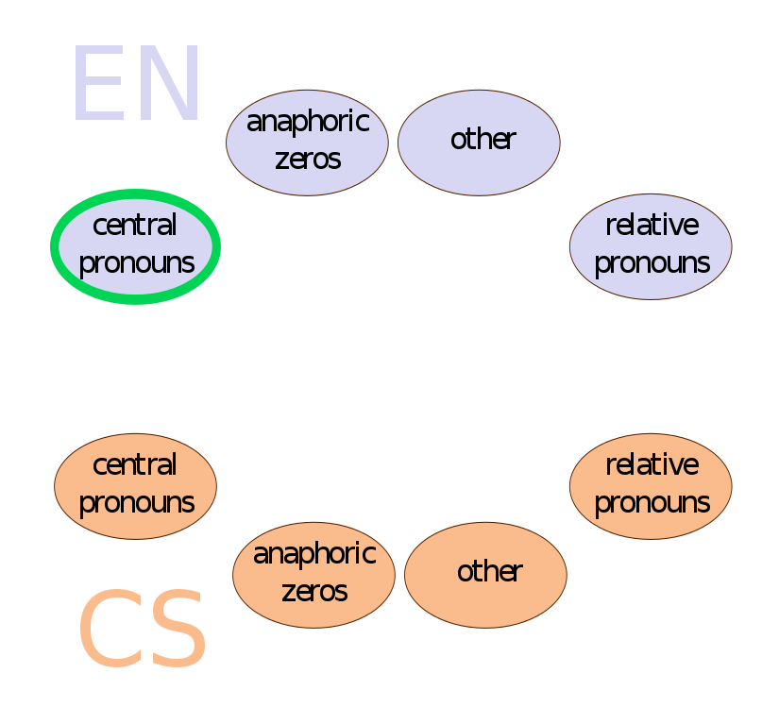
Counterparts

Slide 27
English central pronouns

Slide 28
English central pronouns: personal to zero
57% of English personal pronouns turn into Czech anaphoric zeros, most of them (99%) are in a subject position
EN: He left a message accusing Mr. Darman of selling out. CS: ∅ Zanechal mu zprávu, ve které viní Darmana ze zaprodanosti.

Slide 29
English central pronouns: personal to personal
14% of English personal pronouns turn into Czech personal pronouns, most of them in non-subject position, but still over 30% of them are subjects
EN: Mr. Bush himself essentially acknowledged that he and his aides were trying to head off criticism. CS: Bush sám v podstatě přiznal, že se on a jeho poradci snaží odvrátit kritiku.

Slide 30
English central pronouns: personal to demonstrative
Czech demonstrative pronouns (represented solely by ten), are aligned with the pronoun it (in 99% cases)
EN: It endorsed the White House strategy, believing it to be the surest way to victory. CS: Ta přijala strategii Bílého domu v domnění, že je to nejjistější cesta k vítězství.

Slide 31
English central pronouns: pleonastic it
EN: It wasn’t known to what extent, if any, the facility was damaged. CS: — Nebylo známo, do jaké míry, a jestli vůbec, bylo zařízení poškozeno.

Slide 32
English central pronouns: possessive to possessive
English possessives are mapped to Czech possessives (40%), Czech svůj (35%) or nothing (20%)
EN: Mr. Bush himself essentially acknowledged that he and his aides were trying to head off criticism. CS: Bush sám v podstatě přiznal, že se on a jeho poradci snaží odvrátit kritiku.

Slide 33
English central pronouns: reflexive possessive svůj
EN: While the book amply justifies its subtitle, the title itself is dubious. CS: Zatímco svůj podtitul kniha dostatečně ospravedlňuje, samotný název je zavádějící.

Slide 34
English central pronouns: possessive to nothing
EN: As a result of their illness, they lost $1.8 million in wages and earnings. CS: Důsledkem — nemoci, přišli na mzdách a výdělcích o 1.8 milionu dolarů.

Slide 35
English central pronouns: possessive to dative
usually occupying the role of Benefactor or Adressee
EN: Residents picked their way through glass-strewn streets. CS: Obyvatelé města si razili cestu ulicemi zasypanými sklem.

Slide 36
English central pronouns: reflexive basic
basic and emphatic use of English reflexives [Quirk et al., 1985]
[Novák et al., 2013]
basic – mapped to CS reflexives
EN: The original is a comedy about Alceste, a man who sees falseness and vanity in everyone except himself. CS: Původně to byla komedie o Alcestovi, muži, který vidíı ve všech kromě sebe faleš a marnivost.

Slide 37
English central pronouns: reflexive basic
basic and emphatic use of English reflexives [Quirk et al., 1985]
[Novák et al., 2013]
basic – mapped to CS reflexives
emphatic – other means
EN: As Mr. Bronner himself says, the smell of “raw meat” was in the air. CS: Jak říká sám pan Bronner, ve vzduchu byl cítit zápach “syrového masa”.

Slide 38
English central pronouns

Slide 39
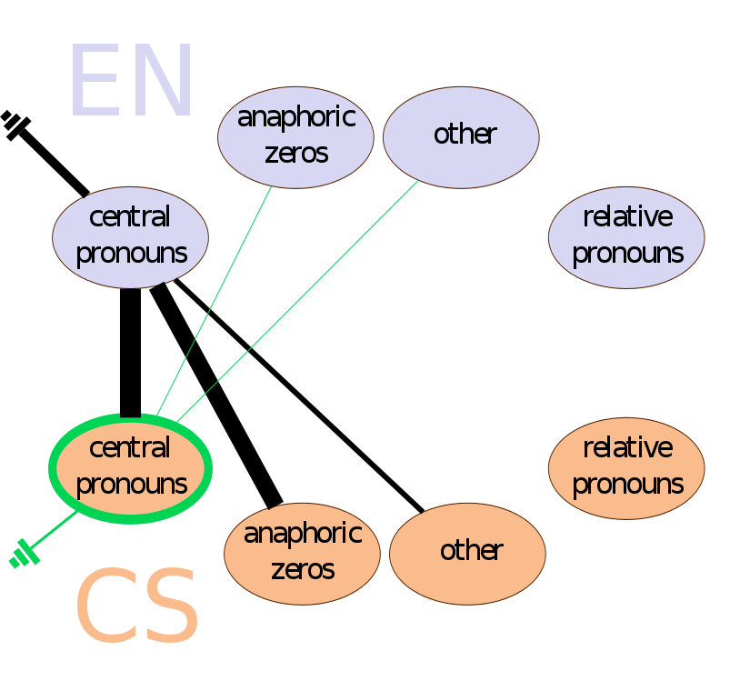
Czech central pronouns

Slide 40
Czech central pronouns

Slide 41
Czech central pronouns: personal to zero
non-finite constructions
CS: Poslanec Bates prohlásil, že dopisy napíše tak, jak mu bylo nařízeno. EN: Rep. Bates said he would write the letters as ∅ ordered.

Slide 42
Czech central pronouns: possessives
mostly to EN poss (94 of 107 cases)
definite article
CS: Tento maloobchodník nebyl schopen najít pro svoji budovu kupce. EN: The retailer was unable to find a buyer for the building.

Slide 43
Czech central pronouns: reflexives
CS: Obyvatelé města si razili cestu ulicemi zasypanými sklem. EN: Residents picked their way through glass-strewn streets.

Slide 44
Czech central pronouns

Slide 45
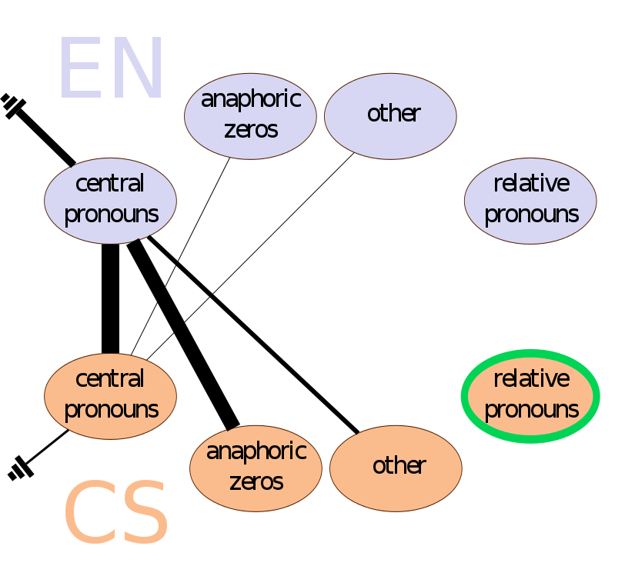
Czech relative pronouns

Slide 46
Czech relative pronouns
což: sentential relative clause other: mostly adnominal relative clause

Slide 47
Czech relative pronouns: což to apposition
CS: Akcie včera uzavřely na Neworské burze na 28.75 dolaru, což je pokles o 12.5 centu. EN: The stock closed yesterday on the Big Board at $28.75, down 12.5 cents.

Slide 48
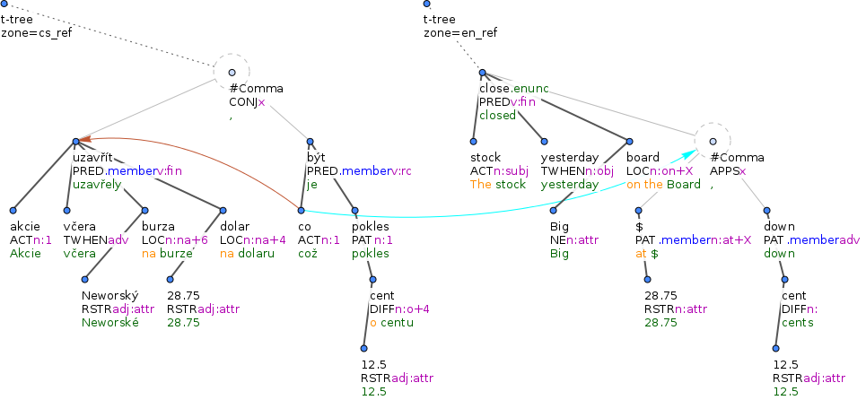
Czech relative pronouns: což to apposition
CS: Akcie včera uzavřely na Neworské burze na 28.75 dolaru, což je pokles o 12.5 centu. EN: The stock closed yesterday on the Big Board at $28.75, down 12.5 cents.

Slide 49
Czech relative pronouns: relative to relative
50% cases
CS: Mohou se objevit síly, které tento scénář pozdrží. EN: There may be forces that would delay this scenario.

Slide 50
Czech relative pronouns: relative to zero
23% cases: (a) ”zero relatives” or (b) non-finite clauses
CS: To je otázka, na níž nemůže Východní Německo odpovědět snadno, at už jeho nový představitel udělá cokoli. EN: That’s a question East Germany can’t answer easily, no matter what its new leader does.
CS: Zanechal mu zprávu, ve které viní Darmana ze zaprodanosti. EN: He left a message ∅ accusing Mr. Darman of selling out.

Slide 51
Czech relative pronouns: relative not aligned
23% cases: (a) ”zero relatives” or (b) non-finite clauses
CS: Dovoz, který tehdy činil šest milionů barelů denně, přicházel především z Venezuely a Kanady. EN: Imports, then six million barrels a day, came primarily from Venezuela and Canada.

Slide 52
Czech relative pronouns: relative to fused or interrogative
CS: Na tom, co ∅ máme, je třeba udělat hodně práce. EN: There is plenty of work to be done on what we have.
CS: Nebylo jasné, kdy se znovu obnoví normální tempo 750 vozů za den.
EN: It wasn’t clear when will resume the normal pace 750-car-a-day.

Slide 53
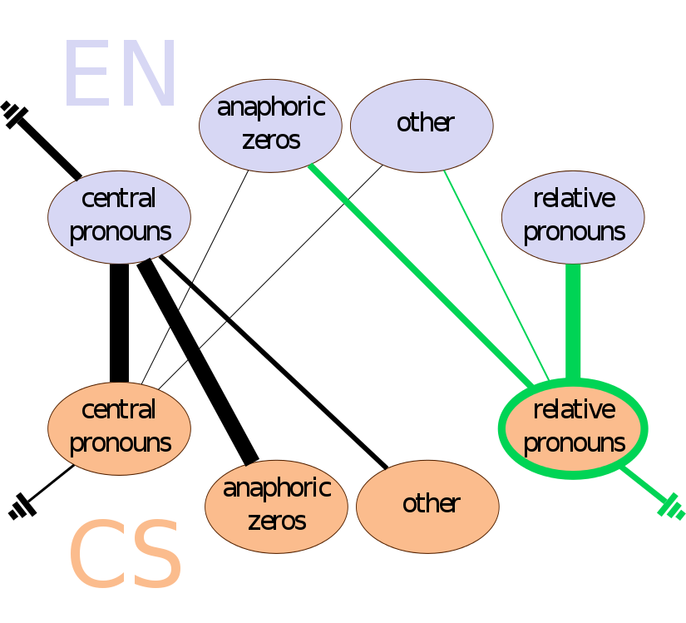
Czech relative pronouns

Slide 54
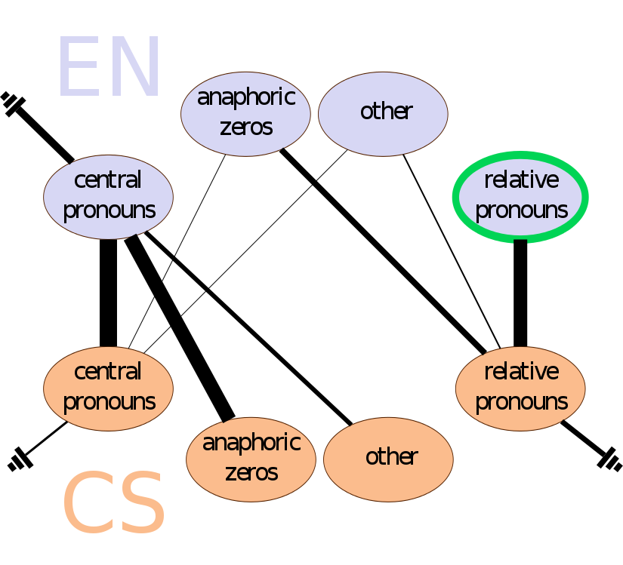
English relative pronouns

Slide 55
English relative pronouns

Slide 56
English relative pronouns: that and relative
alignments between similar categories – 68% of all instances
EN: There may be forces that would delay this scenario. CS: Mohou se objevit síly, které tento scénář pozdrží.

Slide 57
English relative pronouns: interrogative and fused
other relat – 43% of them translated with correlative pairs
other – mostly proč and jak
EN: There is plenty of work to be done on what we have. CS: Na tom, co máme, je třeba udělat hodně práce.

Slide 58
English relative pronouns: subordinating conjunction
EN: In 1956, when Britain, France and Israel invaded Egypt, Arab producers cut off supplies to Europe. CS: V roce 1956, když Británie, Francie a Izrael napadly Egypt, zastavili arabští výrobci dodávky do Evropy.

Slide 59
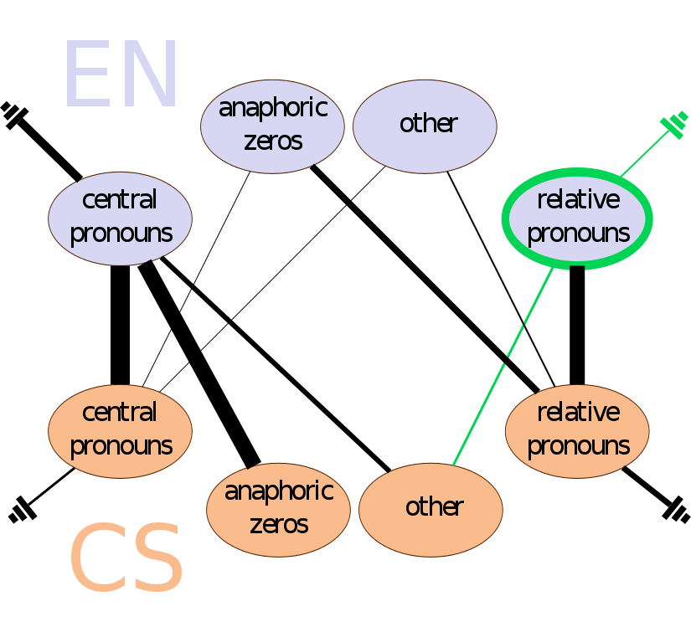
English relative pronouns

Slide 60
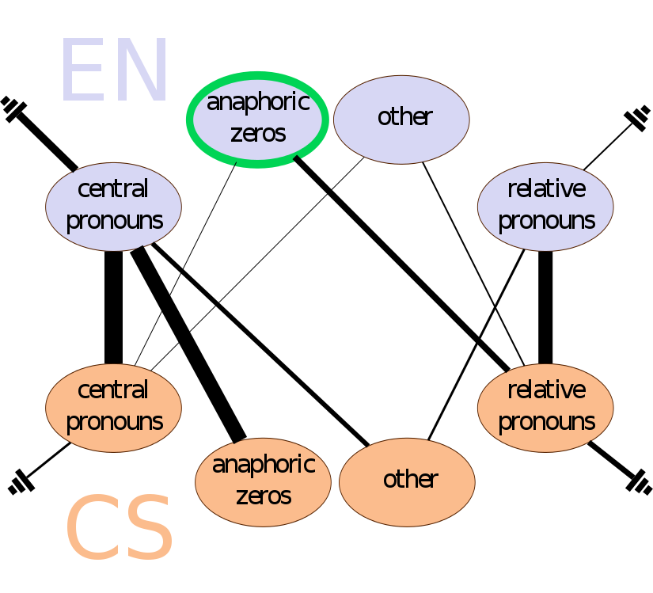
English anaphoric zeros

Slide 61
English anaphoric zeros

Slide 62
English anaphoric zeros: zero to zero
EN: Their reaction was to ∅.ACT do nothing and ∅.ACT ride it out. CS: Jejich reakcí bylo ∅.ACT nedělat nic a ∅.ACT nechat to odeznít.

Slide 63
English anaphoric zeros: zero to relative
About 10% of English anaphoric zeros correspond to Czech relative pronouns
EN: He left a message ∅ accusing Mr. Darman of selling out. CS: Zanechal mu zprávu, ve které viní Darmana ze zaprodanosti.

Slide 64
English anaphoric zeros: not aligned
Almost 50% of anaphoric zeros in English have not found their Czech counterparts (rewording, missing argument, technical reasons)
EN: I want to ∅.ACT publish one that succeeds. CS: Já chci vydávat takový, který uspěje.

Slide 65
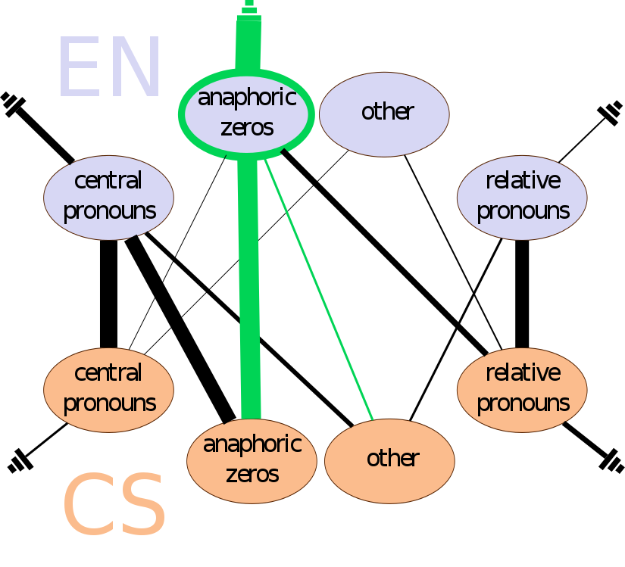
English anaphoric zeros

Slide 66
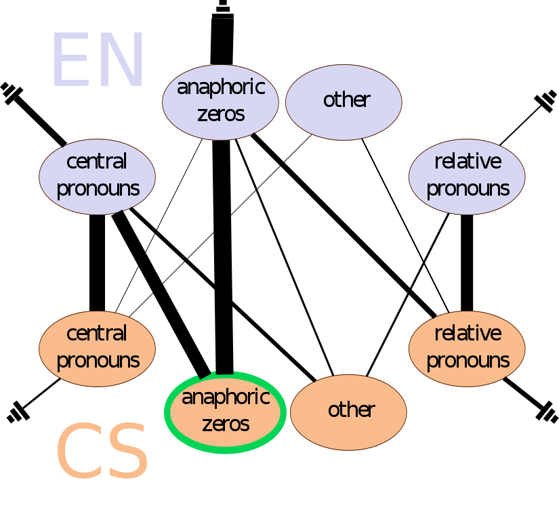
Czech anaphoric zeros

Slide 67
Czech anaphoric zeros

Slide 68
Czech anaphoric zeros: zeros to personal
CS: ∅ Zanechal mu zprávu, ve které viní Darmana ze zaprodanosti.
EN: He left a message accusing Mr. Darman of selling out.

Slide 69
Czech anaphoric zeros: zeros to personal (1st&2nd pers)
CS: ∅ Nemáme pasivní čtenáře. EN: We don’t have passive readers.

Slide 70
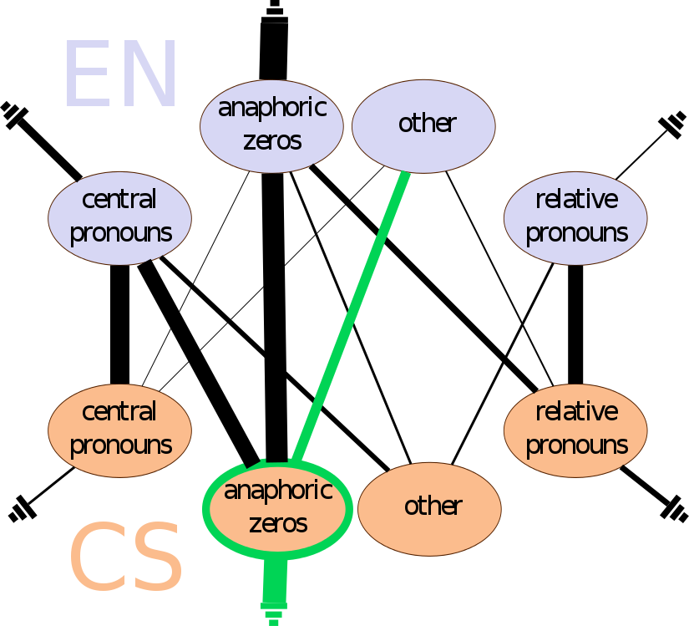
Czech anaphoric zeros

Slide 71
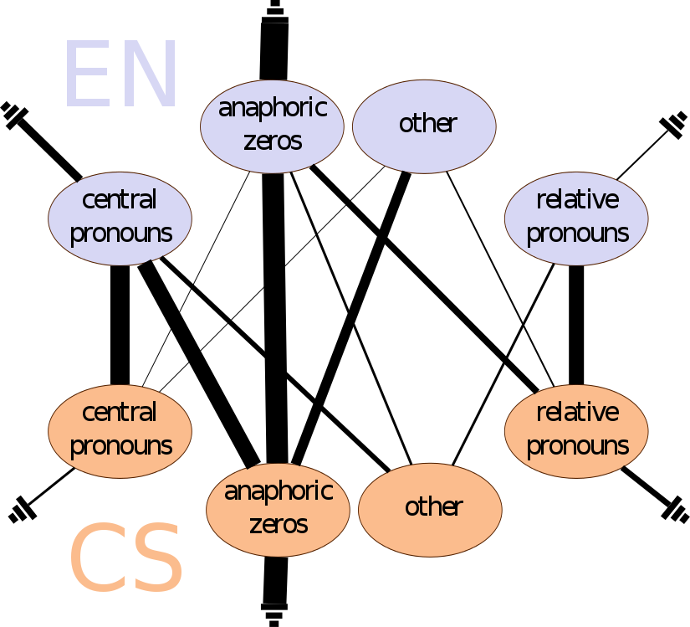
Counterparts

Slide 72
Discussion
Possessivity
EN: As a result of their illness, they lost $1.8 million in wages and earnings. CS: Důsledkem (své) nemoci, přišli na mzdách a výdělcích o 1.8 milionu dolarů.
dative possessors
CS: Ceští reformátoři si ve své zemi mohou ze stejné doby připomenout Wilsonovy ideály. CS: Czech reformers can recall the Wilsonian ideals of the same period in their country.
Pro-drop character of Czech
Factor of translated text

Slide 73
Conclusion
improved alignment of coreferential expressions + manual annotation
comprehensive analysis of mappings between the expressions in Czech and English
Future work:
use the improved alignment in the new version od PCEDT
analyze the alignment of antecedents
co-training with language-dependent feature sets
translation via deep syntax (TectoMT)

Slide 74
Acknowledgements
The presentation of the results is co-financed by the European Union from resources of the European Social Fund
The research was supported from the Grant Agency of the Czech Republic (grant P406/12/0658 Coreference, discourse relations and information structure in a contrastive perspective), GAUK 3389/2015, EU (grant FP7-ICT-2013-10-610516 – QTLeap) and SVV project number 260 224. This work has been using language resources developed, stored, and distributed by the LINDAT/CLARIN project of the Ministry of Education, Youth and Sports of the Czech Republic (project LM2010013).

Slide 75
Bibliography I

Slide 76
Bibliography II

