Slide 1



Overview
Annotation of textual phenomena in the Prague Dependency Treebank (April 27)
Coreferential expressions in English and Czech (April 28)
Coreference in Czech and cross-lingually – ideas and perspectives (April 30)
“made in ÚFAL” Institute of Formal and Applied Linguistics, Charles University in Prague, Faculty of Mathematics and Physics
Notes:
В последней лекции расскажу про проблемы,
А еще про то, что можно делать с нашими данными, например, вместе

Slide 2




Coreference in Czech and cross-lingually – ideas and perspectives
Anna Nedoluzhko,
Warszawa, 30.4.2015

Slide 3
Plan of the talk
Основная мысль – показать результаты резолверов на кореф. Результаты разные, часто плохие. Посмотрим на разные случаи и попробуем объяснить, почему они плохие, и что из этого можно взять хорошего
Resolevers for coreference in Czech
Annotation of coreference and bridging in PDT and PCEDT
Inter-annotator agreement – numbers and analysis of disargeements
“objectivity” of disagreements (experiment with awareness)
Difficult cases with coreference and bridging
Coreference chains in Czech and cross-lingually (Kibrik, pro-drop)
Gacr plans – projection
Планы ч-нем наши и Люцки

Slide 4
Plan of the talk
Corpora and coreference annotation
Principles of coreference and bridging annotation
Benefits and problems of annotation on t-trees
Resolvers for coreference in Czech
Inter-annotator agreement
Analysis of agreement and disagreement
Future plans

Slide 5
PDT 3.0
The Prague Dependency Treebank [Bejček et al. 2013]
Czech newspaper texts,
ca. 50000 sentences (3165 documents, 833195 tokens)
The three PDT layers – capture grammatical information: morphological, surface shape (analytical) and underlying syntactic (tectogrammatical)
t-layer includes
  semantic labeling of content words and coordinating conjunctions
  argument structure description based on a valency lexicon
  ellipsis reconstruction
  coreference annotation (pronominal, zero, NPs incl. differentiation to specific/generic)
  bridging relations annotation
  discourse structure annotation

Slide 6
PCEDT 2.0+
Prague Czech-English Dependency Treebank [Hajic et al., 2012]
English Wall Street Journal texts translated to Czech sentence by sentence
1.2 million words in almost 50,000 sentences for each language
annotated on morphological (m-layer), analytical (shallow syntactic, a-layer) and tectogrammatical (deep syntactic, t-layer),
sentence-aligned, word-aligned
t-layer includes
  semantic labeling of content words and coordinating conjunctions
  argument structure description based on a valency lexicon
  coreference annotation (pronominal, zero, NPs – only specific)
  ellipsis reconstruction
Notes:
поискать в презентациях про ПСЕДТ красивые картинки про синтаксические уровни

Slide 7
Corefence annotations in Prague corpora
 | PDT 3.0 | PCEDT
 |  | English | Czech
grammatical coreference | YES | YES | YES
pronominal textual coreference | YES | YES | YES
anaphoric zeros | YES | YES | YES
textual full-NP coreference - specific | YES | YES (PCEDT2.0+) | YES (PCEDT2.0+)
textual full-NP coreference - generic | YES | no | no
bridging relations | YES | no | no

Slide 8
Coreference
grammatical coreference
  mostly possible to identify the antecedent on the basis of grammatical rules of the given languages
  within one sentence
textual coreference
  not restricted to grammatical means alone, context
  different means (pronominalisation, grammatical agreement, repetitions, synonyms, paraphrasing, hyponyms/hyperonyms, etc.)
  often occurs between entities in different sentences

Slide 9
Grammatical coreference
  arguments in constructions with verbs of control
    – John wants to [#Cor.ACT] kiss Mary.
  reflexive pronouns
    – John shaved himself.
  relative pronouns
    – John, who came late, apologized.
  coreference with verbal modifications that have dual dependency
    – John saw Mary [#Cor.ACT] stand on the windowsill and cry.
  reciprocity
    – John and Mary kissed [#Rcp.PAT].

Slide 10
Textual coreference
  personal and possessive pronouns (Jonh left Mary. He wanted to see his mother),
  demonstrative pronouns ten, ta, to (It means that he doesn’t really love Mary.)
  with textual ellipsis (zeros) (Více si Ø vážil své matky.)
  nouns (John asked his mother to advise him how he should behave with Mary, but mother ignored her son’s wish.)
  local adverbs (John asked mother to come to Mary’s place with him but she decided not to go there.)
  some adjectives (At last, Mary came to Prague herself and found the Prague atmosphere quite casual.)
  reference to events (Mary suggested Jonh to go to the theater, but Jonh ignored her wish).
  If antecedent is a whole segment of (previous) text larger than one sentence (phrase) — special type of textual coreference segm(ent) without explicitly marked antecedent: (The next day Mary suggested to visit his mother. Then she proposed to go swimming. Her last wish was just to look at the city center. Jonh denied all of it.)

Slide 11
Textual coreference - types
  SPEC(ific) for coreference of NPs with specific reference (Jonh_{a} asked his_{a} mother_{b} to advise_{c} him_{a}, but mother_{b} ignored her_{b} son_{a}’s wish_{c})
  GEN(eric) for coreference of NPs with generic reference, e.g.
    (Mary proposed Jonh to go to the Zoo to see animals. She believed that having looked at animals, Jonh will understand how wild he behaved to her.)
END OF STORY

Slide 12
Exophora
An expression refers to situations or reality external to the text – special attribute coref_special, type exoph
Dokončeny by měly být [...] na sídlišti Barrandov v těchto dnech.(= It should be finished [...] in Barrandov district in these days [meaning, in the recent days])
A tu se dostáváme zpět k počátku tohoto textu . (= With this, we come back to the beginning of this text)
Informace v tomto přehledu jsou bezplatnou službou podnikatelům. (=The information in this report is a free service to businessmen.)

Slide 13
Bridging Relations
part – whole (PART_WHOLE and WHOLE_PART)
    Germany – Bavaria - Munich
set — subset/element of set (SET_SUB and SUB_SET)
    students – some students – a student
function - object (P_FUNCT and FUNCT_P)
    prime-minister – government, trainer – football team
semantic contrast (CONTRAST)
  A přesvědčen jsem ještě o jednom - je třeba mít vysoké cíle a s malými [cíli] se nespokojit. (= And I am sure about one thing: it is necessary to have lofty aims and not to be satisfied with small (ones).)
explicit anaphora without coreference (ANAF)
  "Duha?" Kněz přiloží prst k tomu slovu, aby nezapomněl, kde skončil. - “A rainbow?” The priest pointed to the word …
  Jak se Vám zamlouvala Pragobanka Cup? - Takovou/podobnou/stejnou akci bychom také uvítali - How did you like the Pragobanka Cup? We would welcome a similar event …
other (REST)
  family (grandfather - grandson), place – inhabitant, author – work, same denomination to support cohesion of the text (a chance helped – another chance entered the game …) and event – participant of the event (enterprise - entrepreneur )

Slide 14
Statistics –
Types of Relations in PDT

Slide 15
Principles of
Coreference Annotation-1
chains – reference to the nearest antecedent
maximal length of chains (incl. grammatical and textual coreference)
Example:
Helena poprosila svou maminku_{A}, aby #PersPron_{B} na ni počkala. Matka_{C} řekla, že #PersPron_{D} jde do divadla.
Helen asked her mother_{A} #PersPron_{B} to wait for her. Mother_{C} said that
#PersPron_{D} goes to the theatre.
the chain is established: A <= B <= C <= D

Slide 16
Principles of
Coreference Annotation-2
maximal “scope” of the units: whole subtree
“cooperation” with the TGTS’s: no special annotation of apposition, predicates etc.
contribution to the coherence of the text
preference of coreference over bridging anaphora: in case of multiple choice, we prefer textual coreference to bridging anaphora
  Mary – John – children in the class – Mary and John
principle of preferring coreference to anaphora: coreference, not anaphora, is subject to annotation
Notes:
za člen koreferenčního páru se považuje celý podstrom koreferujícího výrazu, tj. koreferující člen vždy zahrnuje determinátory (ukazovací zájmena apod.), modifikátory, předložky a všechny závislé členy

Slide 17
Benefits of dependency trees
extraction of markables (MIN-IDs and maximal scope)
reconstruction of syntactic zeros
  #Perspron: personal or possessive pronouns
  #Cor: controllee in control constructions
  #Qcor: valency modification in constructions with quasi-control, e.g. He offered Jan {#QCor} protection.
  #Rcp: participants that are left out as a result of reciprocation, e.g. The lovers kissed {#Rcp.PAT}.
  a copy of the node representing the same lexical unit as the omitted element
non-referring expressions:
  appositions
  coordinative constructions
  verbal complements

Slide 18
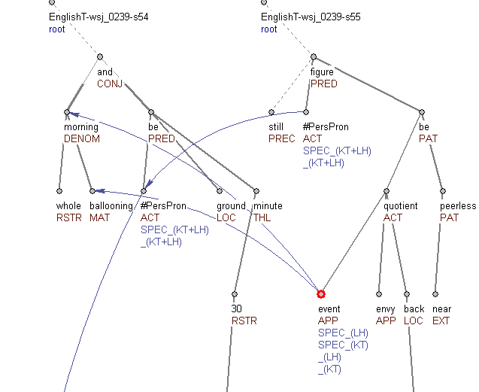
Benefits of t-trees - markable identification
convention: annotate larger antecedent positioned “higher” in TGS.
{_A A whole morning of {_B ballooning}} and I had been off the ground barely 30 minutes. Still, I figured the event's envy-quotient back in the U.S.A. was near peerless.
Notes:
остальные примеры – в базе данных higher/lower

Slide 19
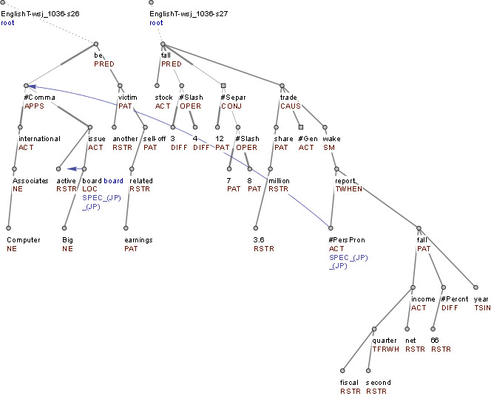
Benefits of t-trees - Apposition
Computer Associates International, the most active Big Board issue, was another victim of an earnings-related sell-off. The stock fell 3/4 to 12 7/8 as 3.6 million shares were traded in the wake of its report that fiscal second-quarter net income fell 66% from a year ago.

Slide 20
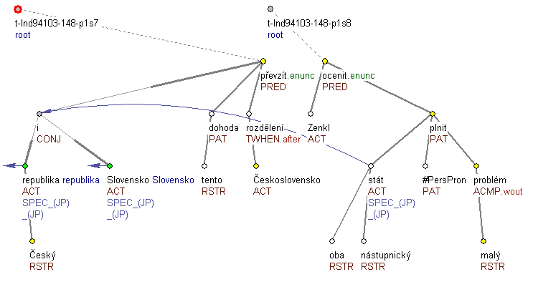
Benefits of t-trees - Coordination
Česká republika i Slovensko tuto dohodu po rozdělení Československa převzaly. Zenkl ocenil, že ji oba nástupnické státy plní bez nejmenších problémů. - Czech Republic and Slovakia took over this agreement after the split of Czechoslovakia. Zenkl appreciated that both successor states follow it without any problems.

Slide 21
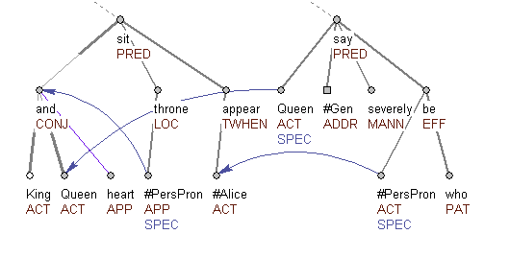
Benefits of t-trees - Coordination
+ ellipsis of dependent element
The King and Queen of Hearts were sitting on their throne when Alice appeared. The Queen said severely “Who is she?”
+ embedded dependent element

Slide 22
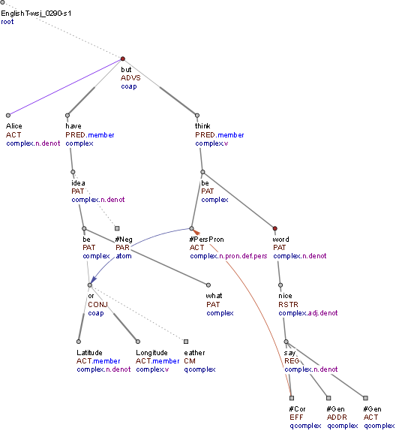
Benefits of t-trees - Coordination
Alice had no idea what [Latitude] was, or [Longitude] either, but thought they were nice grand words to say.

Slide 23
Problematic issues: prepositional phrases
in tectogrammatical structure, prepositions are embedded in tectogrammatical nodes
PPs are annotated as NPs (near Prague = Prague, before the war – during the war – after the war)
not good but technically reasonable decision? (otherwise very low agreement for in Prague – about Prague – for Prague vs. in Prague – around Prague – above Prague) --- not always clear, see example:
Zatím se posunuje stále více za Prahu, čímž ztrácí na své účelnosti z hlediska dopravních spojení do jednotlivých částí města Na druhé straně by tu asi mohlo být víc pozemků vhodných k podnikání. Po dálnici bychom se měli svézt z Prahy až do Českých Budějovic, v roce 1997 pravděpodobně projedou první vozidla po dálnici Praha –Plzeň, dokončena by měla být i dálnice D8 z Prahy do Ústí nad Labem.
(= So far, people begin to move away from Prague, ... various parts of the city. On the other hand, there could be more lands suitable for business there. Highways could take us from Prague up to CeskéBudejovice … .)

Slide 24
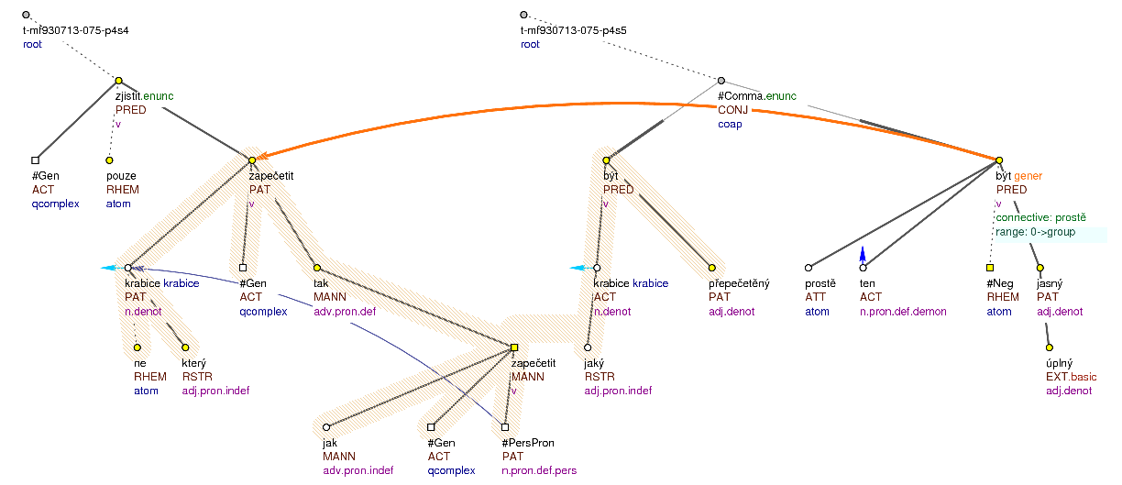
Possibility to refer to bigger segments
Pouze se zjistilo, že ne všechny krabice jsou zapečetěny tak, jak by měly být. Nějaké krabice byly přepečetěné, nebylo to prostě úplně jasné. - However, there was found that not all the boxes are sealed as they should be. Some boxes were sealed too much, it wasn’t just clear enough.
Notes:
если понадобится, в моей книжке есть примеры отсылки на невычленяемые куски дерева (желтая закладочка)

Slide 25
Coreference and Bridging statistics
type of relation | absolute numbers
all textual coreference links | 86,349
textual coreference (specific NPs) | 20,243 (pronouns)+50,593 (nouns) = 70,836
textual coreference (generic NPs) | 3,095(pronouns)+12,418(nouns) = 15,513
all bridging links | 32,171
bridging SUBSET | 5,820(SUB_SET) +12,580(SET_SUB) = 18,400
bridging PART | 1,982(PART_WHOLE)+4,372(WHOLE_PART) = 6,354
bridging FUNCT | 1,719(P_FUNCT)+418(FUNCT_P) = 2,137
bridging CONTRAST | 2,238
bridging ANAF | 802
bridging REST | 2,212
percentage of nodes where a link starts, counting all text-coref and bridging | 17.6%
The Project is co-financed by the European Union from resources of the European Social Fund

Slide 26
Performance of tools for coreference and bridging
type of the task | data | F₁
Grammatical coreference, verbs of control | PDT 2.0 | 91.5
Grammatical coreference, reflexive pronouns | PDT 2.0 | 97.1
Grammatical coreference, relative pronouns | PDT 2.0 | 99.6
Grammatical coreference, reciprocity | PDT 2.0 | 94.7
Pronominal coreference, rule-based | PDT 2.0 | 74.2
Pronominal coreference, perceptron ranking, gold features | PDT 2.0 | 79.4
Pronominal coreference, perceptron ranking, system features | PDT 2.0 | 50.3
NP-coreference, specific NPs | PDT 2.0 | 48.1 (P:59.7, R:40.3)
NP-coreference, generic NPs | PDT 2.0 | 1.8 (P:20, R:0.9)
bridging relations | PDT 2.0 | 0
Identification of an anaphoric unexpressed subject, rule-based | PCEDT 2.0 | 61.5
Identification of an anaphoric unexpressed subject, rule-based, exploiting English side | PCEDT 2.0 | 69.5
Notes:
доделать!

Slide 27
Performance of tools for coreference and bridging
type of the task | data | F₁
Grammatical coreference, verbs of control | PDT 2.0 | 91.5
Grammatical coreference, reflexive pronouns | PDT 2.0 | 97.1
Grammatical coreference, relative pronouns | PDT 2.0 | 99.6
Grammatical coreference, reciprocity | PDT 2.0 | 94.7
Pronominal coreference, rule-based | PDT 2.0 | 74.2
Pronominal coreference, perceptron ranking, gold features | PDT 2.0 | 79.4
Pronominal coreference, perceptron ranking, system features | PDT 2.0 | 50.3
NP-coreference, specific NPs | PDT 2.0 | 48.1 (P:59.7, R:40.3)
(NP-coreference, generic NPs) | PDT 2.0 | 1.8 (P:20, R:0.9)
(bridging relations) new features! | PDT 2.0 | 0
Identification of an anaphoric unexpressed subject, rule-based | PCEDT 2.0 | 61.5
Identification of an anaphoric unexpressed subject, rule-based, exploiting English side | PCEDT 2.0 | 69.5
Notes:
доделать!

Slide 28
Performance of tools for coreference and bridging
type of the task | data | F₁
Grammatical coreference, verbs of control | PDT 2.0 | 91.5
Grammatical coreference, reflexive pronouns | PDT 2.0 | 97.1
Grammatical coreference, relative pronouns | PDT 2.0 | 99.6
Grammatical coreference, reciprocity | PDT 2.0 | 94.7
Pronominal coreference, rule-based | PDT 2.0 | 74.2
Pronominal coreference, perceptron ranking, gold features | PDT 2.0 | 79.4
Pronominal coreference, perceptron ranking, system features | PDT 2.0 | 50.3
NP-coreference, specific NPs | PDT 2.0 | 48.1 (P:59.7, R:40.3)
NP-coreference, generic NPs | PDT 2.0 | 1.8 (P:20, R:0.9)
bridging relations | PDT 2.0 | 0
Identification of an anaphoric unexpressed subject, rule-based | PCEDT 2.0 | 61.5
Identification of an anaphoric unexpressed subject, rule-based, exploiting English side | PCEDT 2.0 | 69.5
Notes:
доделать!

Slide 29
Coreference and Bridging relations
Statistics
type of relation | absolute numbers
all textual coreference links | 86,349
textual coreference (specific NPs) | 20,243 (pronouns)+50,593 (nouns) = 70,836
textual coreference (generic NPs) | 3,095(pronons)+12,418(nouns) = 15,513
all bridging links | 32,171
bridging SUBSET | 5,820(SUB_SET) +12,580(SET_SUB) = 18,400
bridging PART | 1,982(PART_WHOLE)+4,372(WHOLE_PART) = 6,354
bridging FUNCT | 1,719(P_FUNCT)+418(FUNCT_P) = 2,137
bridging CONTRAST | 2,238
bridging ANAF | 802
bridging REST | 2,212
percentage of nodes where a link starts, counting all text-coref and bridging | 17.6%

Slide 30
Inter-annotator Agreement for coreference and bridging in PDT
number of controlled documents | 39
number of controlled sentences | 1606 (3% PDT)
number of controlled tokens | 26,520
F-1 on textual pronominal coreference (including zeros) | 0,86
F-1 on textual coreference for specific NPs | 0,705
F-1 on textual coreference for generic NPs | 0,492
F-1 on bridging relations | 0,455
textual NP_coref kappa of agreement on type | 0,759
bridging kappa of agreement on type | 0,889

Slide 31
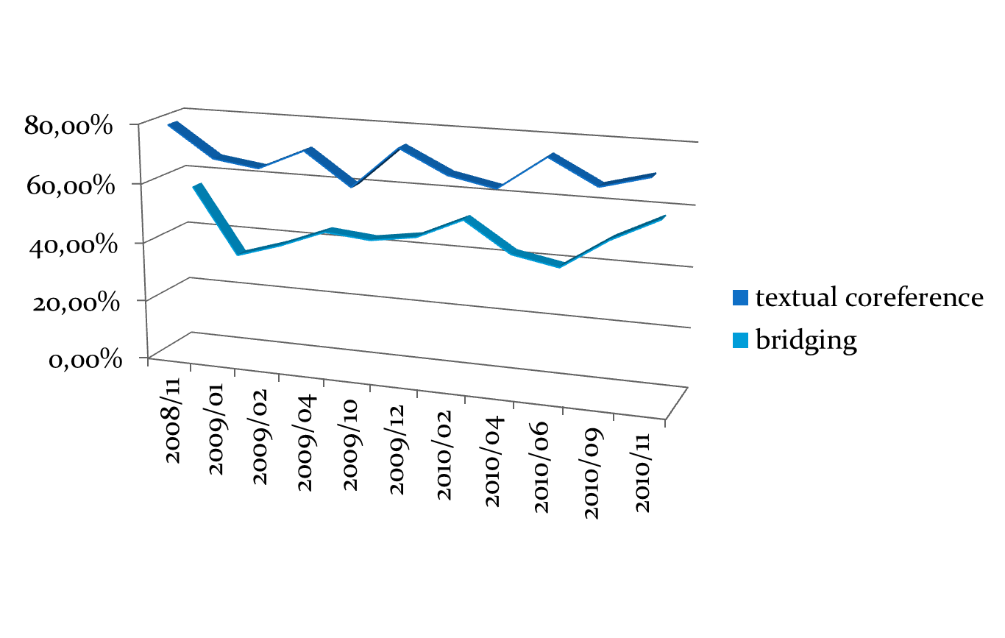
Inter-annotator Agreement

Slide 32
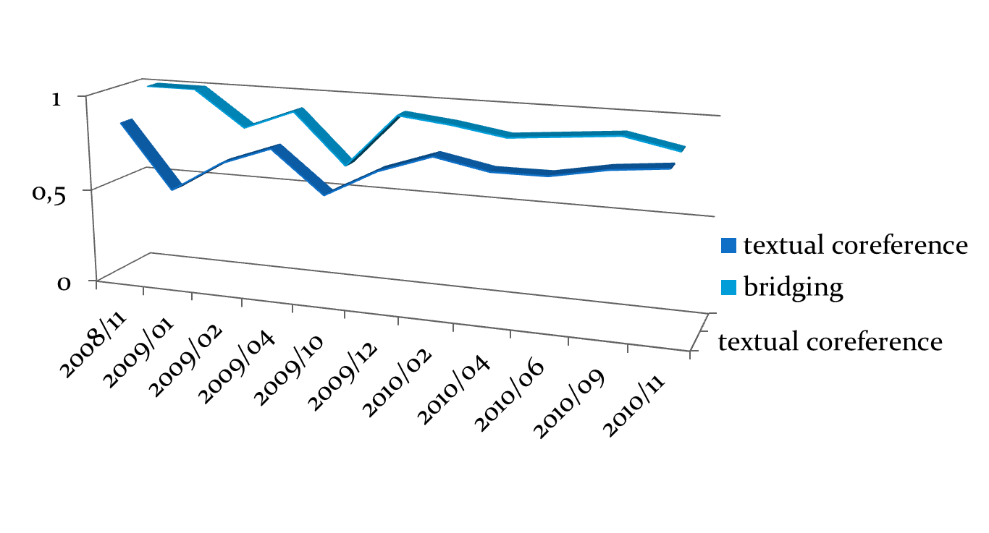
Inter-annotator Agreement: kappa for Types

Slide 33
Types of disagreement
the relation should or should not be annotated for coreference/bridging
what is the correct antecedent of a given noun phrase
distinguishing between the bridging anaphora and the textual coreference
selecting the type of the bridging anaphora or the textual coreference

Slide 34
Annotating / not annotating a relation
A když už byla knížka hotova, tak se zjistilo, že je praktická i pro rodiče. V této knize je poučení, jak snášejí děti rozvod a jak na něj reagují, a návod, jak se mají rodiče chovat, aby se utrpení dětí snížilo.
(=After the book had been already written, it was clear, that it is quite useful for parents too. The book contains explanations, how children go through divorce, how they react to it, and the instructions how parents should behave to minimize the suffering of their children..)

Slide 35
Annotating / not annotating a relation
borderline cases between “generic” coreference and non-coreference
Kdy děti nejvíce volají [... 8 vět ...] Pražské děti budou mít hovor {žádný koreferenční vztah} zdarma. Podle zkušeností ze zahraničí se dá předpokládat, že největší frekvence telefonátů {coref_text, typ=NR na „volat“} nastane vždy mezi 16. až 18. hodinou.
lit.engl. When children call [... 8 sentences...] Prague children will have the call {no coreference} for free. … we can assume that most calls are between 16. and 18. a.m.
We do NOT annotate generics in the following cases: NPs have different extention (i.e. they refer to different sets, women – women in 19. century); Both is true: a) we are not sure that NPs corefer AND b) the relation between these NPs has no influence on the text cohesion In other cases we annotate text_coref, type NR
a. Mnozí čeští podnikatelé si ke své škodě stále ještě neuvědomují, že peníze věnované na získání důležitých údajů se jim mnohonásobně vrátí. [... několik vět ...] b. Naším cílem je, aby podnikatelé {žádný koreferenční vztah} věděli o sobě navzájem.
lit. engl. a. Many businessmen … don’t realise that …. {several sentences} b. Our aim is to make businessmen know about each other.

Slide 36
Different selecting the antecedent/anaphoric element
Tiskárny bankovek mají i nové zákazníky, především v postkomunistických zemích východní Evropy a republikách bývalého SSSR. Bankovky v těchto zemích jsou náchylné na padělání a mají zastaralý design. Kanadská firma CBNC bude tisknout nové bankovky pro Tádžikistán
(= They have new clients, first of all in the post-soviet countries of East Europe and in the republics of the former USSR. Banknotes in these countries can be easily falsified. The CBNC Company will print banknotes for Tajikistan.)

Slide 37
Different selecting the antecedent/anaphoric element
Tiskárny bankovek mají i nové zákazníky, především v postkomunistických zemích východní Evropy a republikách bývalého SSSR. Bankovky v těchto zemích jsou náchylné na padělání a mají zastaralý design. Kanadská firma CBNC bude tisknout nové bankovky pro Tádžikistán .
(= They have new clients, first of all in the post-soviet countries of East Europe and in the republics of the former USSR. Banknotes in these countries can be easily falsified. The CBNC Company will print banknotes for Tajikistan.)

Slide 38
Different selecting the antecedent/anaphoric element
Tiskárny bankovek mají i nové zákazníky, především v postkomunistických zemích východní Evropy a republikách bývalého SSSR. Bankovky v těchto zemích jsou náchylné na padělání a mají zastaralý design. Kanadská firma CBNC bude tisknout nové bankovky pro Tádžikistán
(= They have new clients, first of all in the post-soviet countries of East Europe and in the republics of the former USSR. Banknotes in these countries can be easily falsified. The CBNC Company will print banknotes for Tajikistan.)

Slide 39
Distinguishing between the bridging relations and the textual coreference
I přes klesající inflaci ve světě … je tisk bankovek a výroba bankovkového papíru jedním z nejlukrativnějších odvětví. […] … Rozšíření bankovních automatů vyžaduje neustálý přísun nepoškozených bankovek.
(= Although inflation in the world rather decreases, … printing banknotes and production of banknote paper is still one of the most profitable areas. Mass expansion of ATMs calls for permanent increase of undamaged banknotes.)
coreference (GEN) vs. bridging SUBSET

Slide 40
Distinguishing between the bridging relations and the textual coreference
I přes klesající inflaci ve světě … je tisk bankovek a výroba bankovkového papíru jedním z nejlukrativnějších odvětví. […] … Rozšíření bankovních automatů vyžaduje neustálý přísun nepoškozených bankovek.
(= Although inflation in the world rather decreases, … printing banknotes and production of banknote paper is still one of the most profitable areas. Mass expansion of ATMs calls for permanent increase of undamaged banknotes.)

Slide 41
borderline cases between “specific” and “generic” coreference
  U detergentu Toto jsme například řešili problém s udržením stálé kvality, protože jednotlivé partie byly nevyvážené. Investovali jsme dva miliony korun do nákupu pásových vah, zpřesnili dávkování a jakost pracího prášku stabilizovali.
  engl. For example, for detergent Toto we thought about the problem of supporting the same quality …. We … made the dosage more exact and so we set the quality of washing powder.
In ambiguous cases between specific and generic co-reference, we choose specific co-reference.
Začal jsem provozováním hospody, která byla mnohokrát vykradena. [… 2 věty …] Hospoda byla jen startem, polem k podnikání s masem a masnými výrobky.
lit. engl. I began by carrying out a restaurant… […] A/the restaurant was just the beginning […]

Slide 42
borderline cases between “specific” and “generic” coreference
K tématu pořadu TV NOVA TABU “Zrak za bílou hůl” byl přizván ke konzultaci Oldřich Čálek. Kateřina Hamrová, dramaturgyně pořadu, TV NOVA. (= To consult the topic of the TV NOVA show TABU "Vision for a white cane", Oldřich Čálek was invited. Catherine Hamrová, the dramatist of the show, TV NOVA)
Nic z toho se však nevyrovná míře neštěstí, které Romy postihlo v letech druhé světové války. Spolu se Židy byli označeni za méněcennou rasu a stali se objektem patologických fašistických opatření, jejichž cílem byla úplná genocida tohoto národa. (= Nothing of this, however, compares to the misfortune that befell the Gipsies during the Second World War. Together with the Jews, they were called an inferior race and became the object of pathological fascist measures, their purpose being the complete genocide of the nation.)

Slide 43
Problem Cases - Reasons
different understanding of the content
mostly don’t have influence on understanding the text as a whole
“depth” of interpretation
guidelines “formalism”
Tak je knížka koncipována. V každé kapitole se mluví o určitém problému, uvádíme jak je rozsáhlý, kolik dětí je jím postiženo a co dělat. Je tam v podstatě konkrétní návod.
This is the way this book is organised. Every chapter concerns a certain problem ... . There are actually specific instructions there.
I přes klesající inflaci ve světě … je tisk bankovek a výroba bankovkového papíru jedním z nejlukrativnějších odvětví. […] … Rozšíření bankovních automatů vyžaduje neustálý přísun nepoškozených bankovek. (= Although inflation in the world rather decreases, … printing banknotes and production of banknote paper is still one of the most profitable areas. Mass expansion of ATMs calls for permanent increase of undamaged banknotes.)

Slide 44
Disagreement factors
the text size
degree of abstractedness of the text
Especially long texts with a large number of generic nouns, abstract and verbal nouns have the lowest inter-annotator agreement
problematic are also
  constructions with nouns of measure and time periods
  generic noun phrases, abstract nouns and deverbatives
  coreference between indefinite noun phrases

Slide 45
Short text with 100% agreement
(1) ZLODĚJ SE VRÁTIL.
(2) Policejní hlídka vyrušila v neděli muže, který se vloupal do restaurace Kukačka v obci Horní Životice.
(3) Podařilo se mu zmizet, přestože policisté použili varovného výstřelu a vypustili služebního psa.
(4) Ještě téže noci se zloděj na místo činu vrátil.
(5) S policisty se tam Ø setkal podruhé.
(6) Tentokrát ho Ø zadrželi.
(7) Jedná se o několikrát trestaného M. K. z Ostravy.

Slide 46
Long text with low agreement
(11) Vaše kniha obsahuje ve třiadvaceti kapitolách různé problémy, od těžkých poškození dítěte až po lehčí disfunkci či vliv rozvodu na dítě.
(12) Tím ovšem jednu konkrétní rodinu může zajímat maximálně pět, přinejhorším deset kapitol.
(13) Zdeněk Matějček: Původně tato knížka byla určena pro zdravotnické pracovníky, a to především pro lékaře, kteří jsou ve styku s rodinou.
(14) Na druhé straně se ukázalo, že toto téma je stejně důležité pro pedagogy a vychovatele.
(15) Ti se přece setkávají i s postiženými nebo týranými dětmi.
(16) A když už byla knížka hotova, tak se zjistilo, že je praktická i pro rodiče.
(17) Samozřejmě ne každá kapitola ne pro každého rodiče.
(18) Zdeněk Dytrych: Kdyby se přímo dotýkalo některé rodiny deset kapitol, tak by to byla opravdu nešťastná rodina.
(19) Ale stačí jedna a většinou jich bude i víc.
(20) Vezměte si, kolik je rozvodů - třicet tisíc ročně v republice, to znamená, téměř třicet tisíc dětí je rozvodem nějakým způsobem postiženo.
(21) V této knize je poučení, jak snášejí děti rozvod a jak na něj reagují, a návod, jak se mají rodiče chovat, aby se utrpení dětí snížilo.
(22) Nebo například existuje lehká mozková disfunkce, kterou trpí podle našeho rozsáhlého výzkumu pět procent dětí.
(23) Toto postižení se velice špatně rozpoznává.
(24) Dítě je nemotorné, neklidné a není schopné se soustředit, ale přitom je většinou chytré.
(25) Rodiče ho považují za lajdáka a bývá trestáno třeba za špatný výkon ve škole, tím se zhoršuje vztah k učení atd.
(26) A tohle rodiče musí vědět.
(27) Samozřejmě i pedagogové a v této knížce je návod co s tím.
(28) Zdeněk Matějček: Předkládáme i problémy, na které se zapomíná.
(29) Tak například úmrtí dítěte nebo narození postiženého dítěte.
(30) Tady nejde jenom o rodiče, ale i o okolí, které musí vědět, jak se má chovat.
(31) Nebo úmrtí v rodině a jeho vliv na dítě a může to být třeba babička.

Slide 47
Reasons for Disagreement –
Abstract Nouns
one of very weak points in the PDT coreference annotaion
attempted in PDT, also classified for specific and generic abstracts (e.g. according to the reference of valencies)
actually my problem was that I couldn’t reliably separate abstract nouns from concrete ones
Preferuji širší předvedení s mnoha vnitřními souvislostmi, protože nám chybějí kritéria pro hodnocení současné české výtvarné kultury. {… 11 sentences inbetween…} Měli bychom se znovu pokusit … získávat současné umění, abychom jednou měli autentický soubor naší doby (= I prefer wider demonstration with many internal connections because we lack criteria for evaluation of contemporary Czech art. {… 11 sentences inbetween …} We should try ... to acquire the contemporary art again, in order to get an authentic set of our time.)
antecedent is relatively far from the anaphoric NP

Slide 48
Reasons for Disagreement –
Abstract Nouns
Tímto faktorem je podnikatel-inovátor, který se snaží o zisk, a proto logicky nemůže existovat ve stavu statiky, která nezná ani zisk, ani ztrátu. (= This factor is the enterpreneur-innovator, who is trying to gain profit, and hence, logically, cannot exist in a static state, where there is no profit or loss.)
Ve specifických podmínkách české ekonomiky růst nezaměstnanosti v letech 1991–1993 značně zaostal za poklesem HDP. […] Nejméně dvouprocentní růst české ekonomiky již letos. (=In the specific conditions of the Czech economy the growth of unemployment... This year at least a two percent growth of the Czech economy.)
In the Treasury market, investors paid scant attention to the day's economic reports, which for the most part provided a mixed view of the economy. ``Whether you thought the economy was growing weak or holding steady, yesterday's economic indicators didn't change your opinion,'' said Charles Lieberman, a managing director at Manufacturers Hanover Securities Corp.

Slide 49
Reasons for Disagreement –
Verbal Nouns
Vedení Pojišťovny Investiční a Poštovní banky nás upozornilo, že jejich pojišťovna nebyla zařazena mezi ty, které umožňují úrazové připojištění, ač tuto službu poskytují. Omlouváme se za toto nedopatření, dotyčná redaktorka byla pokutována. (=The Insurance Investment and the Post Bank management has notified us that their insurance company was not included among those that allow casualty insurance, although it provides this service. We apologize for this oversight, the editor who made the mistake was fined.)
Rychlé, avšak i bezpečné vypořádání. Rychlost vypořádání burzovních obchodů v čase odpovídá podle Jiřího Béra potřebám. (= Fast, yet safe transaction. According to Jiřího Bér’s opinion, the speed of transaction corresponds to the needs.)

Slide 50
Ability to refer
specific
concrete NPs
adverbs, PPs
non-specific
concrete NPs
generic NPs
abstract, NPs
adjectives
verbal NPs
verbs

Slide 51
Reasons for Disagreement – Guidelines Restrictions
In Richmond, Ind., the type F railing is being used to replace arched openings on the G Street Bridge. Garret Boone, who teaches art at Earlham College, calls the new structure ``just an ugly bridge'' and one that blocks the view of a new park below.

Slide 52
Reasons for Disagreement – Empirical Ambiguity
I přes klesající inflaci ve světě … je tisk bankovek a výroba bankovkového papíru jedním z nejlukrativnějších odvětví. […] … Rozšíření bankovních automatů vyžaduje neustálý přísun nepoškozených bankovek.
(= Although inflation in the world rather decreases, … printing banknotes and production of banknote paper is still one of the most profitable areas. Mass expansion of ATMs calls for permanent increase of undamaged banknotes.)

Slide 53
Reasons for Disagreement – measure NPs and other NPs with a ‘container’ meaning
skupina lidí (= a group of people)
počet akcií (= a number of stocks)
stádo krav (= a herd of cows)
dostatek financí (= abundance of finances)
milióny Židů (= millions of Jews)
sklenice piva (= a glass of beer)
deset procent obyvatel (= ten percent of population)

Slide 54
Reasons for Disagreement – measure NPs and other NPs with a ‘container’ meaning
Podle výzkumů ve vyspělých zemích se ukazuje, že lidí, kteří potřebují speciální služby, je daleko víc. U nás by tuto skupinu tvořilo asi tak 70000 osob. Jsou to hlavně starší lidé se zbytky zraku a slabozrací. Tato skupina stojí úplně mimo a má tak život ještě více ztížený, protože mnozí o těchto službách ani nevědí. (=According to the research in the developed countries, there are many more people who need special services. In our country, the group of such people would count about 70,000 individuals. They are mainly older people sighted and visually impaired. This group is completely off, their life being even more difficult, because they don’t even know about many of these services.)
a. Tří a půl tisíce dělníků vyhlásili stávku. b. Stávkující žádají zvýšení platů o šest procent. c. Do 8. března se počet stávkujících může zdvojnásobit. (a. Three and a half thousand workers went on strike. b. The strikers demand six percent of salary increase. c. By 8 March, the number of strikers may double.)

Slide 55
Reasons for Disagreement – Constructions with Time Periods
That compares with operating earnings of $132.9 million, or 49 cents a share, the year earlier. The prior-year period includes...

Slide 56
Reasons for Disagreement
almost three fourth of the coders’ disagreements come from the text ambiguity (empirically ambiguous or near-identical in the sense of Recasens (2010))

Slide 57
Experiment - Certainty of the manual annotations
annotators marked the certainty for their annotation decisions on the scale of 1 to 3
  1 : perfectly sure,
  2 : quite sure,
  3 : not quite sure
certainty marked for
  the presence of a relation,
  selecting the antecedent,
  distinguishing between the bridging relation and the textual coreference and
  selecting the type of the bridging relation or the textual coreference

Slide 58
Certainty in the
Presence of a Relation
textual coreference bridging
agreement
disagreement
agreement
disagreement
1.17
1.44
1.35
1.88
naturally, the lower the agreement is, the less are the annotators sure
the number of cases where the annotators didn’t mark uncertainty but still disagreed exceeds all other cases (56 disagreements, only 26 were marked)

Slide 59
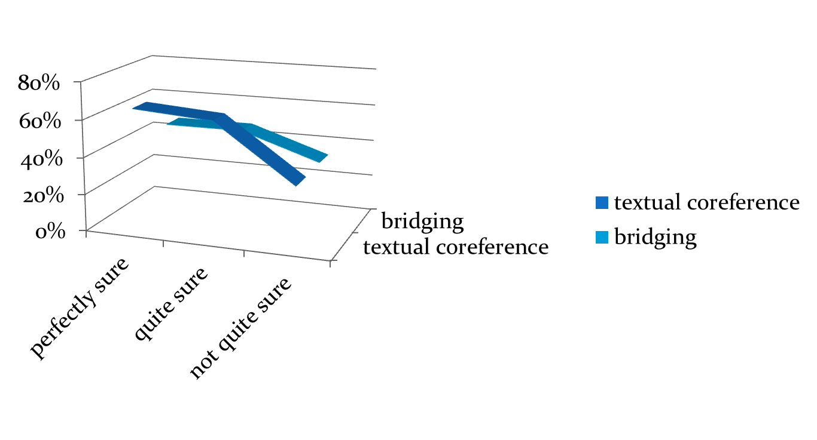
Certainty in
selecting the Antecedent
Again:
the numbers show a lower agreement in cases where the annotators were not sure about the antecedent BUT
from 27 disagreements in choosing the antecedent, only 16 were marked as uncertain by at least one annotator

Slide 60
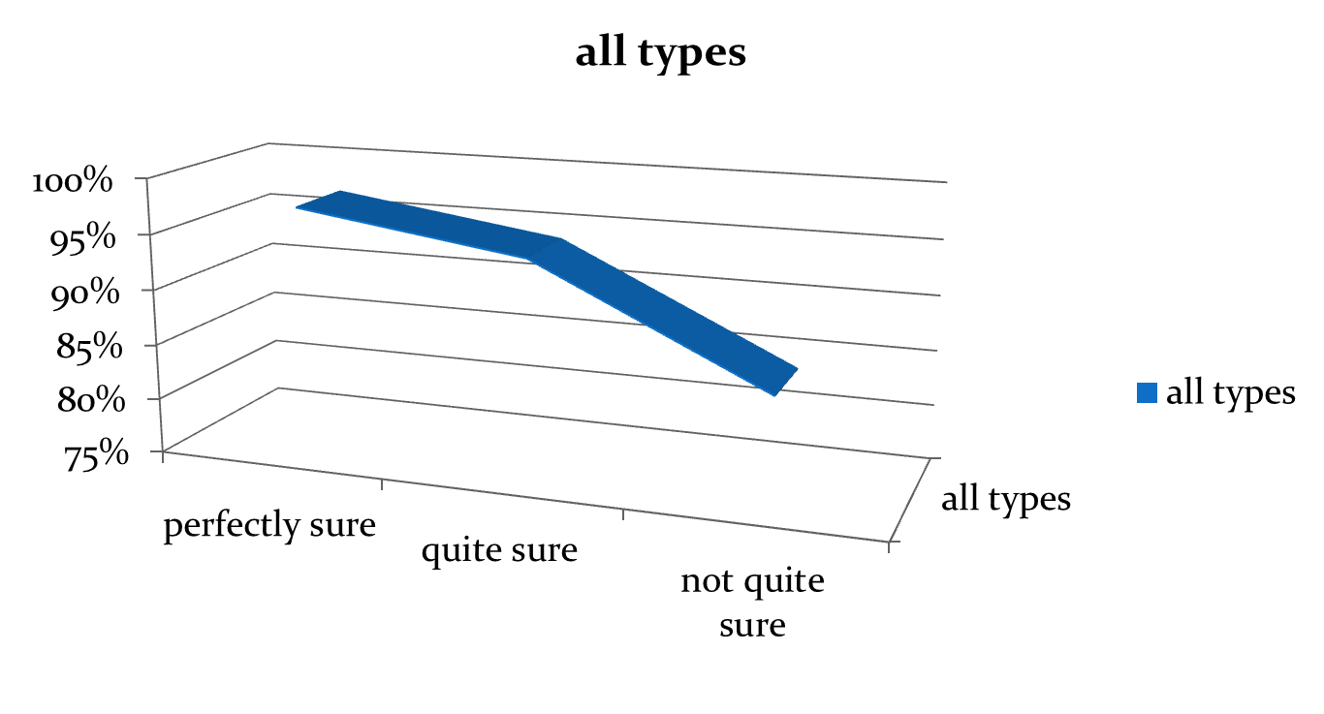
Certainty in
Distinguishing Between Coreference and Bridging
Numbers show:
The difference in agreement between “certain” and “uncertain” relations in this case is not so relevant
In most cases (21 of 32), the annotators marked ambiguity but still made the same decision

Slide 61
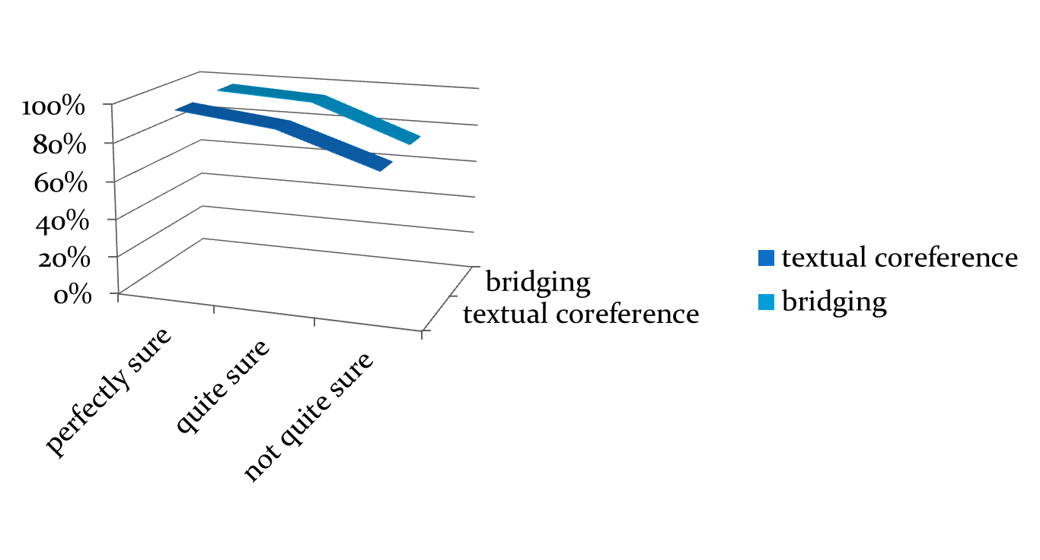
Certainty in
selecting the type of bridging or coreference relation
Again:
the numbers show a lower agreement in cases where the annotators were not sure about the type of the relation

Slide 62
Results of the experiment and analysis
inter-annotator agreement + annotators’ certainty reveal:
empirical ambiguity is much more frequent on text level than on syntax level and lower
the complexity of real corpus data which can never be reflected by any annotation guidelines
ambiguity is frequently not detected by annotators
in many cases world knowledge is needed
annotators are more sure about relations between noun phrases in topic and contrastive topic than about those in focus

Slide 63


Future plans?

Slide 64
Future plans
Coreference chains - analyzing coreference chains as concerns realization of referring expressions in texts, number of chains in texts of different length and genres, length of chains and so on
Coreference chains in different languages CS – EN – other languages (Russian, Polish, German)
Predictability of realization of anaphoric expressions
Linguistic analysis of coreferential counterparts (pro-drop qualities, possessivity, finite vs. non-finite, correlative) CS – EN – other languages (Russian, Polish, German)
Working with parallel data (translated vs. original texts)
Coreference projection CS – EN – other languages (Russian, Polish, German)
Discourse annotation projection (CS - EN)
Multi-language comparison of anaphoric and discourse relations
Comparative theoretical and NLP + corpus analysis of anaphoric connectives
Direction pragmatics (exophoric pronouns, demonstrative pronoun use)
Saliences (beeing done) – analyzing the degree of activation and realization of referents in texts

Slide 65
Pilot study - Coreference chains in English, Czech and Russian
 | PCEDT | RuCor
economics texts | 161 | 166
political news | 230 | 231
other news | 112 | 105
TOTAL | 503 | 499
Chain length | English | Czech | Russian
TOTAL number of chains | 420 (100.0%) | 485 (100.0%) | 263 (100.0%)
number of 2-elements chains | 254 (60.5%) | 304 (62.7%) | 139 (52.9%)
number of chains of length 3-4 | 108 (25.7%) | 109 (22.5%) | 64 (24.3%)
number of chains of length 5-8 | 39 (9.3%) | 47 (9.7%) | 33 (12.5%)
number of chains longer than 8 | 19 (4.5%) | 25 (5.1%) | 28 (10.6%)

Slide 66
Pilot study - Coreference chains in English, Czech and Russian
NP type \ language |  | English |  | Czech |  | Russian
central pronouns | subj | 121 | 8.6% | 2 | 0.1% | 39 | 3.8%
 | non-subj | 129 | 9.2% | 125 | 7.8% | 95 | 9.3%
relative |  | 96 | 6.9% | 136 | 8.5% | 42 | 4.1%
anaphoric zero |  | 28 | 2.0% | 304 | 19.1% | 13 | 1.3%
bare noun |  | 75 | 5.4% | 208 | 13.1% | 164 | 16.0%
NP with determiner |  | 315 | 22.5% | 63 | 4.0% | 20 | 1.9%
NP with other modif |  | 119 | 8.5% | 313 | 19.7% | 172 | 16.8%
NP including NE |  | 104 | 7.4% | 141 | 8.9% | 80 | 7.8%
NE |  | 331 | 23.7% | 216 | 13.6% | 379 | 37.0%
other |  | 81 | 5.8% | 83 | 5.2% | 21 | 2.0%
TOTAL |  | 1399 | 100% | 1591 | 100% | 1025 | 100%

Slide 67
Acknowledgements
The presentation of the results is co-financed by the European Union from resources of the European Social Fund
The research was supported from the Grant Agency of the Czech Republic (grant P406/12/0658 Coreference, discourse relations and information structure in a contrastive perspective). This work has been using language resources developed, stored, and distributed by the LINDAT/CLARIN project of the Ministry of Education, Youth and Sports of the Czech Republic (project LM2010013).

Slide 68
Thank you for attention
http://ufal.mff.cuni.cz/discourse

