Slide 1
Overview
Annotation of textual phenomena in the Prague Dependency Treebank (April 27)
Coreferential expressions in English and Czech (April 28)
Coreference in Czech and cross-lingually – ideas and perspectives (April 30)
“made in ÚFAL” Institute of Formal and Applied Linguistics, Charles University in Prague, Faculty of Mathematics and Physics)
The Project is co-financed by the European Union from resources of the European Social Fund
Notes:
В последней лекции расскажу про проблемы,
А еще про то, что можно делать с нашими данными, например, вместе

Slide 2
keywords
Theoretical,
Prague corpora
Annotations, schemes, guidelines

Slide 3
Annotation of textual phenomena in the Prague Dependency Treebank
Anna Nedoluzhko,
Warszawa, 27.4.2015

Slide 4
Prague Dependency Treebank (PDT 3.0)
The Prague Dependency Treebank – linguistically annotated corpus, Czech newspaper texts (http://ufal.mff.cuni.cz/pdt2.0), data themselves available at LDC (No. LDC2006T01)
The three PDT layers – capture grammatical information: morphological, surface shape (analytical) and underlying syntactic (tectogrammatical)
3165 documents (= 49431 sentences = 833195 tokens
multi-purpose
for other corpora see http://ufal.mff.cuni.cz/data

Slide 5
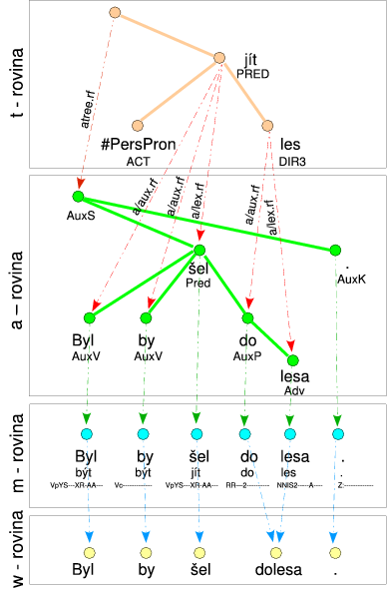
Byl by šel dolesa.
(He) would go to the forest.

Slide 6
Coherence-related annotations
The tectogramatical layer of PDT 3.0 includes annotation of linguistic phenomena from the perspective of discourse structure and coherence.
Four coherence-related subprojects:
annotation of coreference,
annotation of bridging relations,
ellipsis
contextual boundness (tfa)
discourse connectives, discourse units linked by them and semantic relations between these units

Slide 7
Our “roots”
Functional Generative Description (Sgall et al., 1986)
Coreference
Ontonotes (Pradhan et al. 2007), Poesio (MATE, GNOME, VENEX, ARRAU), AnCora (Recasens), PoCoS (Chiarchos-Krasavina) et al. but on dependency trees
Discourse
Penn Discourse Treebank (for English, PDTB, Prasad et. al., 2008) - identification of discourse markers and relations they express

Slide 8
State of coherence-related annotations in Prague corpora
 | PDT 3.0 | PCEDT (Prague Czech-English Dependency Treebank)
 |  | English | Czech
grammatical and pronoun (zeros + #PersPron) coreference | YES | YES | YES
textual full-NP coreference | YES | YES | YES
bridging | YES | no (split ante) | no (split ante)
Ellipses reconstruction | YES | YES | YES
discourse relations | YES | no | no
Information structure | YES | planned | work in progress

Slide 9
Coreference

Slide 10
Coreference
grammatical coreference –
grammar-driven by the use of pronouns,
mostly possible to identify the antecedent on the basis of grammatical rules
within one sentence
textual coreference –
not restricted to grammatical means alone
can be realised by pronominalisation, grammatical agreement, repetitions, synonyms, paraphrasing, hyponyms/hyperonyms, etc.
often occurs between entities in different sentences

Slide 11
Grammatical coreference
arguments in constructions with verbs of control
– John asked Mary to [#Cor.ACT] come.
– John submitted a [#QCor.ACT] complaint to the police.
reflexive pronouns
– John shaved himself.
relative pronouns
– John, who came late, apologized.
coreference with verbal modifications that have dual dependency
– Honza saw Hanka [#Cor.ACT] run around the lake.
reciprocity
– John and Mary kissed [#Rcp.PAT] .

Slide 12
Textual coreference
personal and possessive pronouns (Peter returned. He forgot his hat),
demonstrative pronouns ten, ta, to (=that)
with textual ellipsis (zeros), where a new node with the t-lemma substitute #PersPron is added to the tectogrammatical tree
nouns (Helena asked her mother to wait for her, but mother ignored her daughter’s wish.)
local adverbs (Helen asked mother to come to Prague but she decided not to go there.)
some adjectives (He came to Prague and found the Prague atmosphere quite casual.)
reference to events (Helena asked her mother to wait for her, but mother ignored her daughter’s wish).
If antecedent is a whole segment of (previous) text larger than one sentence (phrase) — special type of textual coreference segm(ent) without explicitly marked antecedent:
The custom union will formally function for twelve more months, but in fact the relations will be of a kind of international trade. The bureacracy will go up. The latest steps of the Slovak government confirm this direction.

Slide 13
Textual coreference - types
SPEC(ific) for coreference of NPs with specific reference (Helen_{a} asked her_{a} mother_{b} to wait_{c} for her_{a}, but mother_{b} ignored her_{b} daughter_{a}’s wish_{c})
GEN(eric) for coreference of NPs with generic reference, e.g.
Your comments implied we had discovered that the principal cause of homelessness is to be found in the large numbers of mentally ill and substance-abusing people in the homeless population. [...] The study shows that nearly 40% of the homeless population is made up of women and children and that only 25% of the homeless exhibits some combination of drug, alcohol and mental problems

Slide 14
Exophora
An expression refers to situations or reality external to the text – special attribute coref_special, type exoph
Dokončeny by měly být [...] na sídlišti Barrandov v těchto dnech.(= It should be finished [...] in Barrandov district in these days [meaning, in the recent days])
A tu se dostáváme zpět k počátku tohoto textu . (= With this, we come back to the beginning of this text)
Informace v tomto přehledu jsou bezplatnou službou podnikatelům. (=The information in this report is a free service to businessmen.)

Slide 15
Bridging Relations

Slide 16
Bridging Relations
part – whole (PART_WHOLE and WHOLE_PART)
Germany – Bavaria - Munich

Slide 17
Bridging Relations
part – whole (PART_WHOLE and WHOLE_PART)
Germany – Bavaria - Munich
set — subset/element of set (SET_SUB and SUB_SET)
students – some students – a student

Slide 18
Bridging Relations
part – whole (PART_WHOLE and WHOLE_PART)
Germany – Bavaria - Munich
set — subset/element of set (SET_SUB and SUB_SET)
students – some students – a student
function - object (P_FUNCT and FUNCT_P)
prime-minister – government, trainer – football team

Slide 19
Bridging Relations
part – whole (PART_WHOLE and WHOLE_PART)
Germany – Bavaria - Munich
set — subset/element of set (SET_SUB and SUB_SET)
students – some students – a student
function - object (P_FUNCT and FUNCT_P)
prime-minister – government, trainer – football team
semantic contrast (CONTRAST)
A přesvědčen jsem ještě o jednom - je třeba mít vysoké cíle a s malými [cíli] se nespokojit. (= And I am sure about one thing: it is necessary to have lofty aims and not to be satisfied with small (ones).)

Slide 20
Bridging Relations
part – whole (PART_WHOLE and WHOLE_PART)
Germany – Bavaria - Munich
set — subset/element of set (SET_SUB and SUB_SET)
students – some students – a student
function - object (P_FUNCT and FUNCT_P)
prime-minister – government, trainer – football team
semantic contrast (CONTRAST)
A přesvědčen jsem ještě o jednom - je třeba mít vysoké cíle a s malými [cíli] se nespokojit. (= And I am sure about one thing: it is necessary to have lofty aims and not to be satisfied with small (ones).)
explicit anaphora without coreference (ANAF)
"Duha?" Kněz přiloží prst k tomu slovu, aby nezapomněl, kde skončil. - “A rainbow?” The priest pointed to the word …
Jak se Vám zamlouvala Pragobanka Cup? - Takovou/podobnou/stejnou akci bychom také uvítali - How did you like the Pragobanka Cup? We would welcome a similar event …

Slide 21
Bridging Relations
part – whole (PART_WHOLE and WHOLE_PART)
Germany – Bavaria - Munich
set — subset/element of set (SET_SUB and SUB_SET)
students – some students – a student
function - object (P_FUNCT and FUNCT_P)
prime-minister – government, trainer – football team
semantic contrast (CONTRAST)
A přesvědčen jsem ještě o jednom - je třeba mít vysoké cíle a s malými [cíli] se nespokojit. (= And I am sure about one thing: it is necessary to have lofty aims and not to be satisfied with small (ones).)
explicit anaphora without coreference (ANAF)
"Duha?" Kněz přiloží prst k tomu slovu, aby nezapomněl, kde skončil. - “A rainbow?” The priest pointed to the word …
Jak se Vám zamlouvala Pragobanka Cup? - Takovou/podobnou/stejnou akci bychom také uvítali - How did you like the Pragobanka Cup? We would welcome a similar event …
other (REST)
family (grandfather - grandson), place – inhabitant, author – work, same denomination to support cohesion of the text (a chance helped – another chance entered the game …) and event – participant of the event (enterprise - entrepreneur )

Slide 22
Coreference and Bridging statistics
type of relation | absolute numbers
all textual coreference links | 86,349
textual coreference (specific NPs) | 20,243 (pronouns)+50,593 (nouns) = 70,836
textual coreference (generic NPs) | 3,095(pronouns)+12,418(nouns) = 15,513
all bridging links | 32,171
bridging SUBSET | 5,820(SUB_SET) +12,580(SET_SUB) = 18,400
bridging PART | 1,982(PART_WHOLE)+4,372(WHOLE_PART) = 6,354
bridging FUNCT | 1,719(P_FUNCT)+418(FUNCT_P) = 2,137
bridging CONTRAST | 2,238
bridging ANAF | 802
bridging REST | 2,212
percentage of nodes where a link starts, counting all text-coref and bridging | 17.6%

Slide 23
Inter-annotator Agreement for coreference and bridging in PDT
number of controlled documents | 39
number of controlled sentences | 1606 (26,520 tokens)
F-1 on textual pronominal coreference (including zeros) | 0,86
F-1 on textual coreference for specific NPs | 0,705
F-1 on textual coreference for generic NPs | 0,492
F-1 on bridging relations | 0,455
new textual kappa of agreement on type | 0,759
bridging kappa of agreement on type | 0,889

Slide 24
Overview of performance of tools for coreference and bridging
type of the task | data | success rate
Grammatical coreference, verbs of control | PDT 2.0 | 91.5%
Grammatical coreference, reflexive pronouns | PDT 2.0 | 97.1%
Grammatical coreference, relative pronouns | PDT 2.0 | 99.6%
Grammatical coreference, reciprocity | PDT 2.0 | 94.7%
Pronominal coreference, rule-based | PDT 2.0 | 74.2%
Pronominal coreference, perceptron ranking, gold features | PDT 2.0 | 79.4%
Pronominal coreference, perceptron ranking, system features | PDT 2.0 | 50.3%
Identification of an anaphoric unexpressed subject, rule-based | PCEDT 2.0 | 61.5%
Identification of an anaphoric unexpressed subject, rule-based, expoiting English side | PCEDT 2.0 | 69.5%

Slide 25
Tree Editor TrEd
PML (Prague MarkUp Language) - XML-based format, designed for annotation of treebanks
fully customizable tree editor TrEd (Pajas & Štěpánek 2008)
extensions, included as modules
the extensions for Bridging and Coreference, for discourse, etc.

Slide 26
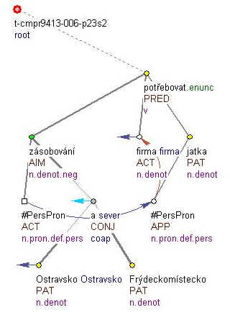
Tectogrammatical tree
Pro zásobování Ostravska a Frýdeckomístecka potřebuje firma svá jatka. –
To supply Ostrava and Frýdek-Místek regions, the company needs its own slaughterhouse.

Slide 27
The Annotation Tool – coreference and bridging module
pre-annotation of the data with highly probable coreference relations
supporting features implemented into the annotation tool – help during the annotation process

Slide 28
Pre-annotation
list of pairs of words that with a high probability form a coreferential pair in texts (cca. 6,000 couples)
Praha (noun) – pražský (adj.) (Prague – Prague)
He arrived in Prague and found the Prague atmosphere quite casual
USA – United States of Amerika

Slide 29
Annotation
manual pre-annotation for nodes with the same t_lemma
(1) Generál Jiří Nekvasil: V české armádě se hrozné věci nedějí
(7) Náčelník generálního štábu Jiří Nekvasil nám k tomu řekl, že nepořádek v armádě nikdy nezastíral, popírá však, že se v ní dějí hrozné věci.
(8) Poměry v útvarech podle něj odpovídají atmosféře ve společnosti.
(9) Armáda jde krok za krokem k lepšímu, říká Nekvasil.
(10) Za nepořádky náčelník generálního štábu považuje nízkou kázeň vojáků na veřejnosti, při výcviku nebo strážní službě.
(11) Starosti mu dělá nedodržování bezpečnostních zásad a neoprávněná manipulace se zbraněmi.
(14) Nekázeň se podle generála týká útvarů, jež transformace teprve zasáhne, zejména když mají být zrušeny.
(17) O panujícím strachu v armádě Nekvasil neví.
(18) Po mnoha letech podle něj dochází k narovnání vztahů mezi veliteli a podřízenými.
(19) Generál kromě toho připravuje nařízení, podle něhož se na něj budou moci obrátit všichni, kteří se domnívají, že se jim děje bezpráví.
(21) I proto se Nekvasil zabývá jednotlivými případy mladých důstojníků, kteří se rozhodli odejít do zálohy.
(22) Šéf generálního štábu považuje lustrace za uzavřenou záležitost.
(26) Jestliže by při jejich penzionování porušila zákon, soud by podle Nekvasila určitě prohrála.

Slide 30
Annotation
manual pre-annotation for nodes with the same t_lemma
(1) Generál Jiří Nekvasil: V české armádě se hrozné věci nedějí
(7) Náčelník generálního štábu Jiří Nekvasil nám k tomu řekl, že nepořádek v armádě nikdy nezastíral, popírá však, že se v ní dějí hrozné věci.
(8) Poměry v útvarech podle něj odpovídají atmosféře ve společnosti.
(9) Armáda jde krok za krokem k lepšímu, říká Nekvasil.
(10) Za nepořádky náčelník generálního štábu považuje nízkou kázeň vojáků na veřejnosti, při výcviku nebo strážní službě.
(11) Starosti mu dělá nedodržování bezpečnostních zásad a neoprávněná manipulace se zbraněmi.
(14) Nekázeň se podle generála týká útvarů, jež transformace teprve zasáhne, zejména když mají být zrušeny.
(17) O panujícím strachu v armádě Nekvasil neví.
(18) Po mnoha letech podle něj dochází k narovnání vztahů mezi veliteli a podřízenými.
(19) Generál kromě toho připravuje nařízení, podle něhož se na něj budou moci obrátit všichni, kteří se domnívají, že se jim děje bezpráví.
(21) I proto se Nekvasil zabývá jednotlivými případy mladých důstojníků, kteří se rozhodli odejít do zálohy.
(22) Šéf generálního štábu považuje lustrace za uzavřenou záležitost.
(26) Jestliže by při jejich penzionování porušila zákon, soud by podle Nekvasila určitě prohrála.

Slide 31
Annotation
(1) Generál Jiří Nekvasil: V české armádě se hrozné věci nedějí
(7) Náčelník generálního štábu Jiří Nekvasil nám k tomu řekl, že nepořádek v armádě nikdy nezastíral, popírá však, že se v ní dějí hrozné věci.
(8) Poměry v útvarech podle něj odpovídají atmosféře ve společnosti.
(9) Armáda jde krok za krokem k lepšímu, říká Nekvasil.
(10) Za nepořádky náčelník generálního štábu považuje nízkou kázeň vojáků na veřejnosti, při výcviku nebo strážní službě.
(11) Starosti mu dělá nedodržování bezpečnostních zásad a neoprávněná manipulace se zbraněmi.
(14) Nekázeň se podle generála týká útvarů, jež transformace teprve zasáhne, zejména když mají být zrušeny.
(17) O panujícím strachu v armádě Nekvasil neví.
(18) Po mnoha letech podle něj dochází k narovnání vztahů mezi veliteli a podřízenými.
(19) Generál kromě toho připravuje nařízení, podle něhož se na něj budou moci obrátit všichni, kteří se domnívají, že se jim děje bezpráví.
(21) I proto se Nekvasil zabývá jednotlivými případy mladých důstojníků, kteří se rozhodli odejít do zálohy.
(22) Šéf generálního štábu považuje lustrace za uzavřenou záležitost.
(26) Jestliže by při jejich penzionování porušila zákon, soud by podle Nekvasila určitě prohrála.

Slide 32
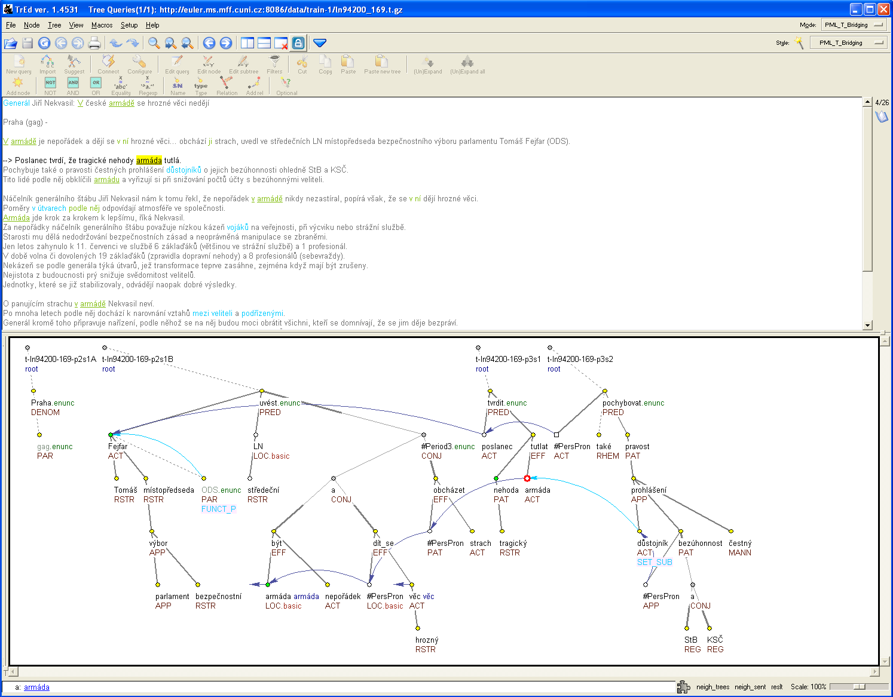

Slide 33
Annotation
finding the nearest antecedent
automatic redirection of a newly created coreferential arrow to the nearest antecedent
A B C

Slide 34
Annotation
finding the nearest antecedent
automatical redirection of a newly created coreferential arrow to the nearest antecedent
A B C
automatical redirection during annotation
A B C

Slide 35
Annotation
preserving the coreferential chain
annotator removes an arrow and interrupts the chain :
the tool can reconnect the chain or leave in unterrupted
A B C D

Slide 36
Comparing different annotations
visual comparison of different annotations of the same data, e.g. annotations from different annotators in the inter-coder agreement measurement

Slide 37
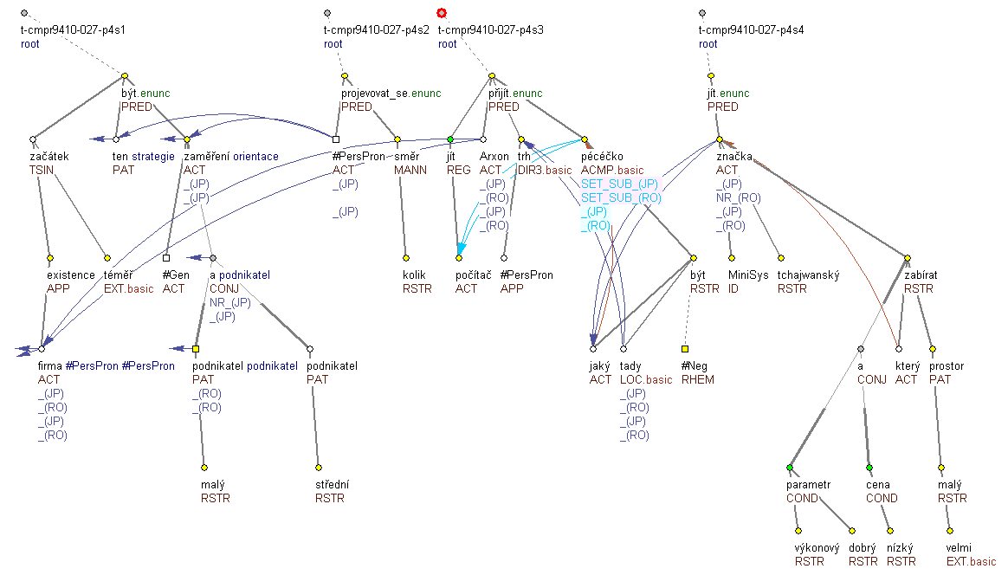
Comparing different annotations

Slide 38
Zeros

Slide 39
Zeros with coreference
t-lemma | description | example
#PersPron | assigned to a node representing personal or possessive pronouns; applies both to newly established nodes and to those present at the surface level | (Firma měla doručit zboží zákazníkovi.) Doručení {#PersPron.ACT} {#PersPron.PAT} {#PersPron.ADDR} se však neuskutečnilo. (=lit. (The_company was_to deliver the_goods to_the_customer.) The_delivery {#PersPron.ACT} {#PersPron.PAT} {#PersPron.ADDR} however did_not_happen.)
#Cor | assigned to a newly established node representing the (usually inexpressible) controllee in control constructions. | Helen decided to {#Cor.ACT} answer him.
#QCor | lemma assigned to newly established nodes representing a (usually inexpressible) valency modification in quasi-control constructions. | He offered Jan {#QCor} protection
#Rcp | assigned to newly established nodes representing participants that are left out as a result of reciprocation. | The lovers kissed {#Rcp.PAT}.
inserted full lemma | In case of textual ellipsis, a copy of the node representing the same lexical unit as the omitted element is inserted into the appropriate position. | Clients of insurance companies which shut down will automatically return to the General {insurance company}.

Slide 40
Zeros without coreference
t-lemma | description | example
#Gen | assigned to a newly established node representing a general participant absent at the surface level | Houses are built {#Gen.ACT} from bricks.
#Unsp | assigned to newly established nodes representing valency modifications not present at the surface level the semantic content of which is very vague (non-specific) | U Nováků {#Unsp.ACT} dobře vaří. (=They cook well at Nováks’.)
#EmpNoun | assigned to newly established nodes representing non-expressed nouns governing syntactic adjectives, not the case of textual ellipsis | Přišli jen {#EmpNoun.ACT} mladší. (=lit. Came only {#EmpNoun} younger.)

Slide 41
Zeros without coreference
t-lemma | description | example
#Oblfm | assigned to a newly established node representing an obligatory adjunct absent at the surface level. | Ta vypadá. {#Oblfm.MANN} (=lit. That.fem looks; meaning: She looks awful/so strange...)
#Equal | assigned to newly established nodes used in comparative constructions | Udělal to jako Tonda. (=lit. (He) did it like Tonda)
#Some | lemma assigned to newly established nodes representing the nominal part of verbonominal predicates (not present at the surface level), used mainly in comparative constructions | Není ovšem ford jako ford. – lit. However, Ford is not like Ford (meaning Not all Fords are the same)

Slide 42
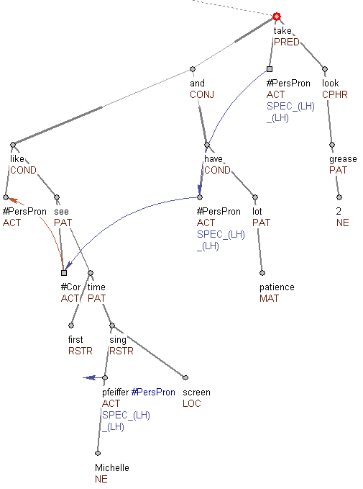
#PersPron, #Cor
If you'd like {#Cor.ACT} to see the first time Michelle Pfeiffer sang on screen, and you have a lot of patience, #PersPron take a look at “Grease 2”.

Slide 43
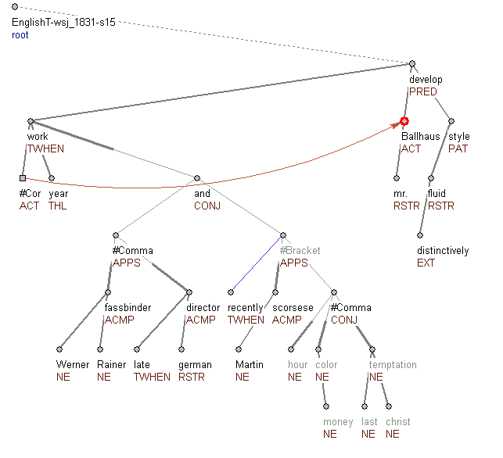
#Cor
After {#Cor.ACT} working for years with Werner Rainer Fassbinder, the late German director, and more recently with Martin Scorsese ''After Hours'', ''The Color of Money'',''The Last Temptation of Christ'', Mr. Ballhaus has developed a distinctively fluid style.

Slide 44
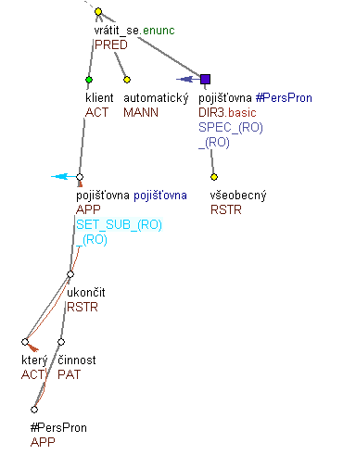
Reconstruction of the omitted node
If it is clear (and possible to find in the text) which noun has been omitted in the surface structure of the sentence (the case of textual ellipsis), a copy of the node representing the same lexical unit as the omitted element is inserted into the appropriate position.
cz. Klienti pojišťoven, které ukončí svou činnost, se automaticky vrátí k Všeobecné.
lit. Clients of insurance companies which shut down will automatically return to the General {one}.

Slide 45
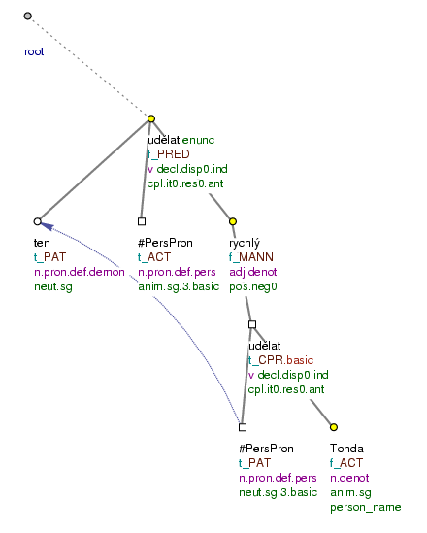
Reconstruction of a syntactic construction
.
Udělal to rychle jako Tonda. (=lit. (He) did it fast like Tonda)

Slide 46
Contextual boundness (TFA)

Slide 47
Contextual boundness (TFA)
Topic-focus articulation (information structure): reflects the cognitively based ‚given‘ – ‚new‘ strategy BUT belongs to the systems of individual languages rather than to the domain of cognition
the description of TFA is an integral part of the representation of the (literal) meaning of the sentence (Sgall et al. 1986) = TFA is semantically relevant
a declarative sentence asserts that its Focus holds about its Topic: F(T)

Slide 48
Contextual boundness (TFA)
a specific TFA attribute
values:
t for a non-contrastive contextually bound node
c for a contrastive contextually bound node
f for a contextually non-bound node
Cz.: Běloruský president Alexandr Lukašenko nařídil pozastavit likvidaci vojenské techniky na území republiky.
Engl.: (lit.) Belorussian president Alexandr Lukašenko ordered to stop liquidation (of) military technique on territory of republic.

Slide 49
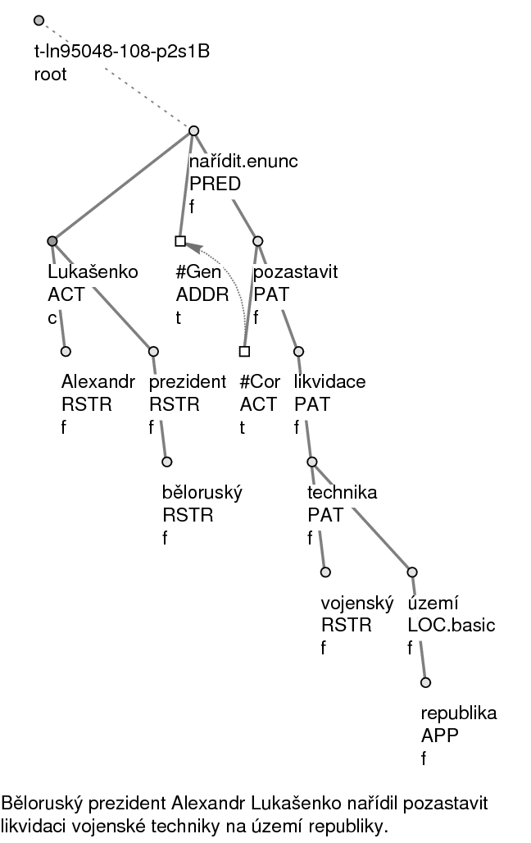
F
T

Slide 50
TFA -present programme
Annotation of TFA in an English parallel text based on the same theory
=> preparation of a manual for such an annotation
Comparison of results
→ material for contrastive studies on TFA

Slide 51
TFA salience -tentative “rules”
(i) if r is expressed by a weak pronoun (or zero, i.e. deleted in the surface shape) in a sentence, it retains its salience degree after this sentence is uttered: dg_{i}(r) := dg_{i-1}(r);
(ii) if r is expressed by a noun (group) carrying nb, then dg_{i}(r) = 0;
(iii) if r is expressed by a noun (group) carrying cb, then dg_{i}(r) = 1;
(iv) dg_{i}(q) := dg_{i}(r) +2 obtains for every referent q that is not itself referred to in S_{i}, but is immediately associated with an item present here;
(v) if r neither is included in S_{i}, nor refers to an associated object, and has been mentioned in the focus of the preceding sentence, then dg_{i}(r) :=
dg_{i-1}(r) +2.
(vi) if r neither is included in S_{i}, nor refers to an associated object, and has been mentioned in the topic of the preceding sentence, then dg_{i}(r) := dg_{i-1}(r) +1.

Slide 52
salience –Text 1
1. Across the river they could now see a fire with two figures beside it.
2. When they moved closer,
3. they could make out two white horses against the background of the dark bushes.
4. Then he recognized them.
5. The pale blue buggy.
6. Two hours ago, the beauty from Chicago had sat on the seat.
7. While the black man in livery had gone into Kapino’s for beer.
8. They stopped …
9. and looked across the river.
10. The young lady in the white dress was biting into a chicken leg. …
11. He looked at Magda.
12. The child’s eyes, wide in amazement, stared across the river at this fairytale banquet. …
13. He looked at the straw hat.
14. Yes, beside it in the grass a pair of white shoes had been casually tossed
15. and beside them lay a crumpled white pile. …

Slide 53
Salience –Text
1.Across the river they could now see a fire with two figures beside it. 2. When they moved closer, 3. they could make out two white horses against the background of the dark bushes.4. Then he recognized them.5. The pale blue buggy.6. Two hours ago, the beauty from Chicago had sat on the seat.7. While the black man in livery had gone into Kapino’s for beer.8. They stopped …9. and looked across the river.10. The young lady in the white dress was biting into a chicken leg. …11. He looked at Magda.12. The child’s eyes, wide in amazement, stared across the river at this fairytale banquet. …13. He looked at the straw hat.14. Yes, beside it in the grass a pair of white shoes had been casually tossed15. and beside them lay a crumpled white pile. … 31. and … she had lifted the skirt over her head, 32. slipped out of it 33. and stood there in nothing but white knee-length knickers … 34. He couldn’t take his eyes off her. … 35. From downstream they could hear a banjo playing. 36. A pleasant baritone voice sang: „…“ 37. The girl let her hands drop… 38. Cautiously, she stepped into the water. 39. On their side of the river, …, something creaked. 40. Looking towards the sound, he could barely distinguish the outline of a small rowboat 41. and, in it, someone’s dark silhouette. 42. The moonlight fell on the head, the white whiskers, the hair in disarray. 43. The Master! 44. He looked quickly across the stream 45. and saw the Rusalka up to her waist in the water. „Borne like a vapour …“46. The Master’s head turned in profile towards the velvet baritone. 47. He doesn’t see; 48. he only hears, 49. he thought. 50. He himself saw. … 51. The Rusalka was slowly lowering herself into the water, … 52. Finally, all that remained on the water was a burning waterlilly. 53. Suddenly the child saw too 54. and shrieked, 55. „Papa!“ 56. The Master started, 57. looked around 58. and then saw.

Slide 54
salience –Text 2
16. The beauty stood up
17. and threw the half-eaten leg into the fire.
18. She stretched,
19. She said something to the man …
20. She lifted up her skirts
21. and, stepping gingerly through the grass,
22. she began walking upstream.
23. her head became a cooly glowing torch.
24. Intoxitated, Kovarik stepped forward
25. and silently followed the beautiful phantom’s pilgrimage.
…
26. The child padded silently behind him. …
27. The child whispered.
28. „She’s a Rusalka! A water nymph!“
29. He caught his breath.
30. The girl across the river unlaced her bodice
The Project is co-financed by the European Union from resources of the European Social Fund

Slide 55
salience –Text 3
31. and … she had lifted the skirt over her head,
32. slipped out of it
33. and stood there in nothing but white knee-length knickers …
34. He couldn’t take his eyes off her. …
35. From downstream they could hear a banjo playing.
36. A pleasant baritone voice sang: „…“
37. The girl let her hands drop…
38. Cautiously, she stepped into the water.
39. On their side of the river, …, something creaked.
40. Looking towards the sound, he could barely distinguish the outline of a small rowboat
41. and, in it, someone’s dark silhouette.
42. The moonlight fell on the head, the white whiskers, the hair in disarray.
43. The Master!
44. He looked quickly across the stream
45. and saw the Rusalka up to her waist in the water. „Borne like a vapour …“
The Project is co-financed by the European Union from resources of the European Social Fund

Slide 56
salience –Text 4
46. The Master’s head turned in profile towards the velvet baritone.
47. He doesn’t see;
48. he only hears,
49. he thought.
50. He himself saw. …
51. The Rusalka was slowly lowering herself into the water, …
52. Finally, all that remained on the water was a burning waterlilly.
53. Suddenly the child saw too
54. and shrieked,
55. „Papa!“
56. The Master started,
57. looked around
58. and then saw.
The Project is co-financed by the European Union from resources of the European Social Fund

Slide 57
Text analysis
seven selected ‚objects‘ (better to say: mental images of objects):
Dvořák’s daughter Magda (M),
her lover Kovarik (K),
the lady (L, referred to also as Rusalka, waterlilly, strawhat, a pair of white shoes, a crumpled white pile)
the black man (A, referred to also as banjo, baritone voice),
the buggy (B, also horses, figures),
the rowboat (R)
Dvořák (D).
The rule (iv) for associated items (thus e.g. banquet in sentence 12 is associated with L and A) not taken into account
In underlying representations of the sentences elements deleted in the surface shape of the sentence are reconstructed:
‘zero’ in 9 (as if there were the pronoun they referring to M and K),
in 17, 21, 32 and 33 (as if there were the pronoun she referring to the Lady),
in 25 and 45 (as if there were the pronoun he referring to Kovarik),
in 54 (as if there were the pronoun she referring to M)
in 57 and 58 (as if there were the pronoun he referring to Dvořák).
The Project is co-financed by the European Union from resources of the European Social Fund

Slide 58
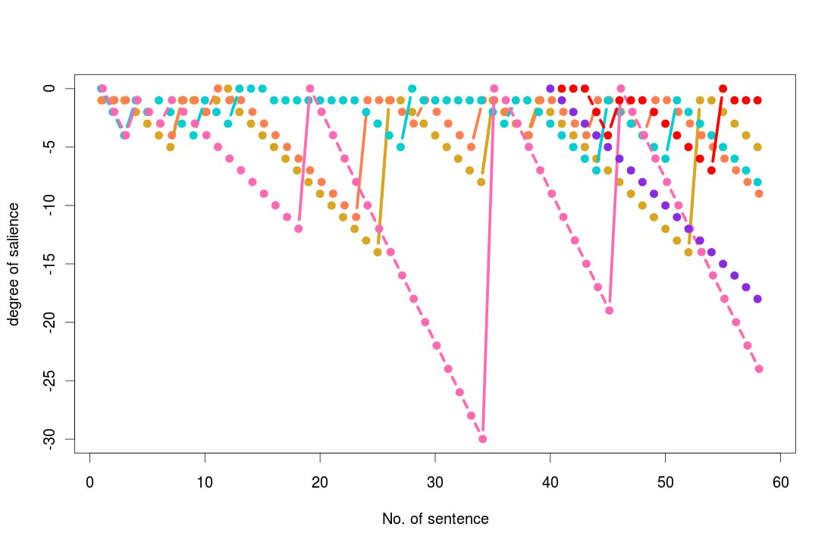

Slide 59
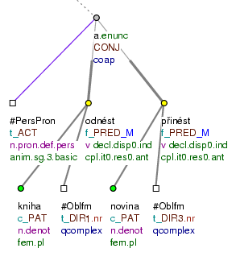
(Contextual boundness)
attributes:
tfa (t, c, f)
deepord (deep word order)
Knihy odnesl a noviny přinesl. – As for the books, (he) took them away, and the magazines have been brought (by him).

Slide 60
Discourse relations - Connectives, arguments, Annotation on Trees

Slide 61
"Slovak elite was disappointed by the political choice of Slovakia. Therefore, the majority of quality specialists remained in Prague."

Slide 62
"Slovak elite was disappointed by the political choice of Slovakia. Therefore, the majority of quality specialists remained in Prague."

Slide 63
"Slovak elite was disappointed by the political choice of Slovakia. Therefore, the majority of quality specialists remained in Prague."

Slide 64
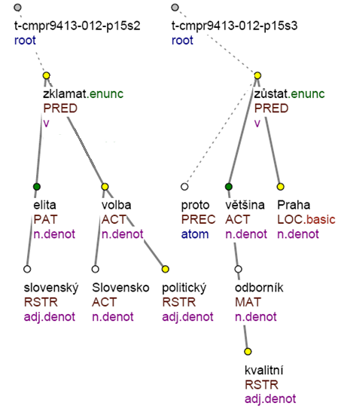
"Slovak elite was disappointed by the political choice of Slovakia. Therefore, the majority of quality specialists remained in Prague."

Slide 65
"Slovak elite was disappointed by the political choice of Slovakia. Therefore, the majority of quality specialists remained in Prague."
linking of the arguments of the relation by arrow (automatically connected with choice of semantic intepretation)

Slide 66
"Slovak elite was disappointed by the political choice of Slovakia. Therefore, the majority of quality specialists remained in Prague."
linking of the arguments of the relation by arrow (automatically connected with choice of semantic intepretation)
adding of the connective

Slide 67
"Slovak elite was disappointed by the political choice of Slovakia. Therefore, the majority of quality specialists remained in Prague."
linking of the arguments of the relation by arrow (automatically connected with choice of semantic intepretation)
adding of the connective
marking of the span of the arguments

Slide 68
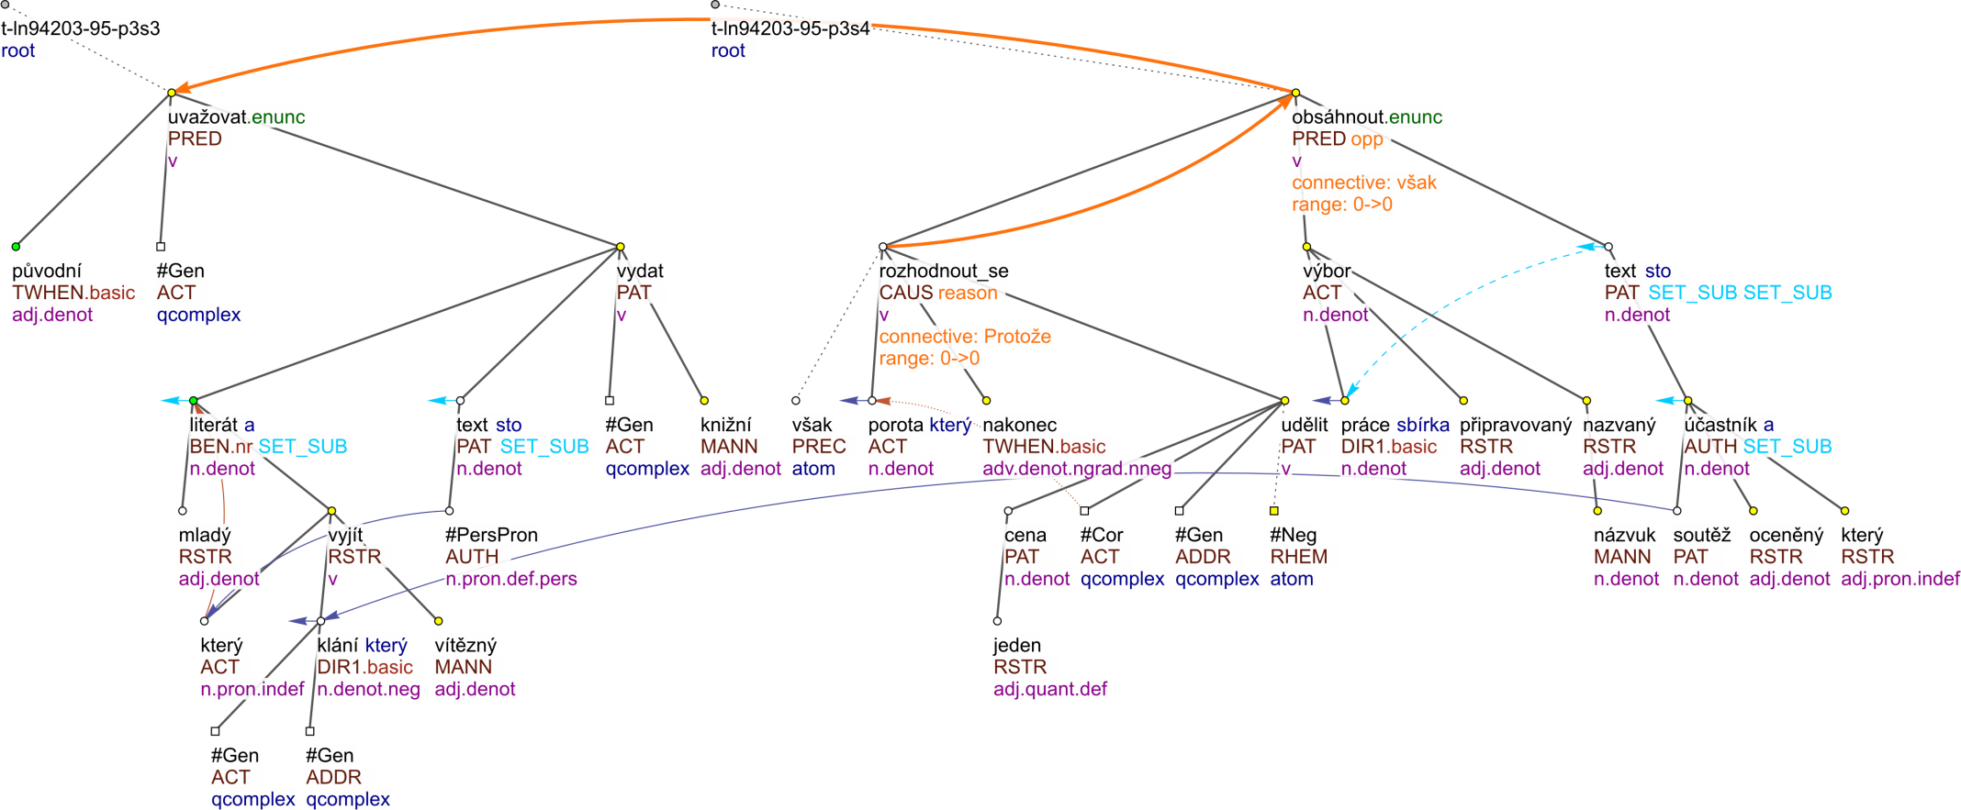
Původně se uvažovalo o tom, že mladému literátovi, jenž by vyšel z klání vítězně, budou jeho texty vydány knižně. Protože se však porota rozhodla nakonec první cenu neudělit, obsáhne připravovaný výbor z prací nazvaný Názvuky texty všech oceněných účastníků soutěže.
Initially, the book of the winner was supposed to be published. However, as the jury decided not to give the first price, the collected works of all authors will be published.

Slide 69
Discourse Representation - Compact View

Slide 70
Discourse Semantic Labels
TEMPORAL | CONTINGENCY | COMPARISON (CONTRAST) | EXPANSION
precedence - succesion | reason - result | confrontation | conjunction
synchronous | pragmatic reason – result | opposition | instantiation
 | purpose | pragmatic contrast | specification
 | explication | restrictive opposition + exception | equivalence
 | condition | concession | generalization
 | pragmatic condition | correction (replacement) | conjunctive alternative
 |  | gradation | disjunctive alternative

Slide 71
Additional Information to Connective Annotation
Also annotated:
List structures – quite typical way of text composition
Headings
Alternative lexical expressions of the connectives, for example:
Z toho vyplývá… = tedy, takže…
(This implies… = so, therefore…)
Double-sense relations
The so-called collections
Not annotated so far:
Implicit connectives and their arguments and senses (in comparison to Penn Discourse TreeBank 2.0)

Slide 72
Genre classification
manually annotated (Poláková et al. 2014, LREC)

Slide 73
Linguistic research based on the annotated data
coreference:
coreference of generic NPs (Nedoluzhko 2013)
translation of it in Czech using dependency structure (Novák – Nedoluzhko 2013)
comparison of coreferential expressions in Czech and English (Novák – Nedoluzhko 2014)
premodifiers
discourse:
problematic connectors: Explication and Cause (Rysová 2011), cause (Jínová 2011)
Sentence Structure and Discourse Structure: Possible Parallels (Jínová et al. 2011)
coreference + discourse:
problem of contrast in tfa, discourse and coreference annotation (Zikánová 2011)
Interplay of Coreference and Discourse Relations (Poláková et al. 2012)
tectogrammatics and discourse (Mírovský et al. 2012), tectogrammatics and coreference (Nedoluzhko - Mírovský 2013)
coreference + discourse + TFA (saliences, etc.) – running grant project
TFA in Czech, English and German

Slide 74
Acknowledgements
The presentation of the results is co-financed by the European Union from resources of the European Social Fund
The research was supported from the Grant Agency of the Czech Republic (grant P406/12/0658 Coreference, discourse relations and information structure in a contrastive perspective), GAUK 3389/2015, EU (grant FP7-ICT-2013-10-610516 – QTLeap) and SVV project number 260 224. This work has been using language resources developed, stored, and distributed by the LINDAT/CLARIN project of the Ministry of Education, Youth and Sports of the Czech Republic (project LM2010013).
I gratefully acknowledge my colleagues Eva Hajičová, Šárka Zikánová, Lucie Poláková, Jiří Mírovský, Kateřina Rysová et al.

Slide 75
Thank you!
http://ufal.mff.cuni.cz/discourse

