Slide 1
Prague Czech-English Dependency Treebank 2.0 ufal.mff.cuni.cz/pcedt2.0
Silvie Cinková, Marie Mikulová,
Jan Štěpánek
& professors, annotators and programmers

Slide 2
Coming soon at the LDC
supercedes PCEDT 1.0 (Cuřín et al., 2004, LDC)
1M+ tokens – PennTreebank WSJ
Czech-English parallel– all texts translated
1:1 sentence alignment
automatic alignment of nodes (2 layers)
manual tectogrammatical annotation
for the first time on English!
2,000 CZ sentences: manual analytical annotation
based on the Functional Generative Description

Slide 3
Time span
English
Czech
English TR – guidelines without data since 2004
valency lexicon since 2005-2011
actual annotation 2006-2011
translation & revision 2006-2009
TR annotation 2007-2010
AR annotation (2000 sent.) 2008 (1 month)
coreference 2010-2011 (9 months)
revisions 2010-2011 (18 months)

Slide 4
Access
entire DVD ROM through LDC
sample:
ufal.mff.cuni.cz/pcedt2.0
in negotiation: additional release without original PTB, no LDC license required

Slide 5
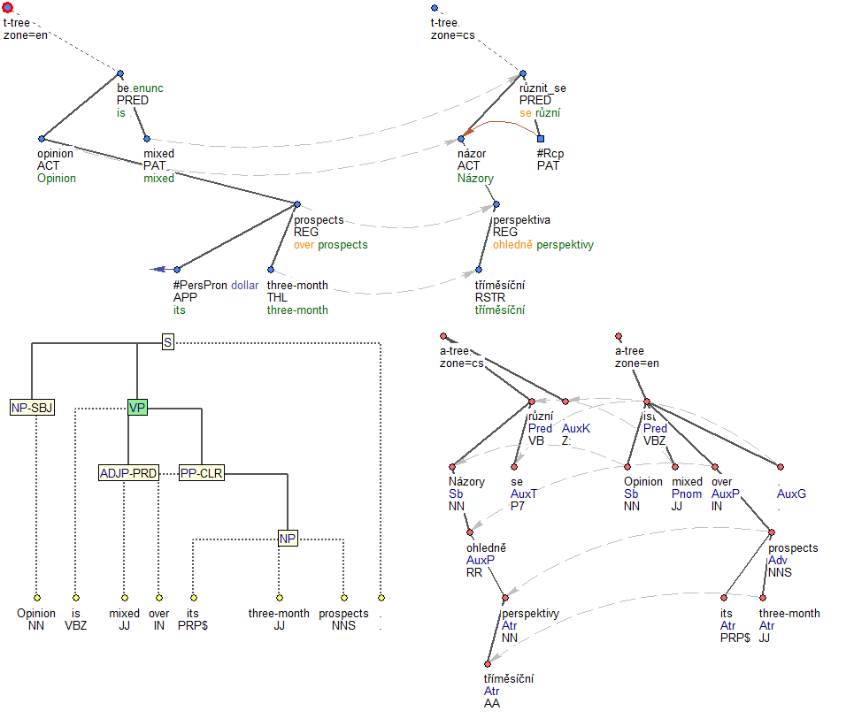

Slide 6
w-layer
m-layer
Opinion [node-id]
is [node-id]
mixed [node-id]
over [node-id]
its [node-id]
three-month [node-id]
prospects [node-id]
. [node-id]
Opinion [node-id] [tag] [lemma]
is [node-id] [tag] [lemma]
mixed [node-id] [tag] [lemma]
over [node-id] [tag] [lemma]
its [node-id] [tag] [lemma]
three-month [node-id] [tag] [lemma]
prospects [node-id] [tag] [lemma]
. [node-id] [tag] [lemma]

Slide 7
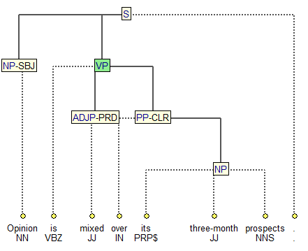
p-layer
original PTB
manual tagging
manual bracketing
added automatically:
node id
lemmatization
NO MANUAL REVISION!

Slide 8
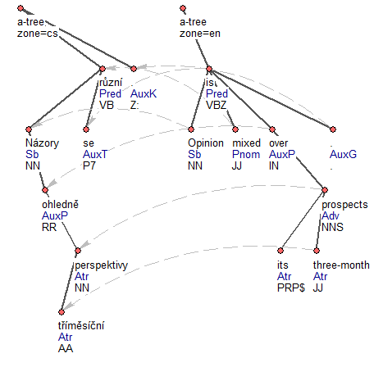
a-layer
m-layer integrated
EN:
manual tagging
automatic lemmatization (no revision)
CZ:
automatic tagging
automatic lemmatization (no revision)
Automatic alignment

Slide 9
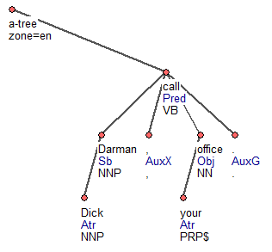
English a-layer (with integrated m-layer)
only automatic!!!
a Treex script by Martin Popel
just a few manual m-tag revisions
dependency structure
labeling (afuns)
tag
lemma
p_terminal.rf
alignment.rf

Slide 10
Afuns
predicate
subject, object
adverbial, attribute
predicate noun/adj.
auxiliary verb
coordination node
preposition
subordinator
terminal punctuation
other punctuation, graphic symbols
technical root
missing (elliptical governing node)
determiners
negation (not, n’t)
unrecognized dependencies

Slide 11
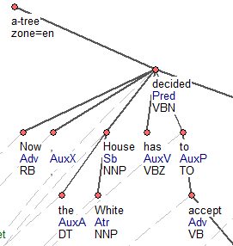
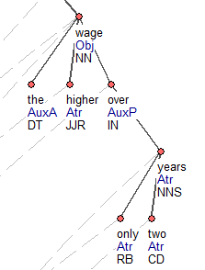
Basic principles

Slide 12
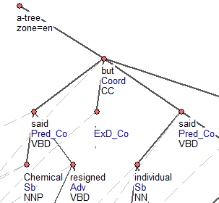
Basic principles

Slide 13
Basic principles
no artificial nodes (traces etc.)
apposition and parenthesis not recognized as a paratactic structure
existential there is clause subject
particles in phrasal verbs labeled as AuxV, like auxiliary verbs
prepositions, conjunctions and to govern “their” content words
lexical verb governs the auxiliary verb
modal verb/verb of control governs lexical verb
coordination head is the conjunction, members are sisters, marked with suffix CO_
determiners are governed by nouns, labeled AuxA.

Slide 14
Czech a-layer

Slide 15
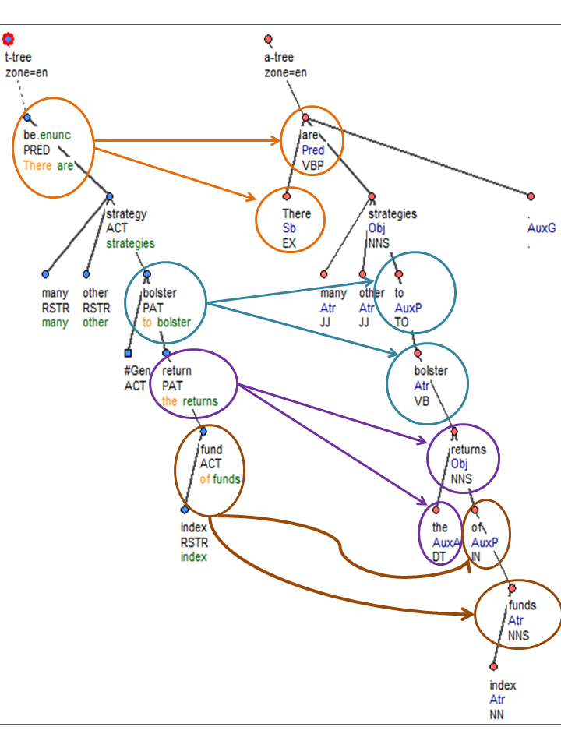
t-layer vs. a-layer
function words collapsed into content word nodes
valency frames (in verbs)
ellipsis restoration
semantic labeling (functors)
anaphora resolution

Slide 16
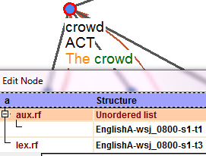
References to a-layer
a/lex.rf: content words
a/aux.rf: auxiliary words

Slide 17
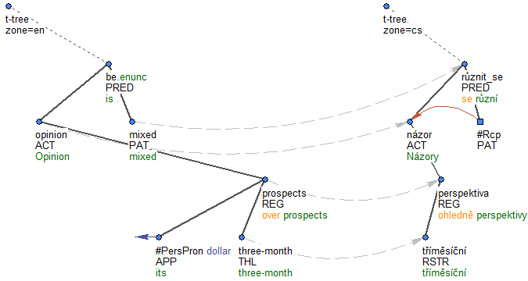
t-layer
The opinion is mixed over its three-month prospects.
Notes:
content words X auxiliary words, dependencies, functors, coreference, reciprocity

Slide 18
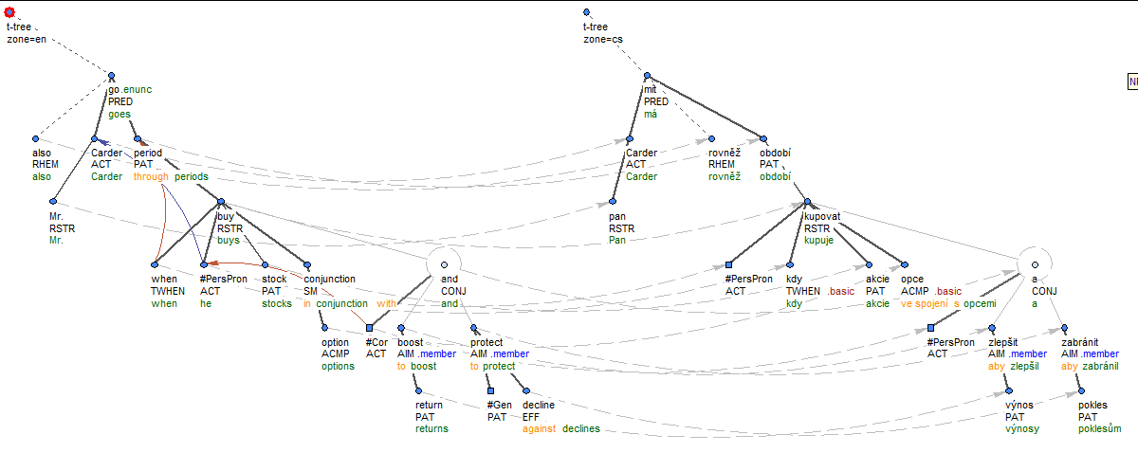
Mr. Carder also goes through periods when he buys stocks in conjunction with options to boost returns and protect against declines. Pan Carder má rovněž období, kdy kupuje akcie ve spojení s opcemi, aby zlepšil výnosy a zabránil poklesům.

Slide 19
Node type
complex: bottles, went, #PersPron
atomic: probably, fortunately, not
quasi-complex: generated #PersPron
paratactic structure/coordination root: and, :, ;
dependent phraseme part: kick the bucket
foreign word: Las, Vegas
list structure: multiword foreign/name/title
technical root

Slide 20
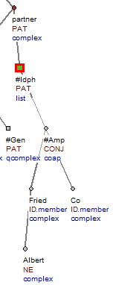
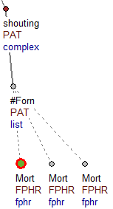
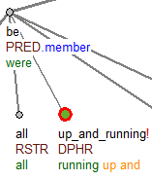

Slide 21
Non-dependency edge
list structure: multiword foreign/name/title
technical root
paratactic structure/coordination root: and, :, ;
atomic: probably, fortunately, not
dependent phraseme part: kick the bucket
foreign word: Las, Vegas

Slide 22
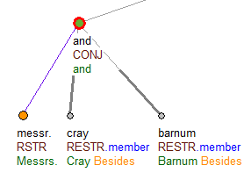
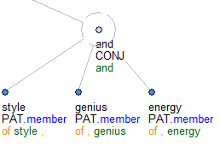
Members and shared modifiers

Slide 23
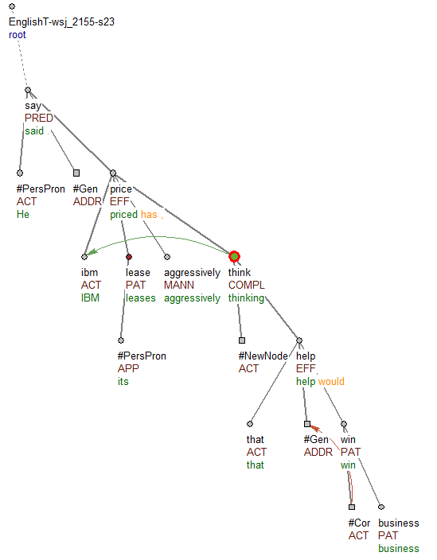
Ambiguous dependencies
He said IBM has priced its leases aggressively, thinking that would help win business.
compl.rf

Slide 24
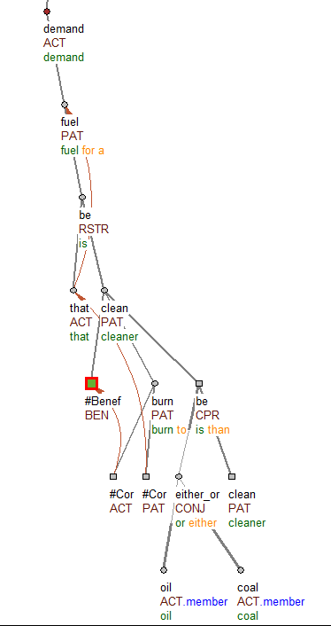
Grammatical Coreference
a fuel that is cleaner to burn than either oil or coal
coref_gram.rf

Slide 25
Generated nodes (is_generated)
restoration of textual ellipsis:
I will take a day off today and you tomorrow.
completion of valency frames
a good book to read [somebody reads something]
restoration of semantic shortcuts
You are [#Equal] like my brother [is] [#Some]

Slide 26
Tectogrammatical lemma (t_lemma)
lexical value
non-negated:
uncool->cool
t-lemma substitute
#PersPron for personal (and possessive) pronouns
#Neg: negation particle
punctuation symbols
#Gen, #Oblfm: generic
#Cor: grammar-required
#Rcp: reciprocal element
#Benef: generic recipient
#Forn: foreign MW expression
#Total, #Equal, #AsMuch, #Some: in semantic shortcuts
#EmpVerb, #EmpNoun: missing element

Slide 27
Formeme
technical shortcut for references to auxiliary words
morphosyntactic surface shape of a t-node
t-node [t_lemma=“cut”, a/lex.rf a-node [m/tag=“NN”], a/aux.rf a-node [m/lemma=“after”]]
t-node [t_lemma=“cut”, formeme=“n:after+X”]

Slide 28
Functor
semantic relation between child and parent
approx. 70 functors
5 arguments, paratactic relations, predicates, adjuncts
ACT, PAT, ADDR, ORIG, EFF
CONJ, DISJ, APPS, PAR
TWHEN, CAUS
English: two additional functors: SM and NE

Slide 29
Grammatemes
semantically oriented counterparts of morphological categories
sempos: semantic nouns, adjectives, verbs, adverbs
substance, quality, event, circumstance
deontmod: modal verbs are auxiliaries, give a grammateme to lex. verb
tense, gender, animacy, negation, degree of comparison, politeness...

Slide 30
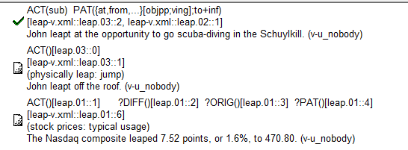
Valency
each verb occurrence linked to lexicon of frames
PDT-VALLEX, Engvallex
participants vs. adjuncts
obligatory vs. free

Slide 31
Complete valency frames

Slide 32
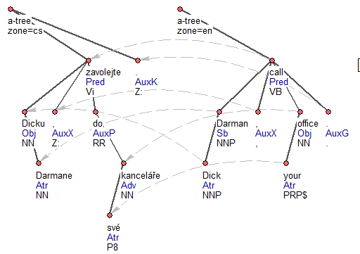
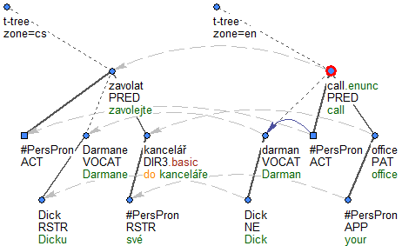
Alignment
translation: sentence-to-sentence
David Mareček: node alignment (a, t-layer) statistical, Gisa++

Slide 33
What has been annotated
manually
automatically
tree structure
references to a-layer
m-tag revision in valency frames (a-layer)
functors
valency
ellipsis
2,000 trees of Czech a-layer
grammatemes
formemes
alignment

Slide 34
Still not there
valency of nouns and adjectives
topic-focus articulation (information structure)
quotation types
subfunctors
manual grammatemes
English textual coreference

Slide 35
Annotation of English
3 – 10 annotators
2008 better pre-processing (rules using BBN named entities, Vadas’ flat noun phrases)
Mapping of Engvallex on PropBank

Slide 36
Annotation of Czech

Slide 37
Searching PDT corpora
PML Tree Query Engine
use the PMLTQ web interface
ask stepanek@ufal.mff.cuni.cz for registration
TrEd add-on

Slide 38
PMLTQ on the web
ask stepanek@ufal.mff.cuni.cz for registration

Slide 39
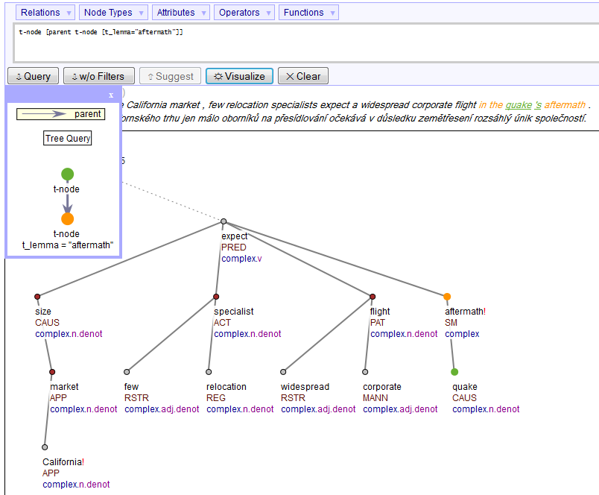

Slide 40
Acknowledgments
Ministry of Education of the Czech Republic projects No.:
MSM0021620838
LC536
ME09008
LM2010013
7E09003+7E11051
7E11041
Czech Science Foundation, grants No.:
GAP406/10/0875
GPP406/10/P193
GA405/09/0729
Research funds of the Faculty of Mathematics and Physics, Charles University, Czech Republic, Grant Agency of the Academy of Sciences of the Czech Republic: No. 1ET101120503
GAUK 116310, 158010, 3537/2011
Also, this work was funded in part by the following projects sponsored by the European Commission:
Companions, No. 034434
EuroMatrix, No. 034291
EuroMatrixPlus, No. 231720
Faust, No. 247762

